Slide 1
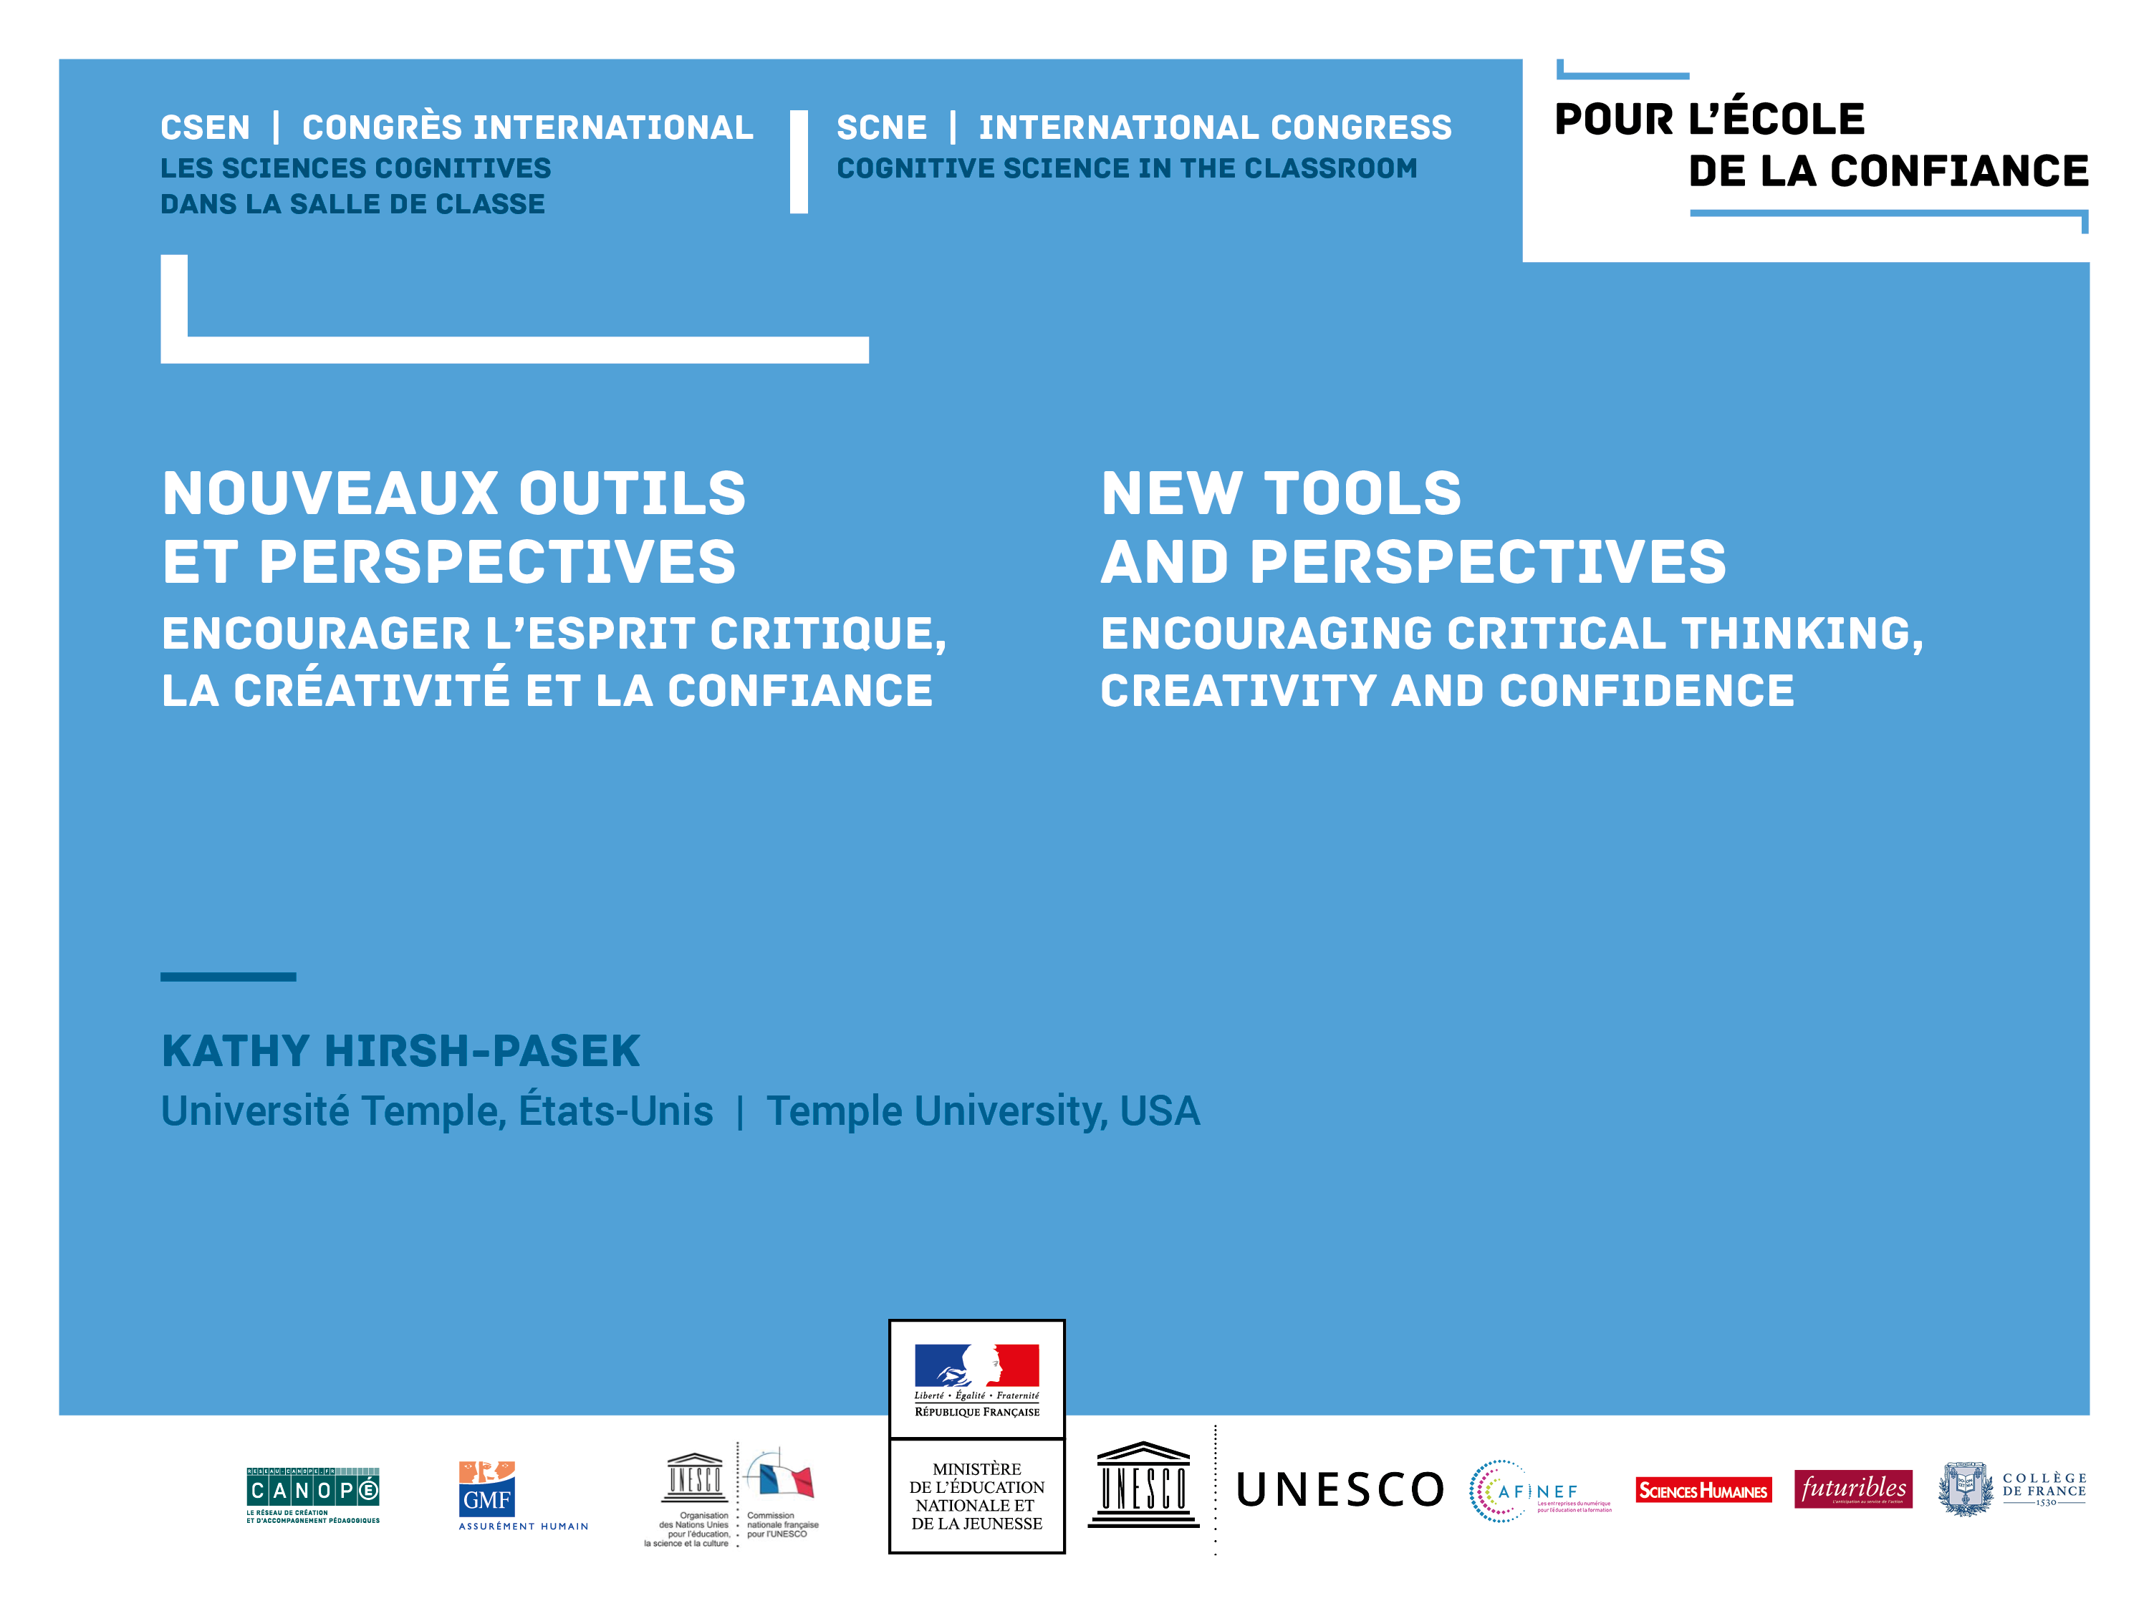

Slide 2


Nolan Finley, May 31, 2018
Today’s students learn very much the way their parents and grandparents did –sitting in rows in front of a teacher who delivers subject content until a bell rings and they shuffle to the next class. That worked in an economy that needed factory and office workers equipped to do rote jobs…..
But that world no longer exists
NOTE: French schools are largely the same!

Slide 3
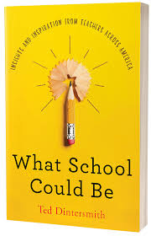
Or as Dintersmith (2018) puts it in his poplar education book…..
We are teaching what is easy to test. BUT, what’s easy to test, is not always what’s important to learn. {paraphrasing from page 64}

Slide 4
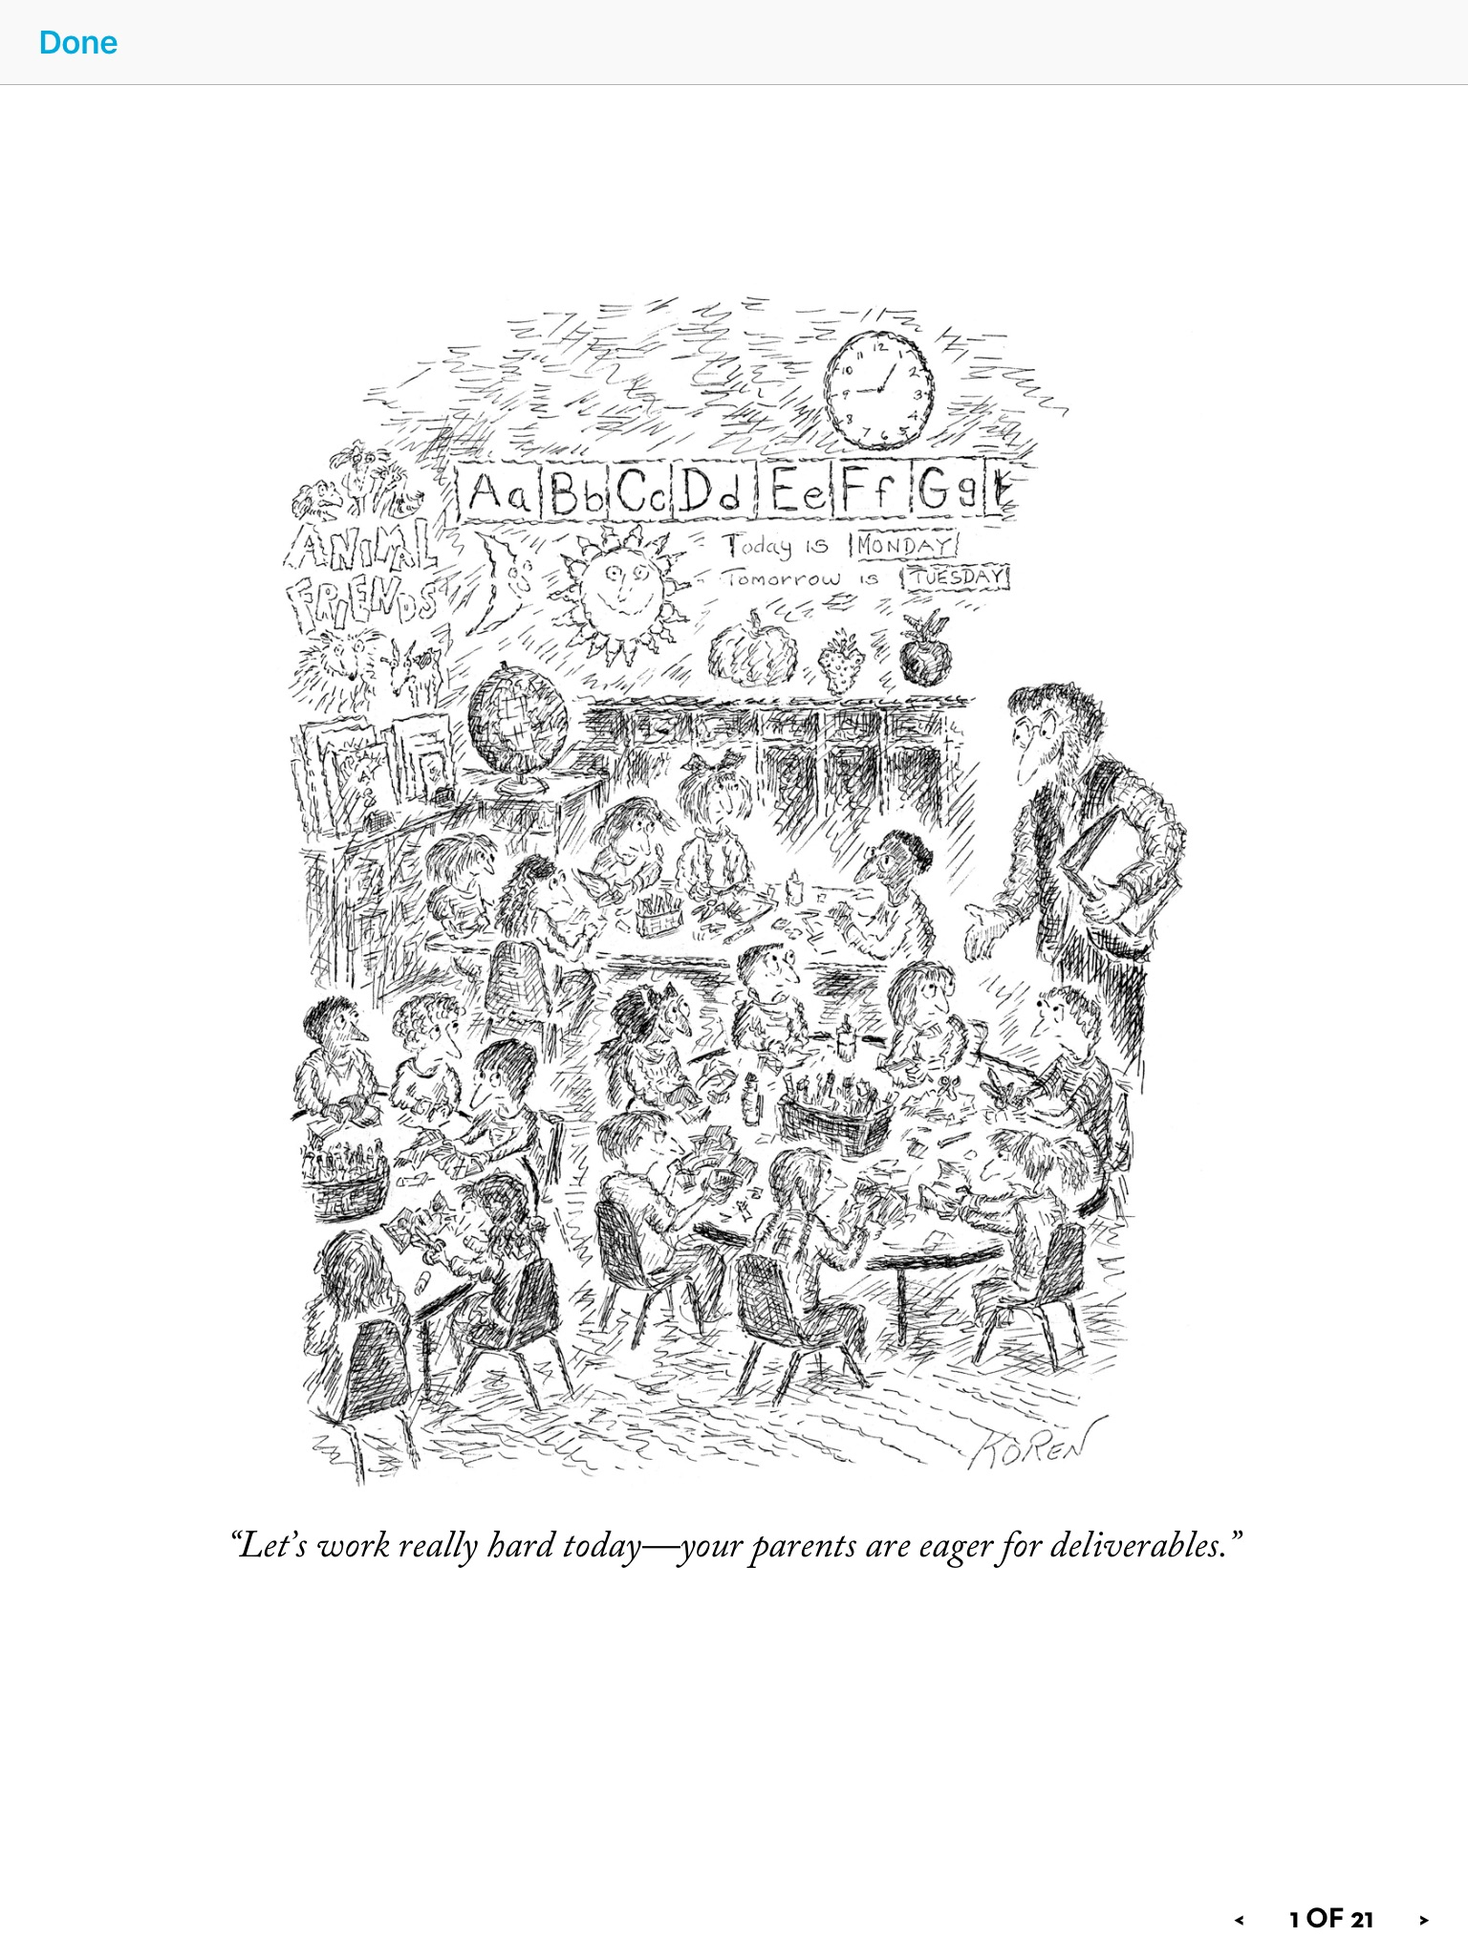
Some interesting facts
We are in the knowledge age. In 2013 Schilling estimated that information was doubling every 12 months now, they project it doubles every 12 hours.
Current thinking suggests that integrating information and innovation is key – emphasizing critical thinking, creativity and curiosity.

Slide 5

Are we preparing children for the workplace of tomorrow (or even of today)? NO – our current model of education (and parenting) is founded on the idea that mastery of content is the key to success in life, but what counts as success has undergone a revolution in a Google and Wiki world where facts are at our fingertips.
The Traditional Way
The 21st Century Way
Preparing Children in just:
Reading
Writing
Math
Supporting Children to include but go beyond content to be:
Happy, healthy, thinking, caring, and social so they become collaborative, creative, competent, and responsible world citizens tomorrow
Echoing Director General of UNESCO Azoulay
Notes:
I would like an animation here where the traditional way comes in first and then you hit the key and get the 21st Century slide

Slide 6
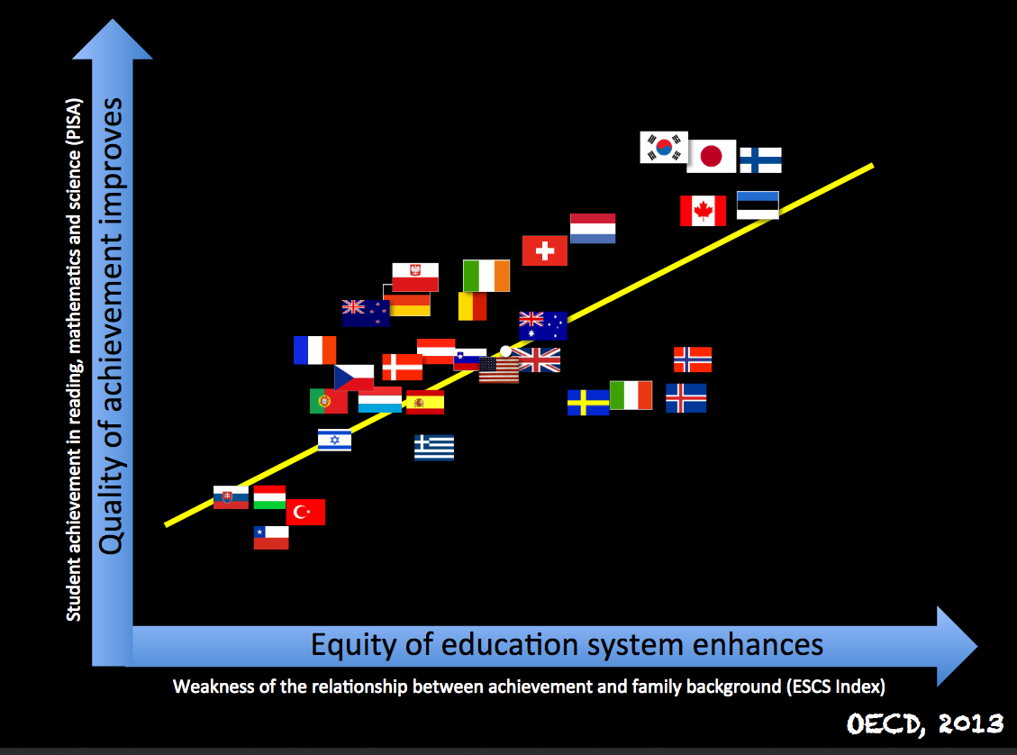

Finnish scientist, Pasi Sahlberg reminds us our laser focus on a narrow view of success has NOT produced results and that the equity of our education system is what matters. Note the French 2012 PISA scores. It changed little in the 2015 tests.
The OECD PISA 2015 results are now in. Even if France’s performance hasn’t deteriorated since the last series in 2012, it has not improved much compared to previous rounds either. France’s results for science and mathematics are around the OECD average, while reading comprehension is slightly above average…

Slide 7

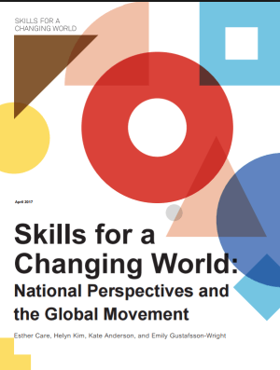
At the Brookings Institution, we are are seeding a movement towards Skills for a Changing World – an effort to broaden the way we look at educational outcomes and the way we define success.
My recent book: Becoming Brilliant: What science tells us about raising successful children is one example of the wider movement.

Slide 8
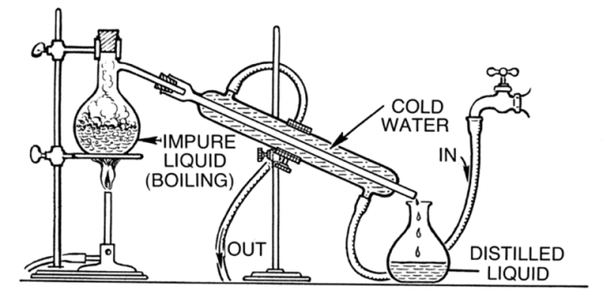
In our book, we distill from research in science of learning, the business community, and education to argue that a narrow focus only on mastery of content will NOT allow us to achieve success for our time
The 6 Cs
Collaboration
Communication
Content
Critical thinking
Creative innovation
Confidence
Science of learning
This process allowed us to suggest 6Cs that could support learning in an evidence-based way

Slide 9
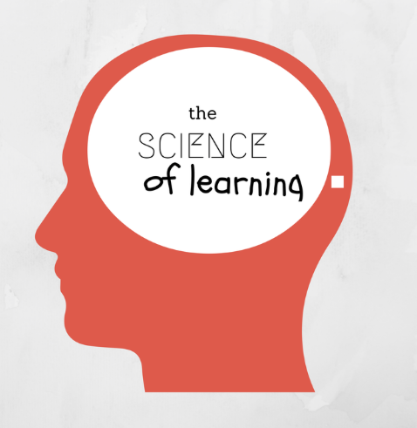
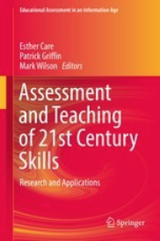
We chose this set because
These skills or competencies are grounded in the science of learning
They are all malleable
They are all measurable (some to a greater degree than others)
Care et al., 2015

Slide 10
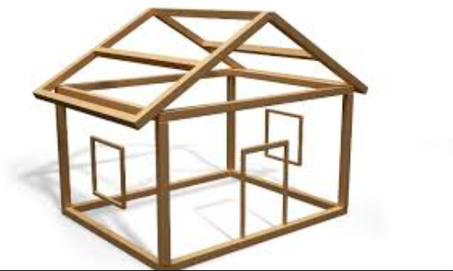
I present this today as a framework

Slide 11
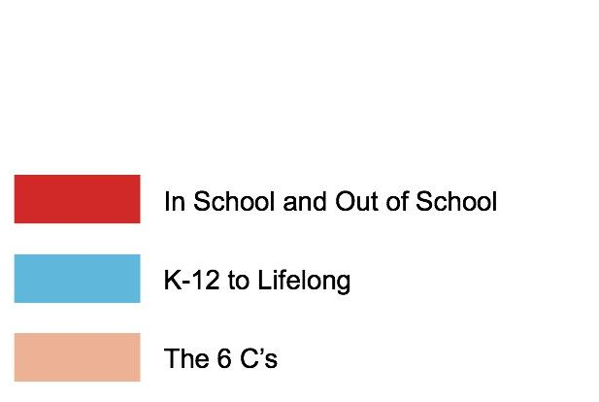




And we argue that the key to success is captured in one word: Breadth
Breadth of Context
Breadth of Skills
Breadth of Ages

Slide 12






How do we achieve success?
21st century education requires a breadth of skills
Each of which is:
- Grounded in science
- Inter-related
- Malleable
- Measurable
Collaboration
Communication
Content
Critical Thinking
Creative Innovation
Confidence

Slide 13
What are the skills needed for Success? The 6C’s and the science behind them

Slide 14
Collaboration
Humans are social beings at their very core. As Kuhl noted, we have a “socially gated brain” such that we learn by forming strong human relationships. This is particularly true for younger children.
This human interaction is not only key for learning (at home and in classrooms) but also for forming communities, having a sense of belonging.
Some of the research in this area is relevant to issues of how to best use technology at home, in classrooms and in the construction of MOOCs
Bodrova & Leong (2007), Tools of the Mind
Yalda et al., (2014) Computers in Human Behavior
McClelland (2016) Stop, Think, Act.
Kuhl, 2007

Slide 15

Communication
Built on collaborations, we communicate through language, reading, writing and listening. Language is the single best predictor of academic and social development. If children have strong language skills – even before they enter into Maternelle (kindergarten), they will be better prepared for ecole elementaire and will generally have better educational trajectories throughout school.
Dickinson & Tabors, 2001 Beginning literacy and language
Ouellette, G.P. (2006). What’s meaning got to do with it: The role of vocabulary in
word reading and reading comprehension.
Pace et al., (2018) Measuring success: Within- and cross-domain predictors of academic and social trajectories

Slide 16
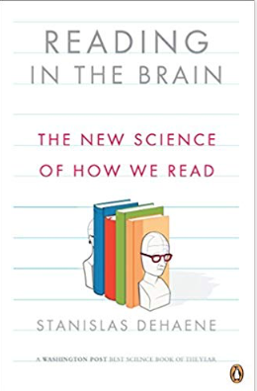

Content
Content is but one of the 6 skills central to development and success: The 3R’s plus Science, Social Studies and the Arts
Includes How we learn: Executive Function skills like memory, attention, flexible thinking, planning
Critically, content relies on communication which relies on strong
Communication or Language Skills– as the brain data from the DeHaene lab makes clear
Verdine, B., Golinkoff, R. M., Hirsh-Pasek, K., & Newcombe, N. (2017)
Duncan GJ, Dowsett CJ, Claessens A, Magnuson K, Huston AC, et al. 2007.
DeHaene, 1997 (Number Sense), 2009 (Reading and the Brain)
Zelazo et al., (2017) Executive Function: Implications for Education. NCER, IES

Slide 17
Critical Thinking
Critical thinking allows us to sift through and organize the content that is rapidly changing and expanding in our digital world. Compare and contrast; select; analyze; synthesize. It is built on content knowledge.
Kuhn, D. (1999). A developmental model of critical thinking. Educational Researcher
Halpern, D. (2013). Thought and knowledge: An introduction to critical thinking. NY: Psychology Press.

Slide 18
Creative Innovation
Creative innovation rests on content and critical thinking. Education needs to promote flexible adaptation to changing circumstances. Current thinking suggests that curiosity (dealing with uncertainty – promoting question asking and exploration) might be related to creativity.
Bonawitz, E. et al. (2010). The double-edged sword of pedagogy: Instruction limits
spontaneous exploration and discovery.
Runco, M. (2007). Creativity: Theories and themes, research, development, and practice.
Evans et al. (submitted) Creativity in childhood.
Jirout, & Klahr (2011) Chidren’s Question asking and curiosity
Shah et al., (2018) Pediatrics

Slide 19
Confidence
Ability to try new things and take intellectual risks. Grit and Growth Mind Set – putting forth effort and learning from failure. As the Ministre of Education said yesterday, failure is good as long as we learn from it.
As Dehaene noted, encouraging confidence, by allowing children to explore and to learn from failure is key.
Duckworth, A. (2016). Grit: The power of passion and perseverance. NY: Scribner
Dweck, C. (2006). Mindset: How we can learn to fulfill our potential. NY: Ballantine Books.

Slide 20
Each skill builds upon the one before it and goes through 4 levels from immature to mature

Slide 21
A new kind of report card
Collaboration
Communication
Content
Critical Thinking
Creative Innovation
Confidence
LEVEL
4
Building it together
Tell a joint story
Expertise
Evidence
Vision
Dare to fail
3
Back and forth
Dialogue
Making connections
Opinions
Voice
Calculated risks
2
Side by side
Show and tell
Wide breadth/ Shallow understanding
Truths differ
Means-end
Where do I stand?
1
On my own
Raw emotion
Early learning/ Situation specific
Seeing is believing
Experimentation
Barrel on

Slide 22




Collaboration
Communication
Content
Critical Thinking
Creative Innovation
Confidence
LEVEL
4
Building it together
Tell a joint story
Expertise
Evidence
Vision
Dare to fail
3
Back and forth
Dialogue
Making
connections
Opinions
Voice
Calculated
risks
2
Side by side
Show and tell
Wide breadth/ Shallow understanding
Truths differ
Means-end
Where do I stand?
1
On my own
Raw emotion
Early learning/ Situation specific
Seeing is believing
Experimentation
Barrel on

Slide 23
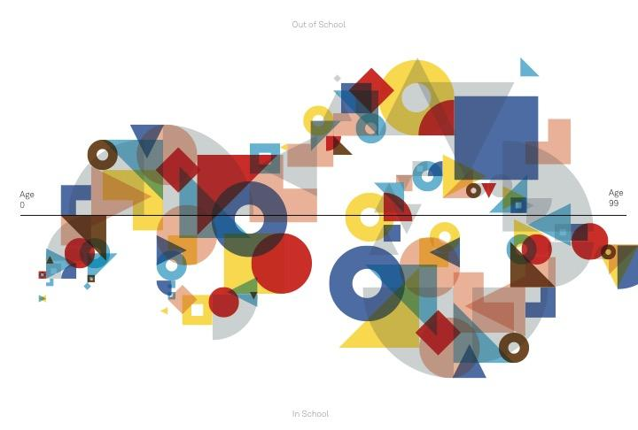
The 6Cs model is dynamic
in that we continue to revisit the 6Cs at higher and higher levels over development to create more than a linear model – but a spiral of learning.
Notes:
The 6Cs influence each other
Skills do not develop in isolation
Skills are not necessarily developing in the same trajectory
The 4Cs can also encompass a dynamic model by approaching assessment as a growth model
For example a kid may start at 1s across the board at the beginning of the year, but can reach a level 3 in some areas
Instead of comparing kids on individual levels to others, we want to also highlight the growth of students
We also want to think about how these skills are related and dependent on other skills. Increasing scores on one skill like EF can have benefits to a variety of different Cs

Slide 24
How might the 6Cs inspire a different kind of learning in schools and in the community?

Slide 25

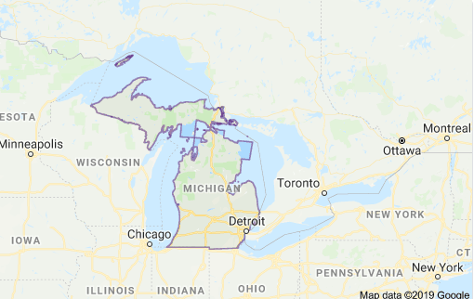
In school – welcome to the Godfrey Lee School in Grand Rapids Michigan
https://youtu.be/kKvXsDRr9ME
We empowered and trained a subset of teachers to use the 6Cs through a thematic based approach
(e.g., “who am I” or “local water quality” for grades 10-12).

Slide 26

Our research design:
Asking students (K, 1st and 2nd grade)
a set of questions from Tripod (Ferguson & Ramsdell, 2019 )
Collaboration
“My teacher asks us to work in groups.”
Communication
“I talk to my teacher and my friends about what we learn in class. “
Content
“In this class, we learn a lot almost every day.“
Critical Thinking
“My teacher asks us to explain our answers – why we think what we think. “
Creative Innovation
“My teacher is happy when I have a new idea.”
“If I think of an idea, my teacher wants me to try it out.”
Confidence
“When something is hard for me, my teacher still asks me to try.”
“In my class, it’s okay to make mistakes.”
Teacher attitude
eager
Not eager
6C - thematic
Classroom pedagogy
business as usual

Slide 27
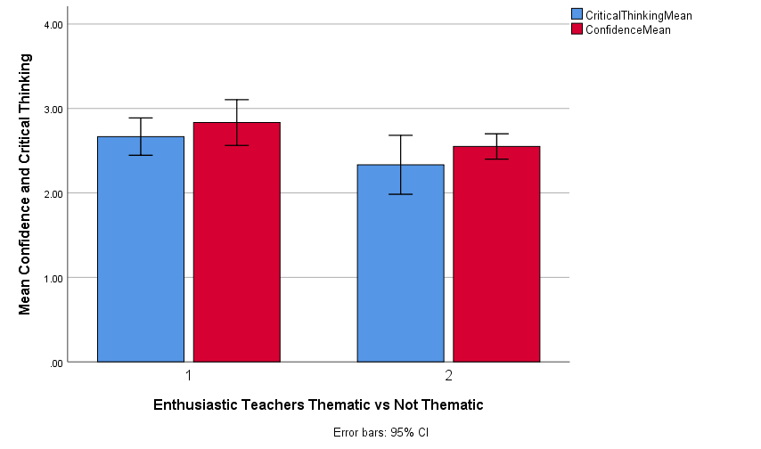
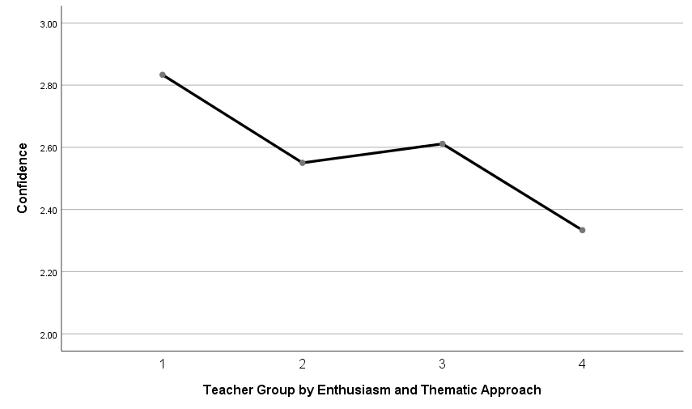
Very very preliminary results with just 2 months into the data collection student data….
Results for confidence
And among children with eager teachers
✝
*
✝ p = .08
* p = .04
N = 21
Eager 6C
Eager Non-6C
For critical thinking and confidence
Non-Eager 6C
Non-Eager Non-6C

Slide 28

In the community: Welcome to Learning Landscapes
Where we have literally put the learning sciences into public spaces where people naturally go to invite the kinds of behaviors that spark the 6Cs by design
For putting it into your PP presentation: here is the URL code you'll enter into power point:
https://player.vimeo.com/video/275917850

Slide 29
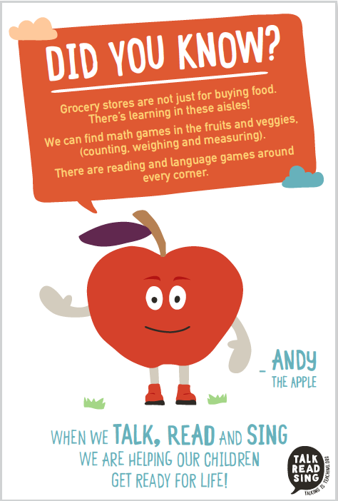
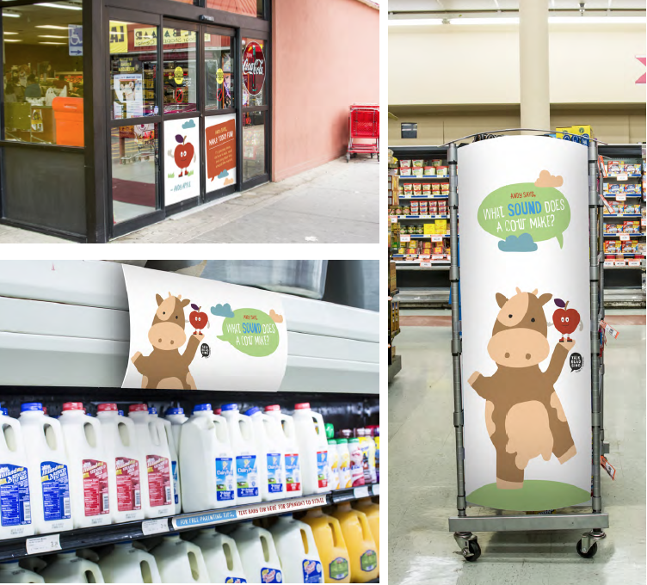
Example 1: Supermarket Speaks Ridge, Ilgaz, Weisberg, Hirsh-Pasek & Golinkoff (2015)
Can the introduction of signs in a supermarket increase caregiver child language interactions?
RESULTS
A 33% increase in caregiver - child language when the signs were up in low income neighborhoods.
Replication by Melissa Libertus: University of Pittsburgh with STEM signs.

Slide 30
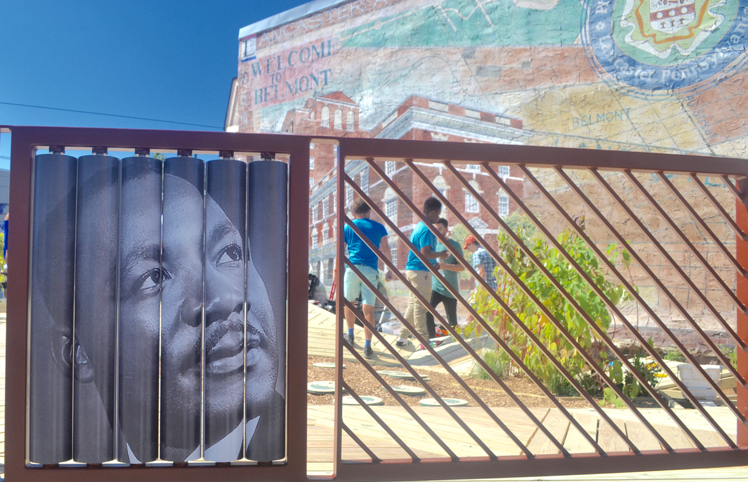


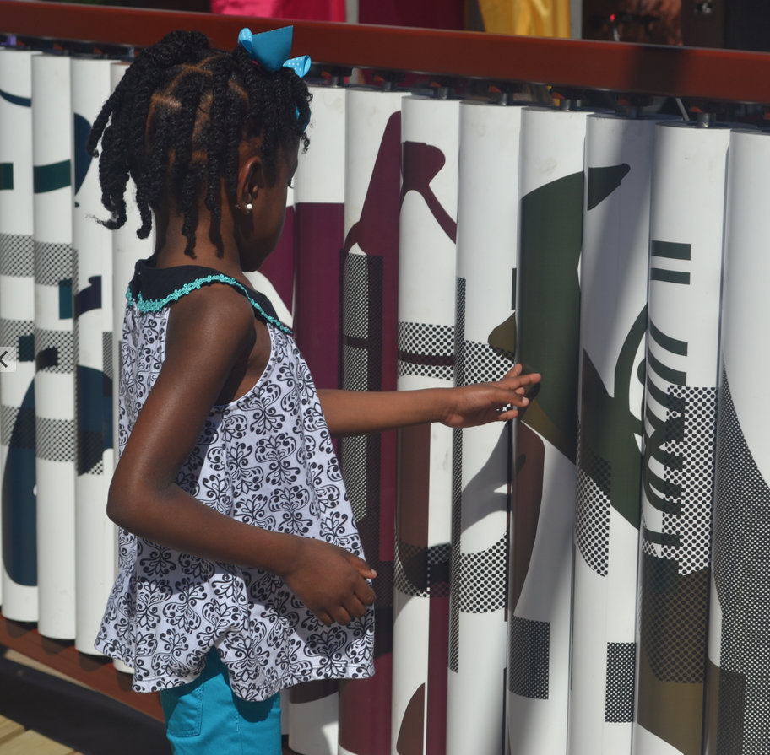

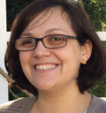

Example 2: Urban Thinkscape
Transforming a bus stop into a playful learning space
RESULTS
The number of families with 6 or more conversation turns >39% from pre- to post-test.
35% more families at Urban Thinkscape had 6 or more conversation turns than those at a playground.
The number of families using number, spatial, color, or letter language increased by 34% from pre- to post-test.
Group Total Interaction at Urban Thinkscape increased 24% and Group Total Language scores increased 27% from pre- to post-test.

Slide 31
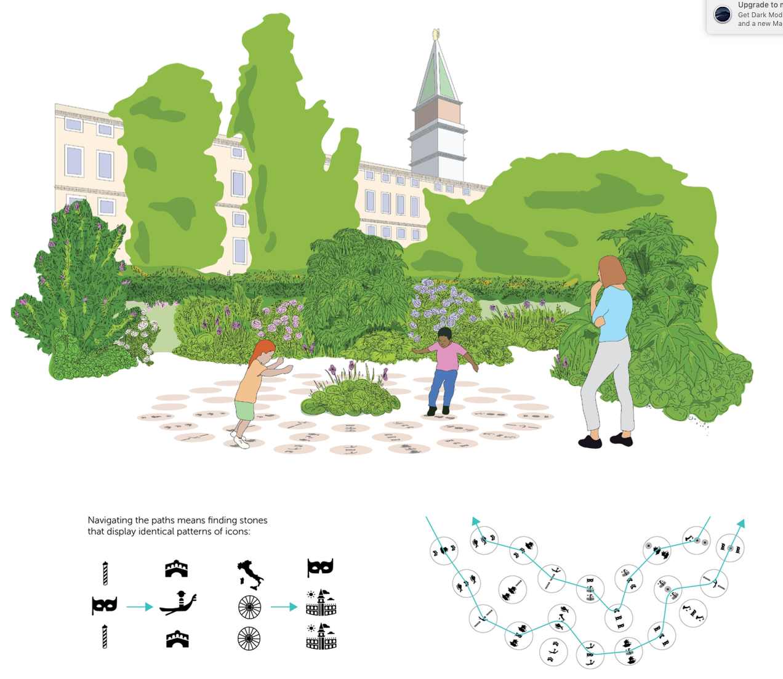
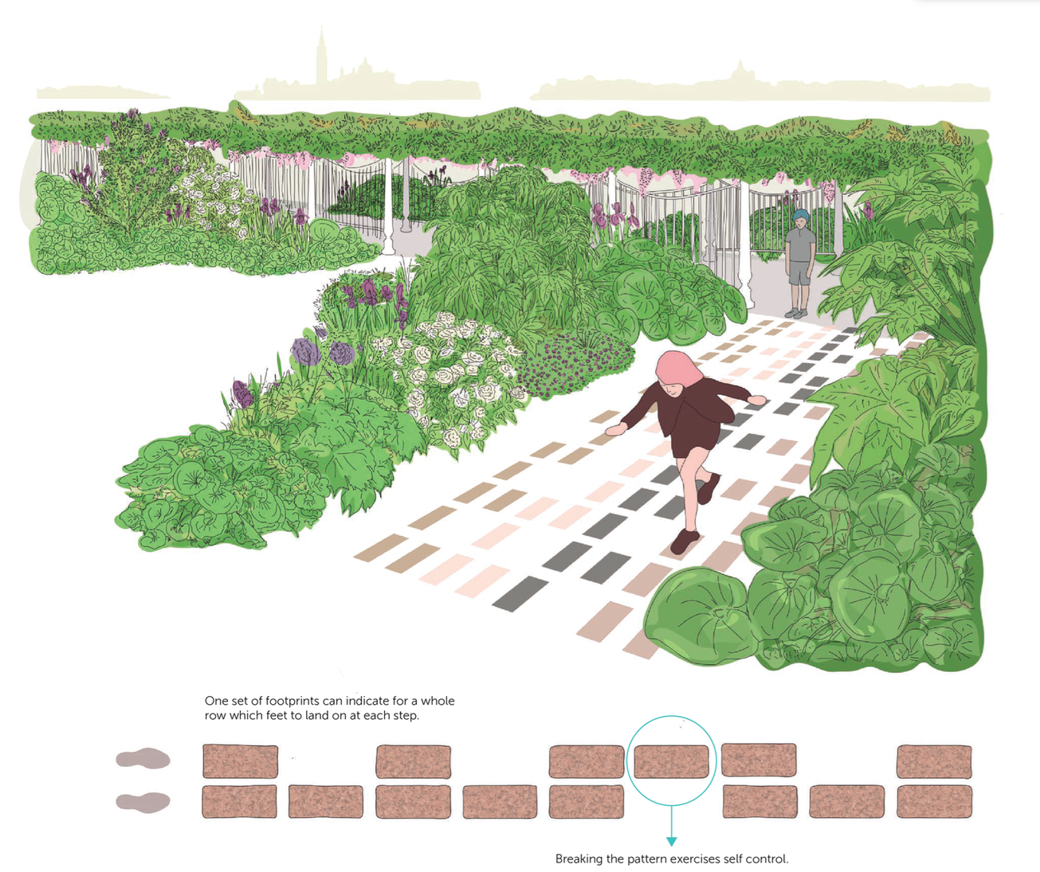
Can we adapt these designs to different cultural environments?
YES! A peek at some preliminary designs for our proposal in Italy
Analogy Stepping Stones
Jumping Feet

Slide 32
The 6C’s framework offers one example of a Skills for a Changing World initiative. Increasing breadth of learning can better prepare children for the challenges of today and the workforce of tomorrow.

Slide 33
Our portrait of success RE-imagines global education and puts a stake in the ground……
Society thrives when we craft environments, in and out of school, that support happy, healthy, thinking and social children who become collaborative, creative, competent and responsible world citizens tomorrow.

Slide 34
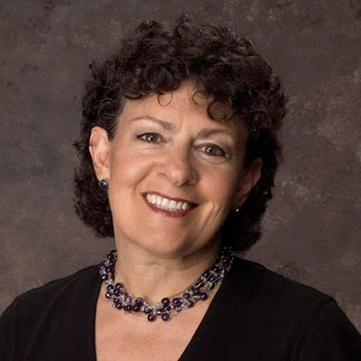



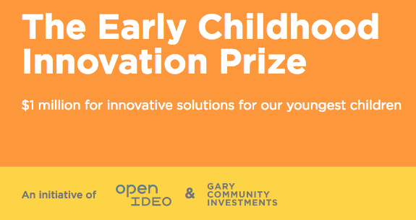





Thanks to our funders
My collaborator
Roberta Golinkoff
The most wonderful postdocs, graduate students and undergrads.
And to the families who make the research we do possible!

Slide 35


Follow us: The Brookings Institution: http://www.brookings.edu/experts/pasekk and on twitter
@kathyandro1

