Slide 1

Advanced technology for learning in the classroom
Bruce M. McLaren
Associate Research Professor
Carnegie Mellon University
Pittsburgh, PA USA

Slide 2
Today’s reality in education …
Class sizes are growing …
Teachers are overwhelmed …
Kids are more technologically sophisticated and they expect to encounter such sophistication in the education and instruction they receive …
So, will advanced learning technology be the panacea?
Notes:
Let me start by stating some of the realities in today’s education …
< click > First, class sizes are growing …
< click > Teachers are overwhelmed …
< click > Also, kids today are more technologically sophisticated and expect to encounter such sophistication in the education and instruction they receive …
< click > So, an important question is this: Will advanced learning technology be the panacea to education?

Slide 3
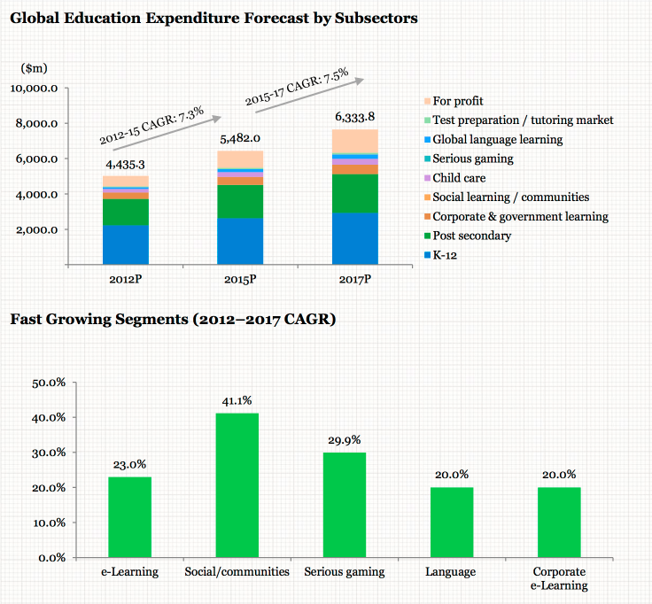
From “Global e-Learning Investment Review” by IBIS Capital, January 2013
Certainly money is being poured into learning software …
Notes:
Certainly it is also true that considerable money has been poured into educational technology and software –
The top graph shows the amount of capital investment into e-Learning and educational technology in millions of U.S. dollars from through 2017.
As can be seen, the investment has risen at a healthy rate of over 7% a year through 2017, across a variety of sectors, including K-12, post-secondary, and for profit. It continues to grow today.
< Click > Not surprisingly, the fastest growing segments are in the areas of “hot” development – social networking and serious gaming.

Slide 4
So what underlies Advanced Technology for Learning in the Classroom?
The Learning Sciences: an interdisciplinary field to further our understanding of learning – and learning with technology
Educational Psychology
Cognitive Science
The Learning Sciences
Artificial Intelligence
Computer Science
Notes:
Given the current excitement about advanced technology for learning what role will the Learning Sciences play? The Learning Sciences explores how people learn, the techniques and approaches that are best for learning, and how technology assists that learning.
My contention is that the interdisciplinary mix of contributors to the Learning Sciences – Educational Psychology, Cognitive Science, Artificial Intelligence, Computer Science -- is JUST what is needed to address the needs of educational software. I hope to show this with some examples of work that – I believe – is clearly showing success and pushing forward intelligent, adaptive educational software.
All of these fields – some that are more focused on human learning and psychology, some on advanced technology -- have come together and play a role in the Learning Sciences
Let me take a moment to talk about some of the findings from the Learning Sciences that provide the foundation for Advanced Learning Technology

Slide 5
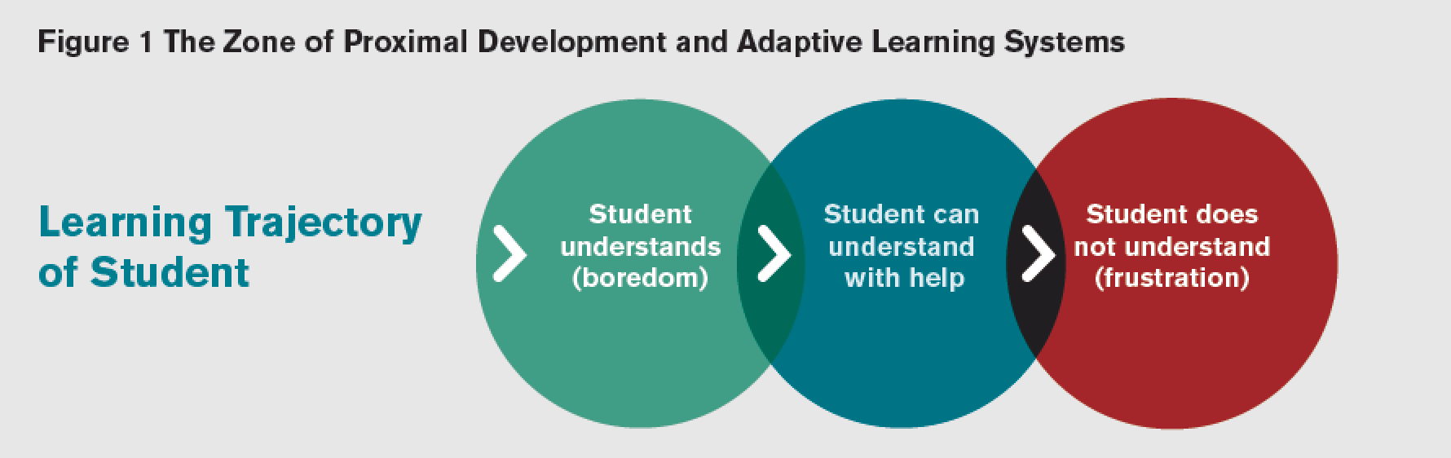
Zone of Proximal Development (Vygotsky)
Zone of Proximal Development
Notes:
Perhaps the most influential theory is from Vygotsky, a Russian psychologist who lived in the early part of the 20th century and is still quite influential in today’s world of educational research. Vygotsky’s ideas clearly lead directly to the idea of adaptive instruction that is seen in our technology today.
< click > The "Zone of proximal development" (ZPD) is Vygotsky’s term for the range of tasks that a child is in the process of learning – and can complete and learn with help. This theory, which has been used and extended by a variety of educational theorists, since it was first proposed in the early 20th century, is a key concept underlying all adaptive learning.
The way the theory is applied in educational software is that a student is presented with material just at the edge, or slightly beyond, his or her current level of understanding. In this way, the learner is challenged, but at the same time can use what he or she currently knows to create new knowledge and understanding. This approach is also sometimes called Mastery Learning.
Piaget is another giant in the theory of learning. His theory of cognitive development is a comprehensive theory about the nature and development of human intelligence. It was first created by the Swiss developmental psychologist Jean Piaget (1896–1980). ... Piaget's theory is mainly known as a developmental stage theory.

Slide 6
The Assistance Dilemma (Koedinger & Aleven)
Koedinger & Aleven 2007; Koedinger, Pavlik, McLaren, & Aleven, 2008
Should online instruction provide:
  More assistance & make learning tasks easier? OR
  Less assistance & make learning tasks more difficult?
 | Benefits | Costs
Giving assistance
Withholding assistance
Shallow processing;
Does not engage long-term memory
Less wasted time
Generative processing;
Engages & structures long-term memory
Floundering, confusion, wasted time
Notes:
However, assisting learners – adaptive or otherwise – is not as straightforward as it seems. Koedinger and Aleven formulated the so-called Assistance Dilemma, which highlights the problems of providing support to learners.
The basic issue is:
Should we give more assistance, and make tasks easier?
Should we give less assistance, and make tasks more difficult?

Slide 7
What is the variety of advanced learning technology that has resulted?
Individual learning
  Intelligent tutoring systems
  Educational games
Collaborative learning
  Debate and argumentation systems
  Joint writing exercises
  Joint problem solving
Classroom Orchestration
  Tools to help instructors guide a classroom
Notes:
So, these examples of theories and principles are all well and good, but what about the specific advanced learning technology we’ve developed? What kinds of educational software have we been developing and how has that technology fared?
There are many types of intelligent, advanced learning technology that has been developed, and I couldn’t hope to cover all of these in this talk, but I would like to highlight three categories of software and how I believe we have so far fared with these categories …
First, there are individual learning systems, for instance, intelligent tutors for subjects like math, science and reading and educational games
< click >
There is emerging software for collaborative learning, software that allows groups of students to work together while they learn
< click >
A relatively new technology to enter the classroom is what is called “classroom orchestration.” These are tools to help instructors guide the students in their classrooms.
< click >
There are also simulation systems, such as virtual laboratories. And Concept-mapping tools are commonly used to represent stories and concepts.
This list is certainly not meant to be exhaustive – I may well have missed your favorite type of adaptive educational software – but rather to focus attention on various types of educational software that are the most established or have drawn the most attention or that appear to be the most promising moving forward.
What I would like to do now is briefly review these different types of educational technology, especially focusing on the way the Learning Sciences is either validating the learning benefit of each technology or providing tools by which each technology can be improved to the point of eventually seeing regular classroom use.

Slide 8
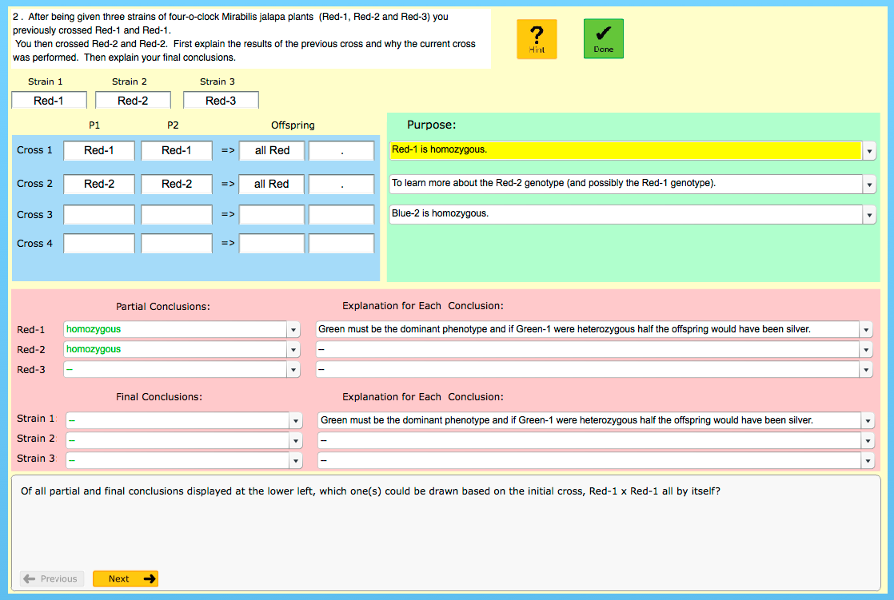
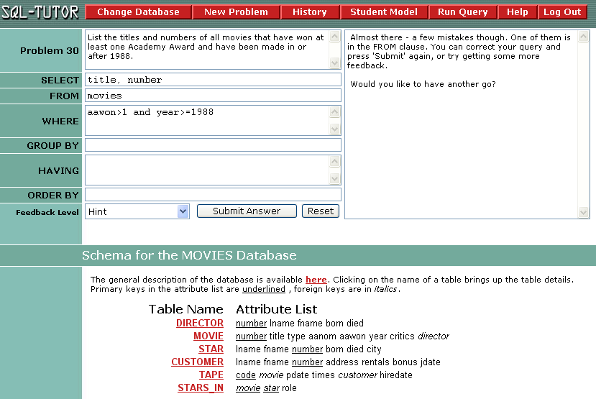
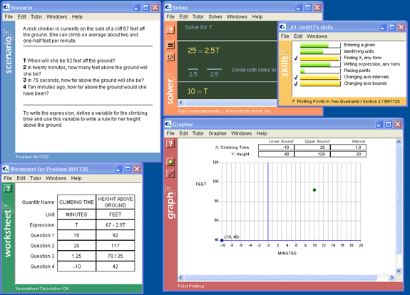
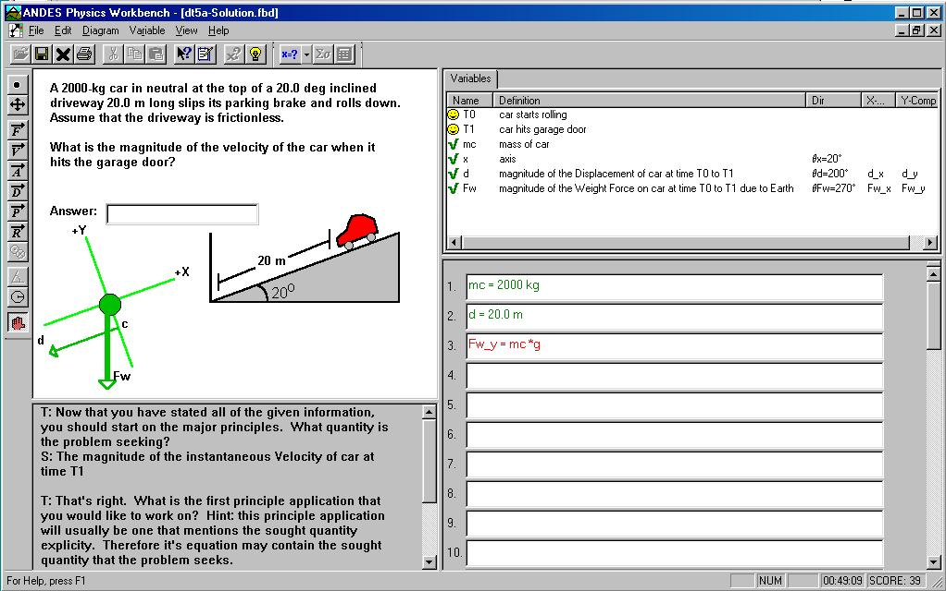

Individual Learning: Intelligent Tutoring Systems
Intelligent tutoring systems (ITS)
  Adaptively presents tasks
  Hints on demand
  Error feedback based on specific errors
Algebra Cognitive Tutor
  Part of complete course
Andes: College Physics Tutor
  Replaces homework
Genetics Tutor
  Most of a full course
SQL-Tutor Constraint-Based Tutor
  Central part of Addison-Wesley Course
Notes:
The first type of adaptive educational software I would like to talk about are individual learning systems, and in particular intelligent tutoring systems. Intelligent tutoring systems are certainly not the only type of individual learning system – in fact, there are many, many individual learning programs available for learning – yet few of these rely on strong learning theory or principles, have been subjected to rigorous scientific testing, or most importantly to today’s talk, operate adaptively.
ITSs are software tutors that work with single students. I say that ITS software is a “perfect storm” of educational psychology, cognitive psychology, computer science, and AI because it truly uses principles of each. It is based on pedagogical principles such as providing immediate, context-sensitive feedback to students but uses computing and AI techniques, such as adapting instruction using modeling techniques.
< click > Andes, a college physics tutor, is one well-known example of an ITS.
< click > Another example is the Algebra Cognitive Tutor, currently used in thousands of high schools across the U.S. The Cognitive Tutor concept was developed by colleagues of mine at Carnegie Mellon University and is now marketed and sold by Carnegie Learning, a spin-off of Carnegie Mellon University.
< click > The Genetics Tutor, which is a tutor I have been involved in developing and studying, is a tutor that has been used in many biology and genetics courses in the U.S. It covers material that is equivalent to a full course in genetics.
< click > Yet another example is the SQL-Tutor, a constraint based tutor that was developed at the University of Canterbury in New Zealand and is a central part of an online Addison-Wesley course.

Slide 9
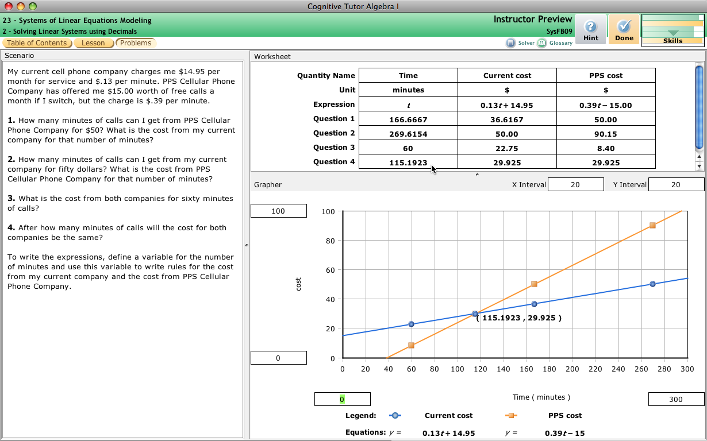
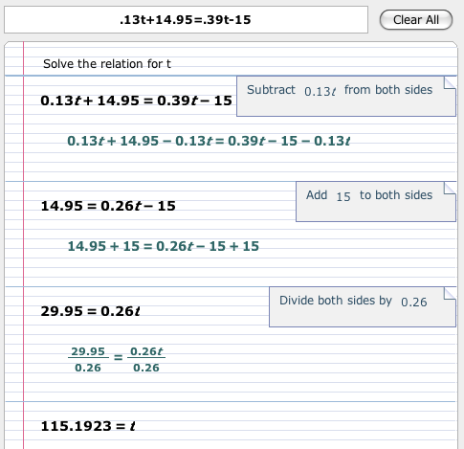
Algebra Cognitive Tutor
Individual Learning: Intelligent Tutoring Systems
Notes:
The Algebra Cognitive Tutor is a real-world success story of intelligent tutors. It has shown benefits over a more than 10-year period and is regularly used in 1000s of schools by 100s of thousands of students

Slide 10
Effectiveness of Cognitive Tutor Algebra at Scale
Individual Learning: Intelligent Tutoring Systems
Over 17,000 students in 147 schools across 7 U.S. states
Duration: 2 years
Cost: $6 million
Test: Algebra Proficiency Exam, 32-item multiple-choice assessment
Participants using Cognitive Tutor Algebra improved eight percentile points, compared to the control group
  About the same as doubling math learning in a year for a high-school student
Notes:
http://www.carnegielearning.com/press-room/press-releases/2013-06-20-rare-government-study-attributes-significant-algebra-gains-to-innovative-curriculum/
‘about the same as doubling math learning in a year for a high school student’
Only in the second year: takes teachers a while to become familiar with a new curriculum
Alabama, Connecticut, Kentucky, Louisiana, Michigan, New Jersey, and Texas
Tells us that cognitive tutor curriculum is more effective than other curricula, but tells us very little (if anything) about why
Useful for decision makers, not for scientists …

Slide 11
Individual Learning: Intelligent Tutoring Systems
There are other intelligent tutoring systems with positive and highly encouraging learning results, e.g.,
  AutoTutor (Graesser et al)
  iStart (McNamara et al)
  the Reading Tutor (Mostow et al)
Other directions with intelligent tutoring systems
  How to identify and adapt to affect (e.g., confusion, frustration, boredom)
    Using student actions, video, brain and body sensors
  How to identify and adapt to meta-cognitive states
    E.g., Help Seeking, Task Planning
Notes:
Of course, these are only a few examples of individual learning / adaptive tutoring systems. There are a number of other adaptive intelligent tutoring systems that have shown positive and highly encouraging learning results, including for instance AutoTutor, iStart, and the Reading Tutor.
An important emergent area of intelligent tutoring systems is the connection between affect and learning – and how tutoring systems can promote positive affect and subsequent learning. This is a fascinating area of ITS and one that is still very much a research question.
Researchers are looking at issues such as how technology can identify affect, both from video and sensors and student actions. The idea is to automatically adjust tutoring strategies based on affect states.

Slide 12
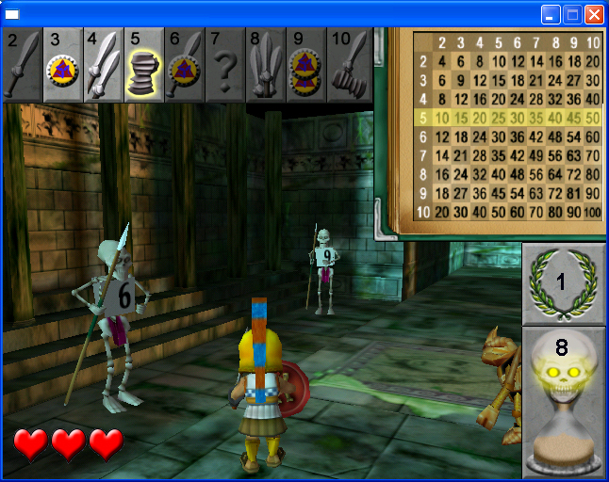
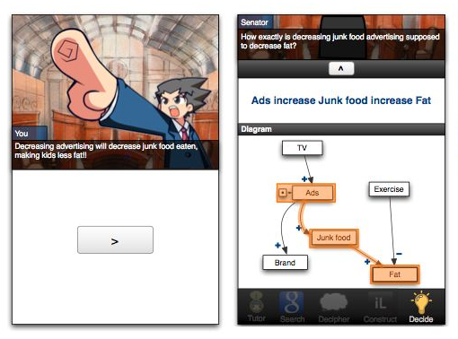
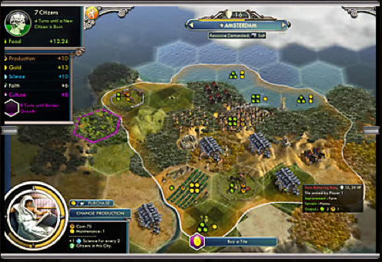
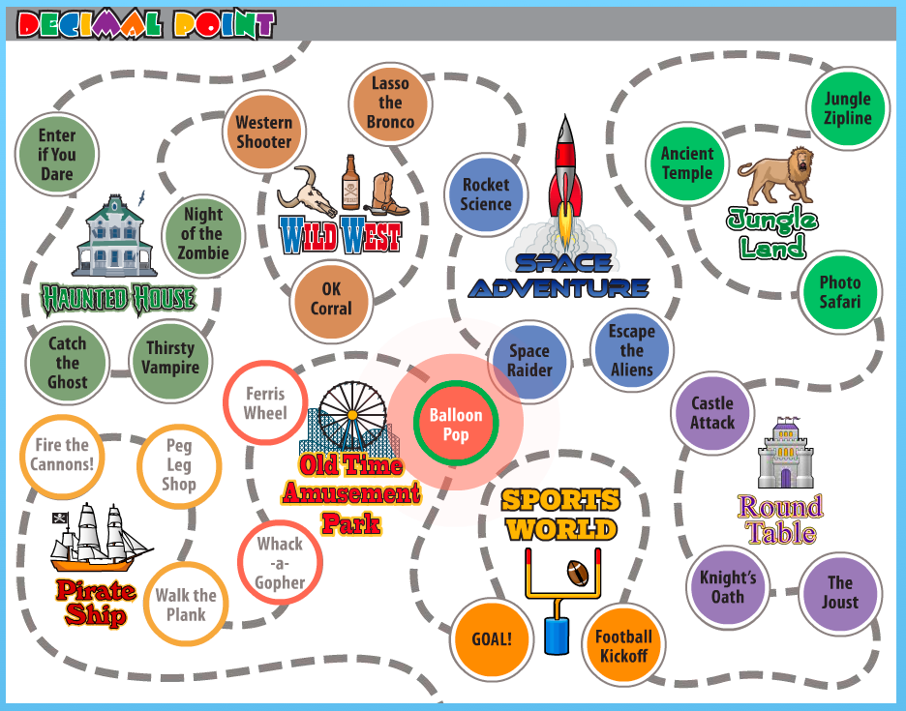
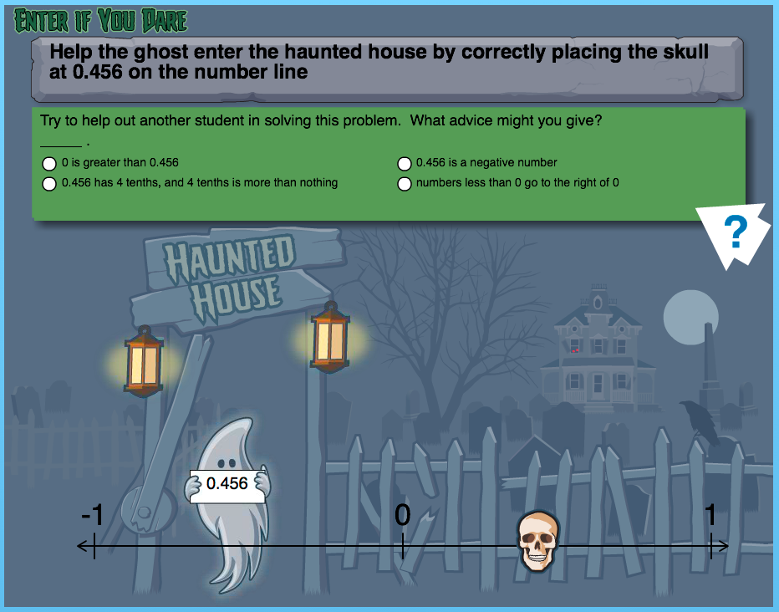
Individual Learning: Educational Games
Zombie Division
(Habgood et al)
Students spend much more time out of school than in school …
… and much of it playing video games!
What if even a small portion of this time was devoted to educational games?
Policy World
(Easterday)
Decimal Point (McLaren et al)
Civilization
(Meier)
Notes:
Another type of adaptive educational software that is emerging is educational games.
The idea here is that students spend much more time out of school …
< click >
… and much of that time is spent playing video games
< click >
So, what if even a small portion of that time was spent playing educational games?
For instance, some games that have been developed include:
< click >
Civilization: Players develop simulated civilizations, given a series of cultural resources to build from. As you move through the ages, you interact with new types of city-states, engage in new city-state quests and global competitions, and master new systems for land and naval combat.
< click >
Zombie Division is a 3-D action game, in which students learn whole number division, while at that same time shooting zombies.
< click >
Policy World is a game that engages students in policy deliberation, while at the same time providing game-like characteristics to motivate them to play.
< click >
Finally, an educational game that I was involved in designing and developing – Decimal Point – is aimed at helping young students learn decimals and decimal operations. This game is distinguished by being one of the few Ed Games that has provided empirical evidence of its effectiveness for learning.
========
U. Of Michigan survey in 2003 came up with an even higher figure: 8th-grade boys play video games 23 hrs/week, 8th-grade girls 12 hrs/week

Slide 13
E.g., Zombie Division
Individual Learning: Educational Games
Habgood, M. P. J., & Ainsworth, S. E. (2011). Motivating Children to Learn Effectively: Exploring the Value of Intrinsic Integration in Educational Games. Journal of the Learning Sciences.
3D action-adventure game
Designed to support learning of whole number division
Zombies succumb when attacked with weapon whose number divides the Zombie’s number evenly
Mathematics is integrated into game’s core mechanic
Notes:
Complements classroom instruction
Learning is integrated in the game’s core mechanic
About 20 different levels with 20 zombies each

Slide 14
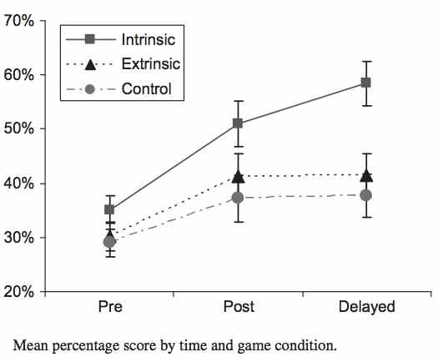
Zombie Division Results – Study
Individual Learning: Educational Games
Results
Study: Compared 3 groups using 3 versions of the game:
  Intrinsic: Division as part of the game (20 kids)
  Extrinsic: Division as separate step (between levels) of the game (20 kids)
  Control: No division in the game (18 kids)

Slide 15
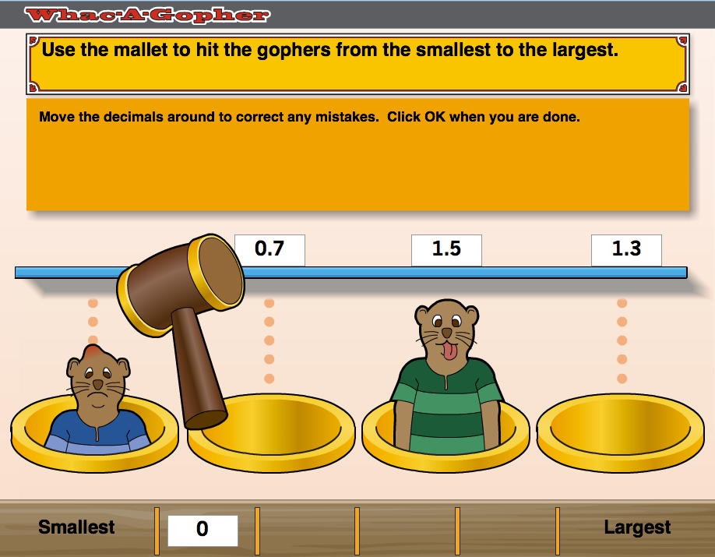
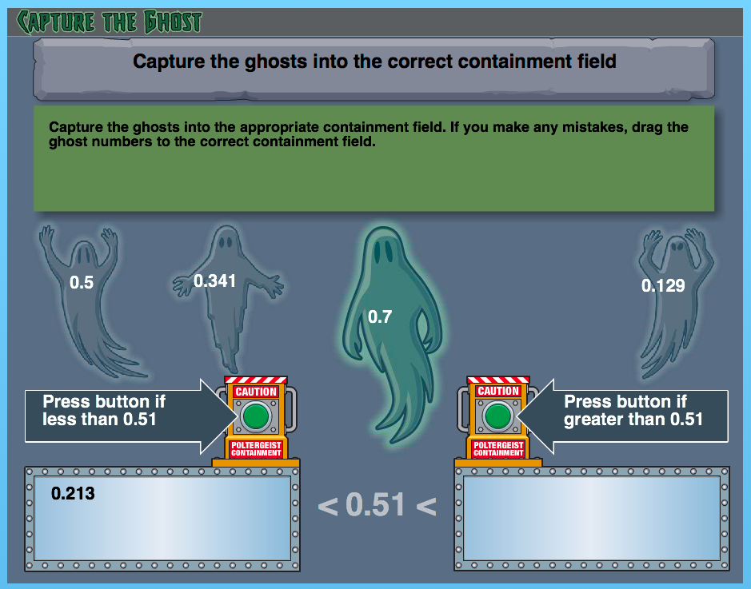
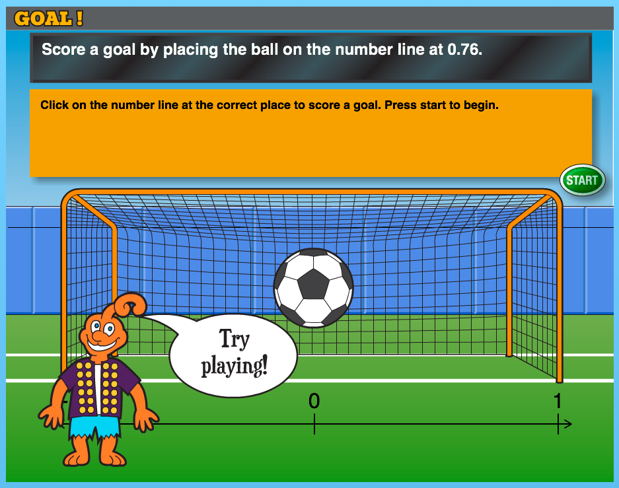
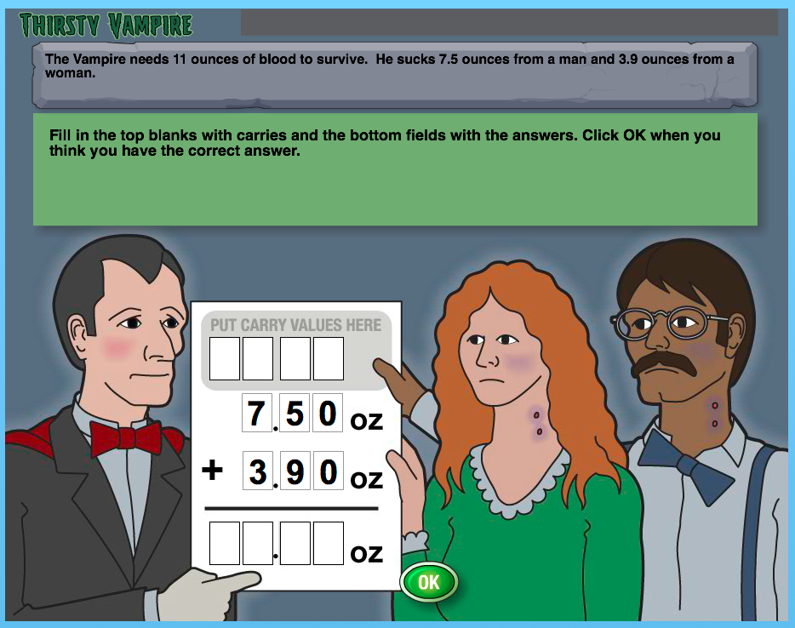
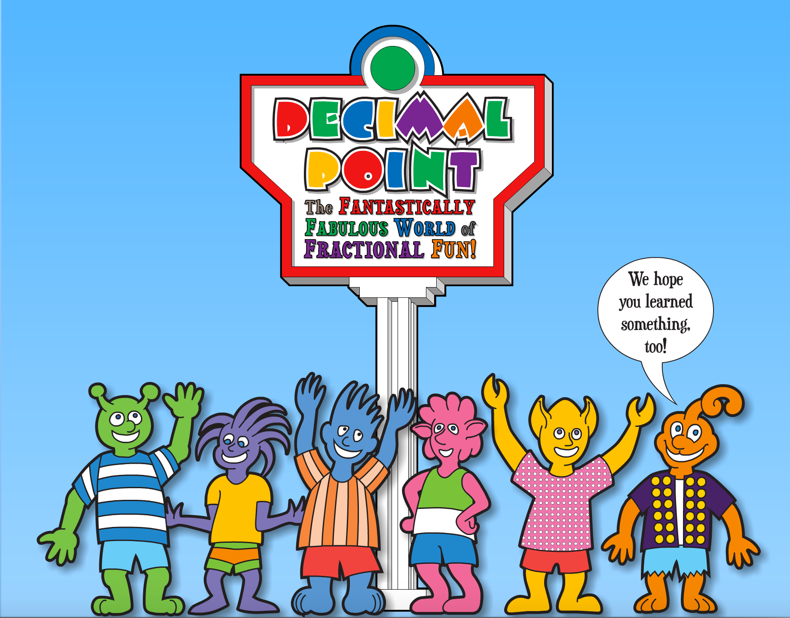
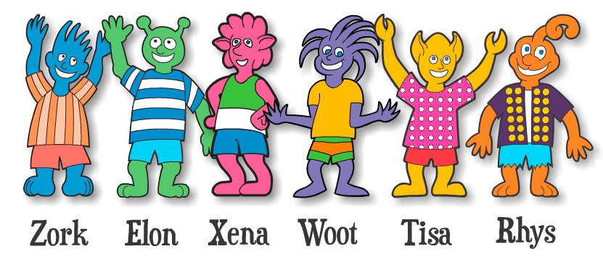
Decimal Point – McLaren, Mayer, Forlizzi, Adams
Individual Learning: Educational Games
Students Play –
  A series of amusement park “mini-games”
  The next game in sequence
  With fantasy characters
Students Learn –
  Decimal place value
  Comparing decimal magnitude
  Ordering decimals
  Placing decimals on a number line
  Adding decimals
Notes:
The fantasy characters act as guides to Decimal Point and encourage students to play and congratulate them when they correctly solve problems.

Slide 16
Decimal Point Study: Results and Conclusions
Individual Learning: Educational Games
Results reveal a clear benefit to learning with an educational game
  Game students learned more than Control students
  Game students enjoyed their experience more than Control students
Lower prior knowledge students benefited more
  Perhaps the best audience, as they tend to lack motivation and/or interest
Females benefited more
  Simple game; Young females tend to be less “gamers” than young males
A rigorous study that shows the benefit of learning mathematics with an educational game!
Notes:
< click > In contrast to relatively scant prior evidence that learning mathematics with an educational game is better than a conventional approach (Mayer, 2014), the results of this study show a clear benefit to learning mathematics with an educational game.
Game students learned more
Game students enjoyed their experience more
Game students made significantly less errors
The higher pretest scores for the Game group could be seen as more of a disadvantage than an advantage for that group, since they had less room to improve. Nevertheless, the Game group gained significantly more than the Non-Game group from pretest to posttest and from pretest to delayed posttest.
< click > We were expecting that one cost of the increased enjoyment for the Game participants would be that the students would take longer to complete the intervention than the Non-Game students, given the additional game steps and visual details the students were presented with in the Game group. However, this did not happen; the Game participants took longer than the Non-Game participants, but the difference was not significant. The significantly higher number of errors made by the Non-Game participants likely explains why it took them longer than expected to complete the materials. If the Non-Game participants were bored or unmotivated, this may have led them to make more errors and, in turn, enjoy their experience less.
< click > Low prior knowledge students learned more about decimals from game playing than from using more conventional learning materials. In fact, the low prior knowledge students may be precisely the best targets for mathematics educational games. These students perform less well and seem to struggle more with mathematics, perhaps because they lack self-motivation or interest. Games might get such students more excited and engaged in mathematics learning. This study provides some real evidence for this often-cited (but not often substantiated) claim.
Caveat to study: Finally, we had a relatively high dropout rate (52 out of 213 or ~24%) due to students not completing one or more of the sections of the study materials. This is addressed by the fact that an equal number of students were eliminated from each group (26 from the Game group, 26 from the Non-Game group) and the finding that the pretest scores of the eliminated students were not significantly different across the groups (Game: 18.0; Non-Game: 18.5, p = .81).
< click > This result may not be surprising to you – it may seem almost obvious that a game would help students learn better – but keep in mind that there has been very little research that has shown this result – particularly in mathematics. So, I would claim that this is a significant result.
< click > This is an example of a rigorous study of educational games, and a journal paper we wrote about our study has been accepted at IJGBL. McLaren, B.M., Adams, D., Mayer, R., & Forlizzi, J. (2017). Decimal Point: An Educational Game That Benefits Mathematics Learning More Than a Conventional Approach. Submitted to the International Journal of Game-Based Learning (IJGBL).

Slide 17
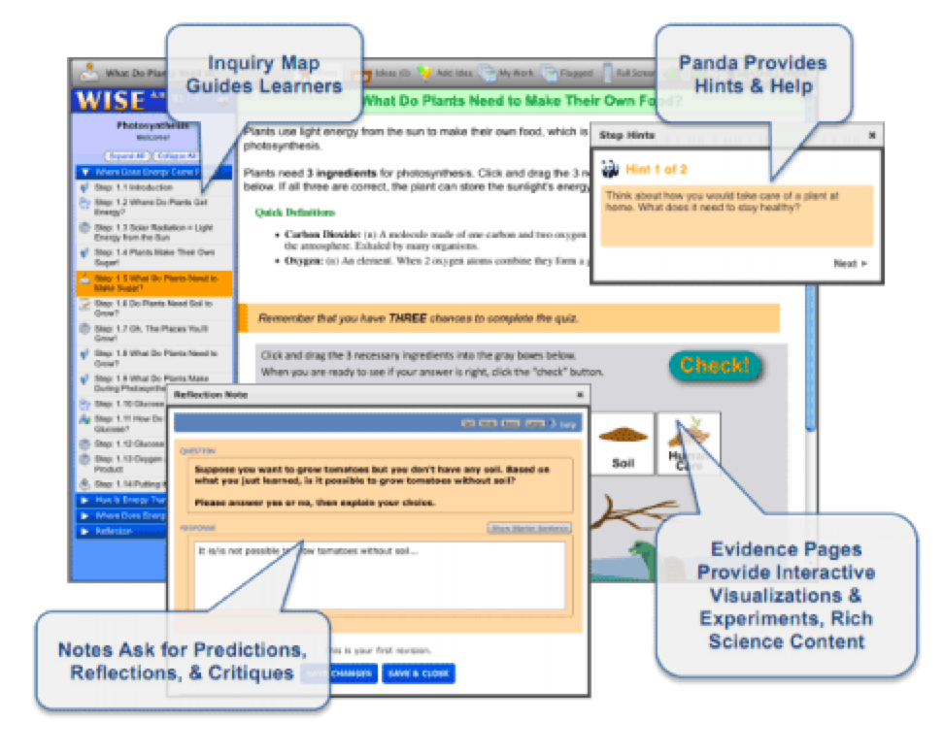
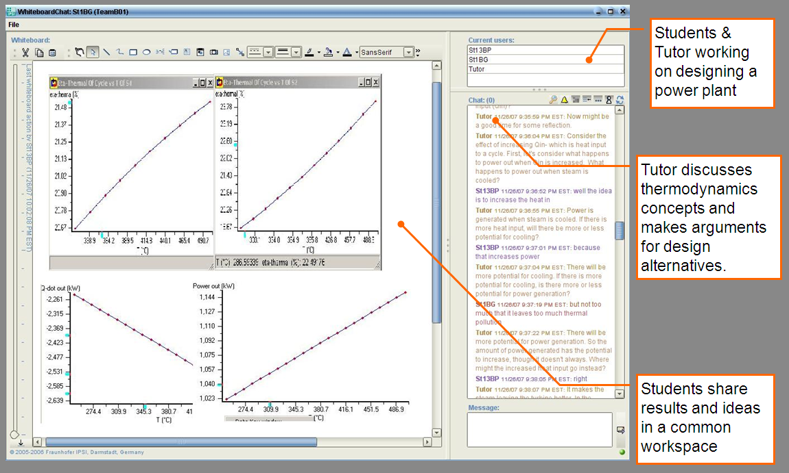
Collaborative Learning:
Computer-Supported Collaborative Learning
Builds on the theory of constructivism; students develop their own understanding
WISE
(Linn et al)
Groups share and construct knowledge
Computers and software are used as the means of communication or as a common resource
The interaction is what matters in CSCL
More design-based than empirical, hypothesis-testing research
VMT-Basilica
(Kumar et al)
Notes:
With respect to the guiding of collaboration by the computer, the field of computer-supported collaborative learning (CSCL) has emerged over the past 20 years. CSCL draws heavily from learning theories that emphasize that knowledge is the result of learners interacting with each other, sharing knowledge, and building knowledge as a group.
Computers are used for communication or as a common resource.
A big emphasis in CSCL is that it is not enough to measure the outcome (e.g. posttest results, learning gains). Need to analyze interaction processes.
Finally, CSCL is much more design-based than empirical, hypothesis-testing research. What this means is that a big emphasis is on understanding how collaboration contributes to, or hinders learning, but doing so in a more exploratory than hypothesis-testing way.
On the right side of this slide are some examples of collaborative learning systems, a couple of which I will discuss in the following slides.
=======
CSILE: Students collaboratively create a concept map, by creating nodes of the map. Other students access the nodes and make comments, and the system notifies other users when comments have been received. Students get practice in refining their own thoughts by reading and commenting upon the responses of others. By trying to explain their ideas to other students and interacting with their peers around academic content, students sharpen their thinking and gain new knowledge.
VMT-Basilica is a system that uses so-called “conversational agents”, software agents that use natural language techniques to interact with collaborating students, prompting them to work together and share their ideas. In this particular instance, students discuss thermodynamics in a shared workspace with support of the “conversational agent”
LASAD, a system for which I have been involved, is a web-based argumentation environment, in which students collaboratively debate issues. We have developed scripting methods to guide students in their learning, such as providing sentence openers to guide their interaction, and also have developed automated techniques to analyze student interaction.

Slide 18


Collaborative Learning:
Computer-Supported Collaborative Learning
WISE (Linn, Slotta, et al)
Software platform to support science inquiry activities
Scaffolds learning in multiple ways:
  Personalized instruction
  Cognitive hints
  Role & Activity Scripting
  Discussion diagramming
WISE
Student pairs jointly do knowledge co-construction by:
  Role playing
  Peer critiquing
  Debating
Notes:
As an example of collaborative learning supported by technology, let me talk briefly about WISE, a software platform designed and developed by Marcia Linn and Jim Slotta at Berkeley to support science inquiry activities.
The WISE system scaffolds learning using a variety of the general techniques, such as role scripting, activity scripting and discussion diagramming. It does this using its many interface components, including cognitive hints, automated essay evaluation, and a tool for discussion.
< click >
The system is typically used by pairs of students and aims at knowledge co-construction through student role playing, peer critiquing, and debating.
An example of an Role Script / Activity Script / Discussion Diagramming
Linn, M. C., Gerard, L., Ryoo, K., McElhaney, K., Liu, O. L., & Rafferty, A. N. (2014). Computer-Guided Inquiry to Improve Science Learning. Science, 344(6180), 155–156
Linn, M. C., & Eylon, B.-S. (2011). Science Learning and Instruction. Lawrence Erlbaum, Mahwah, NJ.

Slide 19


Collaborative Learning:
Computer-Supported Collaborative Learning
Conversational Agents (Rosé, Kumar et al)
Adapt collaborative process as students work together on a design task
Use of Conversational Agents (natural language processing) to shape conversation and support effective participation to achieve positive impact on learning
Historical Perspective:
  Socratic dialogue tutors (Rosé et al, 2001)
  Students learn more when working with a partner, and even better with support (Gweon et al, 2006)
  Tutorial dialogue agents provide effective support for collaborative learning (Kumar et al, 2007)
VMT-Basilica
** Students learn up to 1.25 standard deviations more when interactive support is provided in the environment. (more than a full letter grade!)
Notes:
An example of an Adaptive Script (i.e., Conversational agents)
An example of a CSCL system is conversational agents, developed by Carolyn Rosé, Rohit Kumar and others at Carnegie Mellon University. The idea behind conversational agents is to use natural language processing techniques to create “virtual partners” – that is software agents – to help spur and adapt conversation. The virtual partners – 3 to 5 students collaborating on a design task – make contributions to keep the conversation moving, raising and answering questions and using conversational techniques to engage all partners in discussion.
Rosé and her student Kumar developed a system called VMT-Basilica, which is used by students to collaboratively design a power plant. The conversational agent discusses thermodynamics with students and suggests design alternatives.
This is a form of “adaptive scripting” because the conversational agent adapts to what the collaborating students are saying, as they try to engage them.

Slide 20
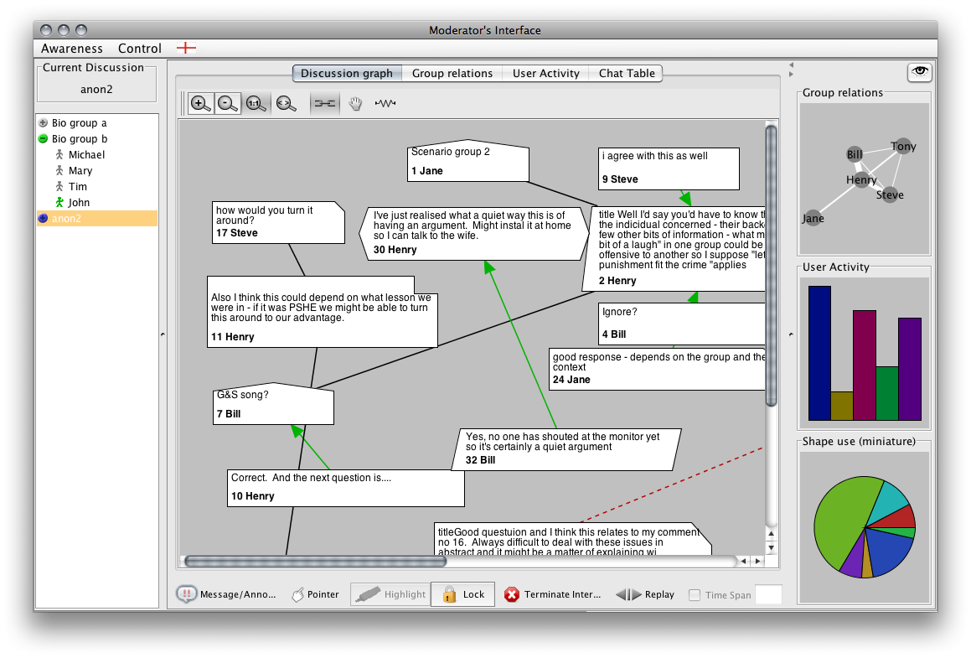
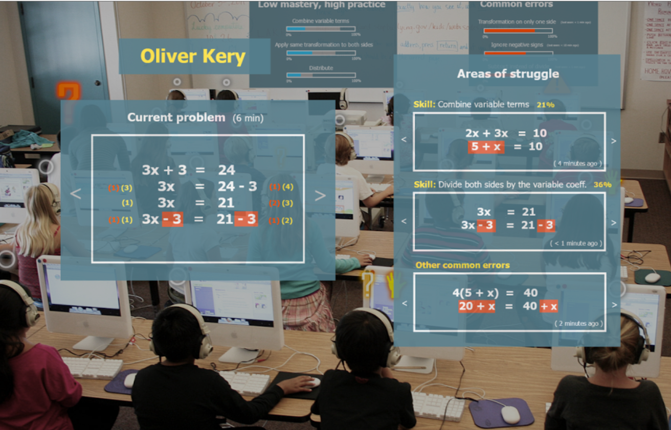
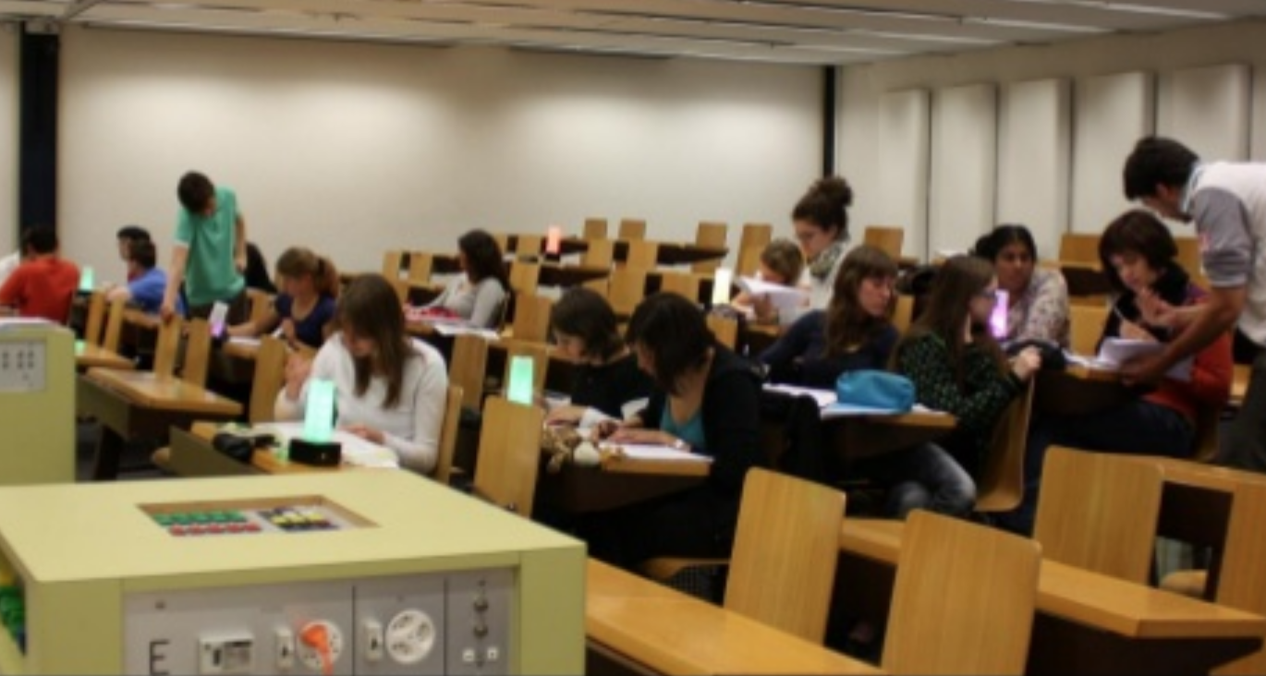

Classroom Orchestration
ARGUNAUT
(McLaren et al)
Traditional classrooms: the teacher’s role is to be the primary source of information, and the learners passively receive it.
Modern Classrooms: the teacher’s role will shift more and more to the “guide on the side”
Educational technology is taking a more prominent role in supporting students in their learning
Schools and universities are beginning to redesign learning spaces
Vast amounts of data on student activities is being collected and analyzed
LUMILO
(Holstein et al)
Lantern (Alavi et al.)
Notes:
The traditional model of the teacher has been of an “all knowing” sage, where students passively receive all information from their teacher. This has been the model in education for a long time, dating back to the time of the Greeks and Aristotle, and it is still very much in evidence today.
< click > However, because of the access to information and educational opportunity that technology has enabled, and as students take more responsibility for their own learning using technology, the model is shifting to teachers being “guides on the side”
< click > A key reason for this, as alluded to in my earlier cartoon slides, is that educational technology is taking an increasing role in education
< click > Schools and universities are beginning to redesign learning spaces to enable this new model of education, foster more interaction and small group work, and use technology as an enabler.
< click > At the same time, vast amounts of student data is being collected and analyzed, allowing for an up-to-the-moment assessment of what students are learning and doing. The emergent field of Educational Data Mining is helping us to corral and understand this data.

Slide 21

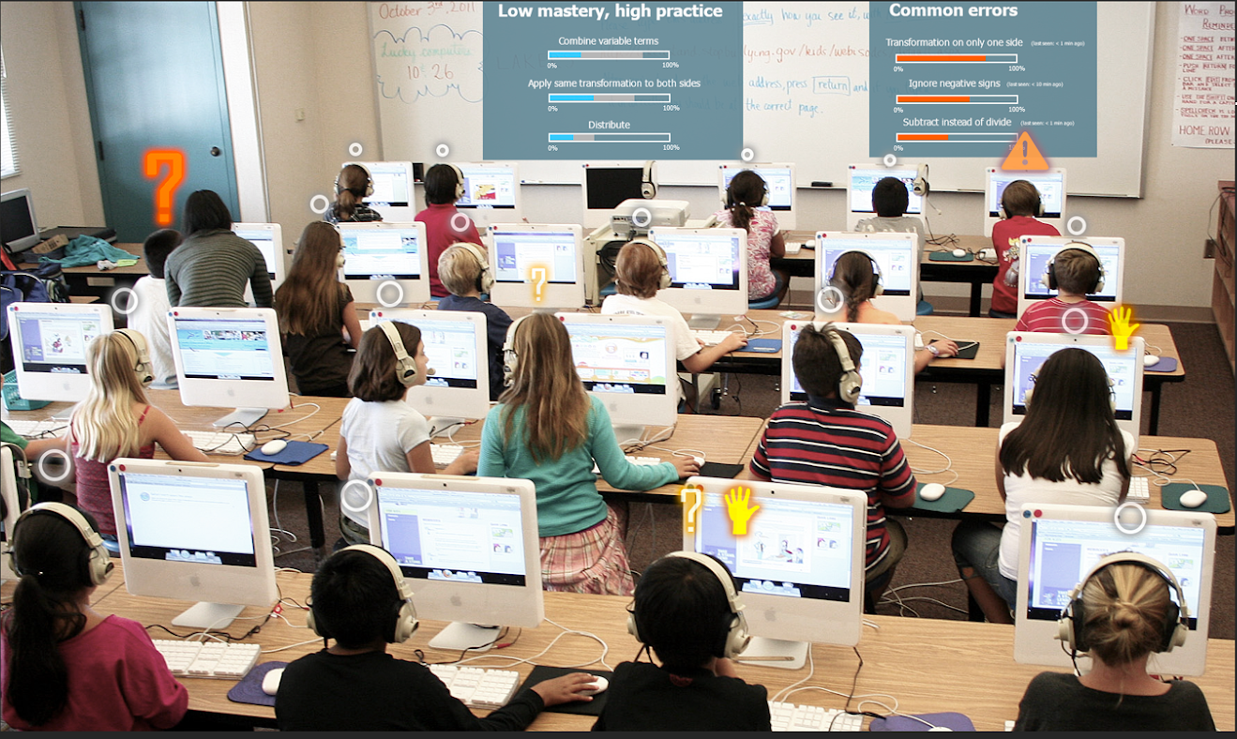
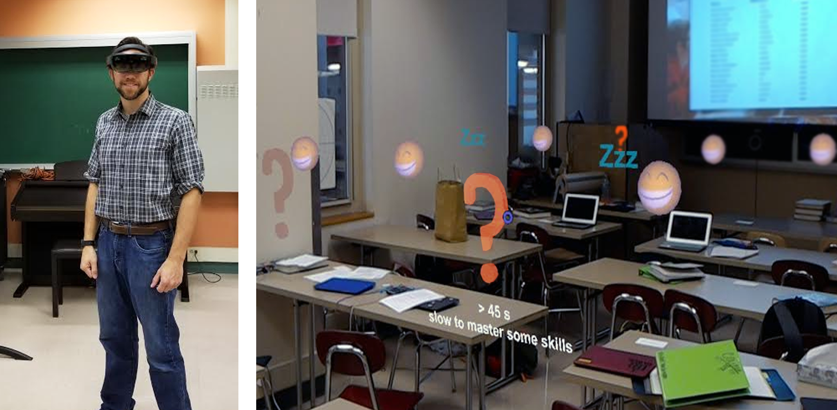
Classroom Orchestration
Lumilo (Holstein et al)
Help Teachers help their students
Lumilo uses mixed-reality smart glasses to deliver learning analytics to an AI-enabled classroom
Joint work with
Ken Holstein &
Vincent Aleven
Allows teacher to keep their eyes on the class
Information is delivered in a private manner
Notes:
The result of the user-centered design process with many middle school math teachers is a prototype called “Lumilo”, using the Microsoft HoloLens
Lumilo uses mixed-reality smart glasses to overlay analytics and indicators on the teacher’s view of the classroom
That is, the teacher sees their class, but with annotations that indicate how the learning process is going, for students.
The idea to use mixed-reality glasses arose during the user-centered design process, based on ideas from teachers.
The smart glasses have advantages over other mobile technologies that they allow the teacher to keep their eyes on the class and that the information is displayed in a private manner, visible only to the teacher. Teachers were concerned about student privacy.

Slide 22
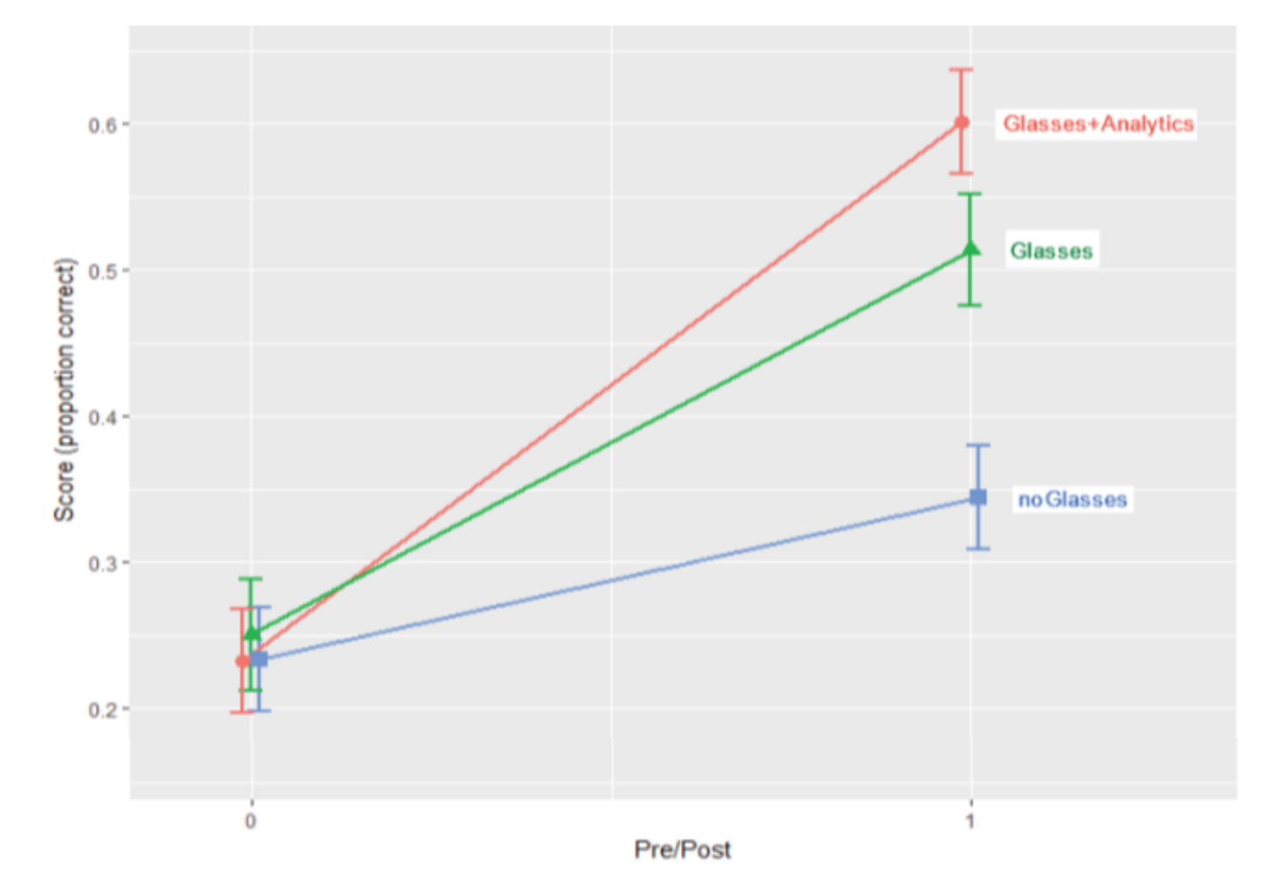
Classroom Orchestration
Lumilo (Holstein et al)
When teacher has mixed-reality, real-time orchestration tool, students learn more
Glasses + Analytics (Lumilo)
Glasses
Test
Score
NoGlasses
Pre-test
Post-test
Holstein, K., McLaren, B.M. & Aleven, V. (2018). Student learning benefits of a mixed-reality teacher awareness tool in AI-enhanced classrooms. In C. Rosé, R. Martínez-Maldonado, H.U. Hoppe, R. Luckin, M. Mavrikis, K. Porayska-Pomsta, B. McLaren and B. du Boulay (Eds.). Proceedings of the 19th International Conference on Artificial Intelligence in Education (AIED 2018). LNAI 10947 (pp. 154-168). Springer: Berlin.
Notes:
Here are the results – the pre-test and post-test scores for each of the three conditions. (The difference between the post-test score and the pre-test score is how much students learned.)
Thus, we see that all three conditions started with about the same pre-test scores and that all three conditions learned from pre- to post-test. At one level, the increase from pre- to post-test simply confirms the known effectiveness of intelligent tutoring systems in enhancing students’ learning outcomes.
More surprising, and more interesting, are the condition difference in the learning that occurred between pre-test and post-test. As you can see, the increase was the greatest for the Lumilo condition. In this condition there was more learning, from pre- to posttest, than in our two control conditions. The difference was bigger compared to the business-as-usual with classrooms where students work with an ITS, but where the teacher does not use an awareness tool like Lumilo. It was smaller compared to the condition where the teacher does have smart glasses and a simple monitoring tool.
Results from our second control condition (the Glasses condition) suggest that part of the difference may be due to a novelty effect. It may be that students are more excited when the teacher has smart glasses, and it may be that students learn better as a result. But our second control condition also indicates that the effect of Lumilo cannot fully be attributed to a novelty effect. The analytics (such as the symbols displayed above students’ heads) played a role as well.
This is a really remarkable result! Since the glasses only influence the teacher directly, not the students, this result shows that the glasses help the teachers help their students better. And does so in comparison to a very high bar control condition: As discussed, intelligent tutoring systems are very effective in helping students learn, as is quite clear from research.

Slide 23
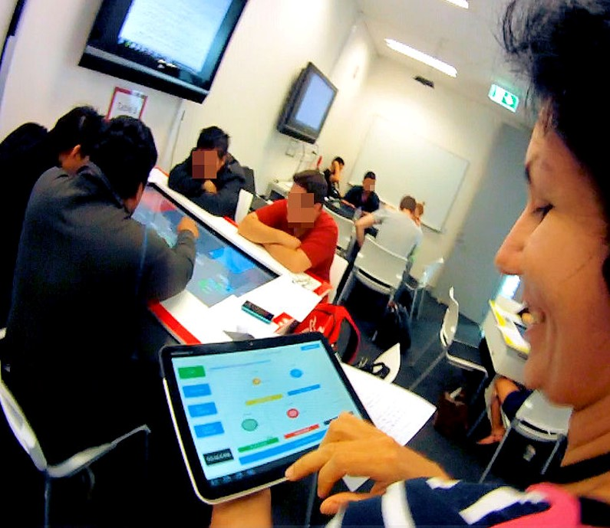
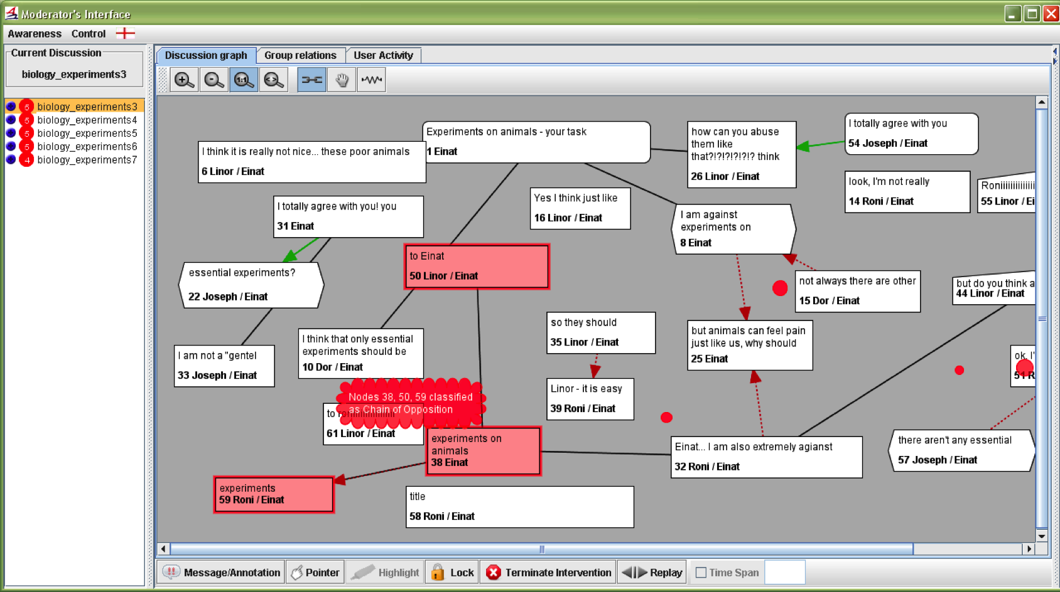
Classroom Orchestration
Other Advanced Technology
Lantern
(Alavi et al., 2009; 2012)
MTDashboard and MTFeedback
(Martinez-Maldonado et al., 2013; 2015)
Deep Alerts
ARGUNAUT
(McLaren et al., 2010)
Notes:
Here are three other instances of classroom orchestration tools. While they each have their own novelty, note that all three of these projects ran into limitations of existing prototyping methods, thus leading researchers to develop new prototyping approaches for data-driven/analytics-driven orchestration tools.
Lantern (Alavi et al., 2009; 2012)
Context: Lantern is an ambient awareness tool, designed for supporting the learning process in university recitations, (i.e., when students work in small teams on the exercise sets with the help of tutors). Each team is provided with an interactive lamp that displays their work status: the exercise they are working on, if they have called for help, since when, and on which exercise. Lantern, by providing this information, is meant to facilitate the interaction between tutors and teams, to encourage collaboration among students, and to provide awareness feedback to teachers.
Novelty: Displays are spatially distributed throughout the classroom. This is rare for orchestration tools... Lumilo and Lantern share this in common, but Lantern's design means that signals are available to others in the class.... also note that Lantern's signals are *student controlled* .... students use the devices to communicate with the teacher.
MTDashboard and MTFeedback (Martinez-Maldonado et al., 2013; 2015)
Context: Collaborative, technology-enhanced [tabletop] university recitation/lab sessions using tabletops; A handheld tablet is used by the teacher to orchestrate (although they considered using a head-up display)
Novelty: Much of the novelty here (with a few exceptions) lies in the unique context [tabletop classrooms!] and the tight integration of the design of MTDashboard and MTFeedback with other technologies in these contexts [i.e., MTDashboard and MTFeedback are really: orchestration tools + smart classrooms designed alongside these tools]. ...... much of the novelty also lies in the *research this tool has been used for*:
- data mining studies and quasi-experiments, which investigated teacher attention and potential effects on student learning more deeply, and at a finer grain-size, than any prior projects
- prototyping approaches/workflows like "LATUX"
Teacher Assistance Tools: Class Dynamics (Mavrikis et al, 2016)
Context: K-12 classrooms using personalized learning software, i.e., exploratory learning environments [MiGen from UCL Knowledge Lab]; A handheld tablet is used by the teacher to orchestrate
Novelty: Much of the novelty here (with a few exceptions) lies in the iterative design processes the researchers employed, working with teachers and students [e.g., prototyping approaches like "Iterative Context Engineering"]
Notes on the above: LATUX and Iterative Context Engineering have much in common. Our own "Replay Enactments" builds on both of these prototyping approaches.
More on Lantern: I've always been very impressed by Lantern's minimalistic design: information is displayed through multiple channels: color, intensity, flicker rate [ranging from solid/non-flickering to rapidly pulsing light], .... Actually, I'd highly recommend checking out this brief video: https://youtu.be/ndWYJP0AFUM?t=25 (this link will take you directly to a ~20 second excerpt in which Hamed Alavi demonstrates/explains how information is displayed *and* how students control the devices)
More on LATUX: LATUX is a prototyping workflow/framework that Roberto and others developed in the process of developing MTDashboard and MTFeedback. It is fairly broad (as workflows and frameworks tend to be):
From http://learning-analytics.info/journals/index.php/JLA/article/viewFile/4458/5180
"LATUX is a five-stage workflow to design, validate and deploy awareness interfaces in technology-enabled learning environments.” Our work on "Causal Alignment Analysis" (also a broad framework) was aimed at filling gaps in LATUX (specifically: moving beyond usability/usefulness for teachers, towards trying to improve student learning outcomes). Similarly, our work on Replay Enactments builds on LATUX, but shifts towards more of a focus on the design/selection/tuning of analytics, whereas the LATUX work focused a bit more on the visual design of awareness tools

Slide 24
Trade-offs of sophistication of technology versus demonstrated learning benefits
Still lots of room for successes here!
More
Educational Games
Collaborative Systems:
High Tech
(Conversational Agents)
Sophistication of Technology
Classroom Orchestration Tools
(e.g., ARGUNAUT, Lumilo)
Intelligent Tutors
(e.g., Cognitive Tutors, Constraint-based Tutors)
Collaborative Systems: Low Tech
(e.g., WISE, Coler)
Less
Less
Demonstrated learning benefits (Scientifically and/or practically)
More
Notes:
So, how are we doing with respect to the science of educational technology? In this graph I will give my personal assessment of where we stand today by way of two dimensions – sophistication of technology and demonstrated learning benefits. So let’s see where I’ve placed the educational technologies that I’ve discussed today on this graph.
< click > First, intelligent tutors. I would claim that intelligent tutors have been shown to be effective for learning, probably more so than any other technology that I’ve discussed, but their level of sophistication is only in the mid-range. Many of the techniques of ITS – production rules, constraints, student models and Bayes Nets – have been well understood and established for years. I should note, however, that tutors that process and produce natural language are more sophisticated and, if we manage to find techniques to reliably detect and react to student affect, this category of educational technology would move up the sophistication scale.
< click > Second, let’s consider educational games. Games employ sophisticated graphics, of course, and also some AI techniques, so they are relatively sophisticated from a technology perspective. Yet, we are still in the early stages of empirical evidence of their benefits
< click > Third, collaborative learning systems. Here I distinguish between “low-tech” CSCL and “high-tech” CSCL. Low-tech CSCL refers to the many systems that have been used more as communication devices between collaborating students and those that provide very basic scripting capabilities. As mentioned earlier, many of these systems have been subject to more exploratory, design-based research; there is some empirical evidence of their effectiveness for collaboration and learning, but to a limited extent. < click > On the other hand, the more high-tech CSCL systems – in particular, conversational agents, those that employ natural language techniques – are much more sophisticated from a technology perspective. Yet, these have only a limited amount of empirical evidence in support of their benefits to collaboration and learning, mostly the work done by Carolyn Rosé’s group.
< click > Finally, there are Classroom Orchestration tools. These tools leverage advanced technology, both software and hardware, but are in the early stages of proving themselves in the classroom.
< click > What I would like to point out here is the opportunity that is still in front of all of us – Learning Scientists and Technologists, alike. There is still a very open area here in which we can develop new advanced technologies and prove that technology with our scientific tools and methods.

Slide 25
Conclusions
Learning science is definitely helping:
  To guide the development of advanced learning technology
  To evaluate, validate, and improve the learning technology
Yet, there has been more success in research, less in real-world classroom use:
  Advanced technologies are moving forward, proving themselves scientifically
  However, we are still in the early stages of incorporating these advanced technologies into real-world classrooms

Slide 26
The Future
Researchers will leverage advanced technologies to investigate new ways of learning
  augmented reality
  virtual reality
  novel use of haptic devices
  combining technologies (e.g., Ed Games & Collaboration)
Companies spinning off from universities to deploy the advanced learning technologies
Classrooms full of artificial intelligence-infused software and hardware to support learning
Yet, more science and technology is needed:
  How can we identify and adapt to boredom, frustration and confusion in tutoring systems?
  How can we make collaborative learning systems more directly adaptive to student needs?
  Educational games are exciting, but are they beneficial to learning? Can we leverage game adaptation to the benefit of learning?

