Slide 1
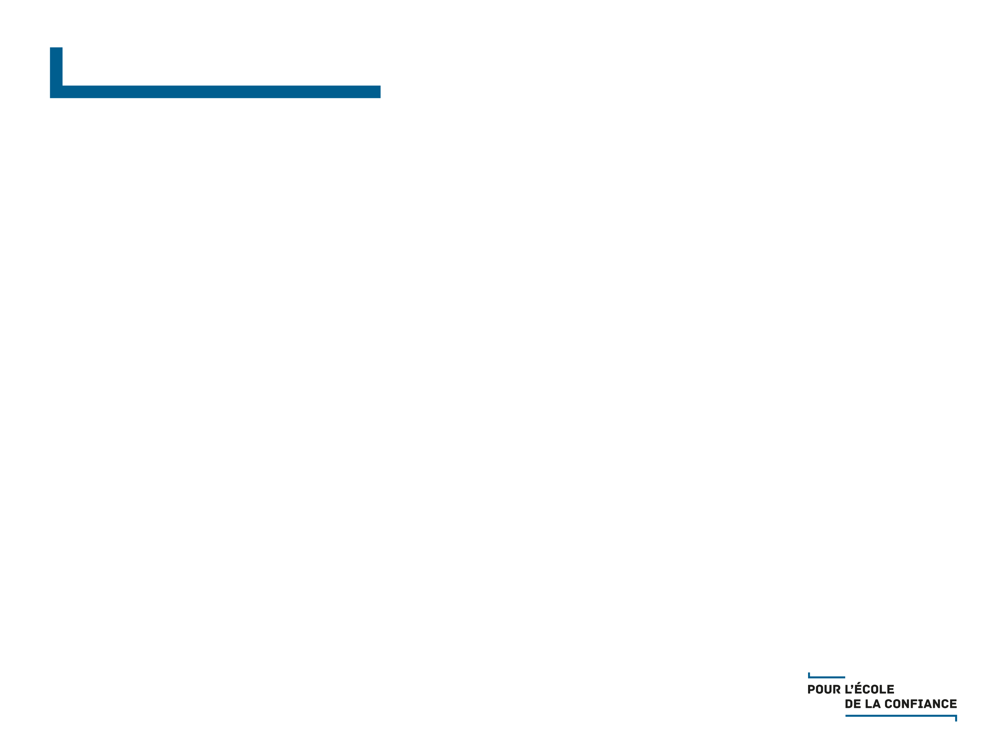
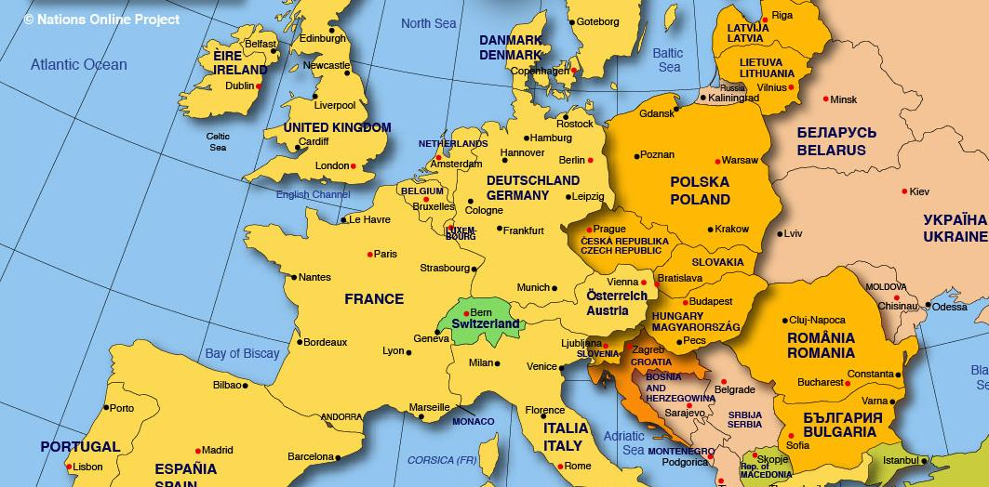
HOW HAS MATHEMATICS TEACHING BEEN IMPROVED IN POLAND?
Area: 319 sq.km Population: 38.5 mln Math teachers: 30 000 Masters Degree in math: 95%

Slide 2
HOW HAS MATHEMATICS TEACHING BEEN IMPROVED IN POLAND?
Area: 319 sq.km Population: 38.5 mln Math teachers: 30 000 Masters Degree in math: 95%

Slide 3


HOW HAS MATHEMATICS TEACHING BEEN IMPROVED IN POLAND?
Winds of change…

Slide 4


HOW HAS MATHEMATICS TEACHING BEEN IMPROVED IN POLAND?
Winds of change…

Slide 5

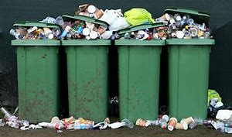
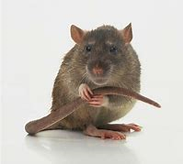
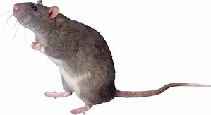
HOW HAS MATHEMATICS TEACHING BEEN IMPROVED IN POLAND?
Winds of change…
He
must be
really smart!

Slide 6
HOW HAS MATHEMATICS TEACHING BEEN IMPROVED IN POLAND?
Winds of change…
non-routine
routine

Slide 7
HOW HAS MATHEMATICS TEACHING BEEN IMPROVED IN POLAND?
Winds of change…
non-routine
non-routine
routine
machine solved
routine – human solved

Slide 8
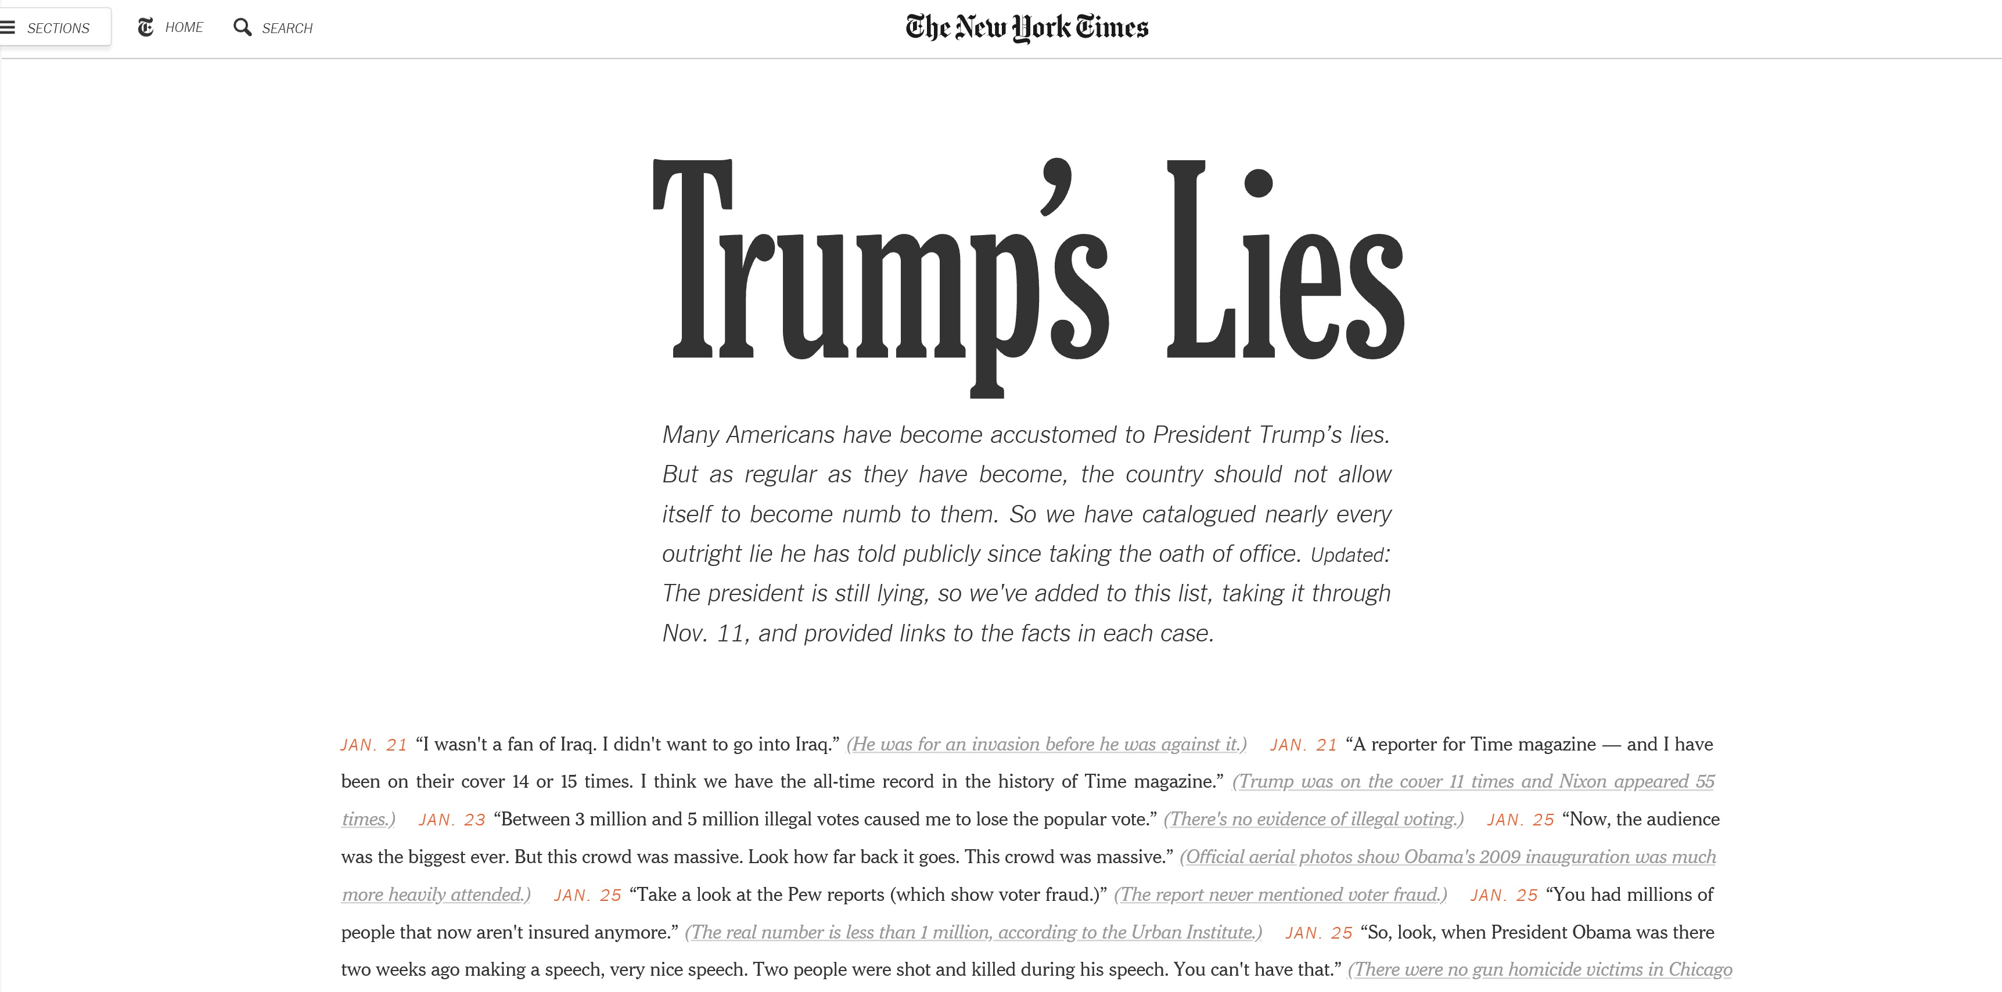
HOW HAS MATHEMATICS TEACHING BEEN IMPROVED IN POLAND?
Winds of change…

Slide 9
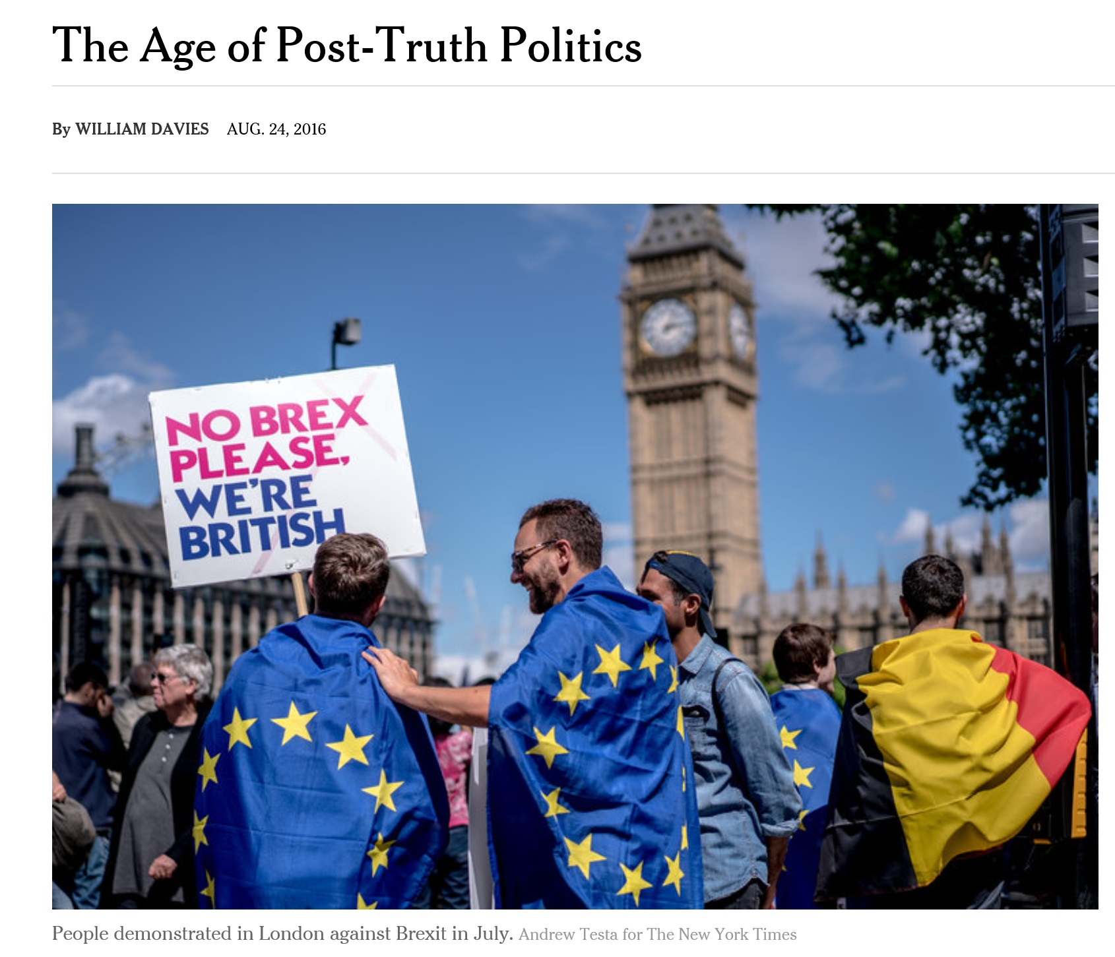
HOW HAS MATHEMATICS TEACHING BEEN IMPROVED IN POLAND?
Winds of change…

Slide 10
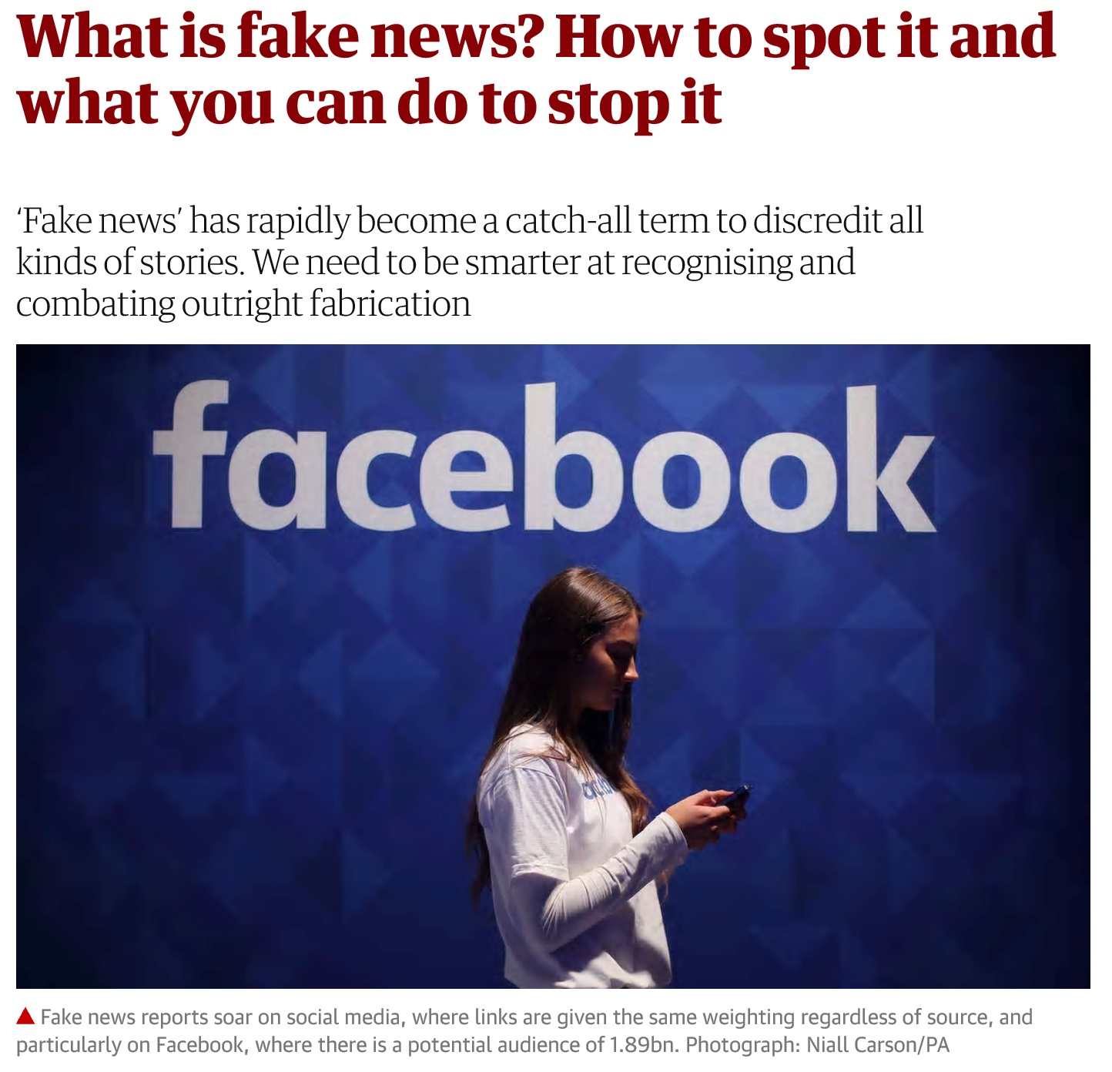
HOW HAS MATHEMATICS TEACHING BEEN IMPROVED IN POLAND?
Winds of change…

Slide 11
HOW HAS MATHEMATICS TEACHING BEEN IMPROVED IN POLAND?
Conclusions for education
Prepare students to be ready to deal also with non-routine tasks
Prepare students to recognize and deal with lies

Slide 12
HOW HAS MATHEMATICS TEACHING BEEN IMPROVED IN POLAND?
Conclusions for education
Prepare students to be ready to deal also with non-routine tasks
Prepare students to recognize and deal with lies
How to achieve that?

Slide 13

HOW HAS MATHEMATICS TEACHING BEEN IMPROVED IN POLAND?
Realities
Why do we have to learn mathematics?!

Slide 14
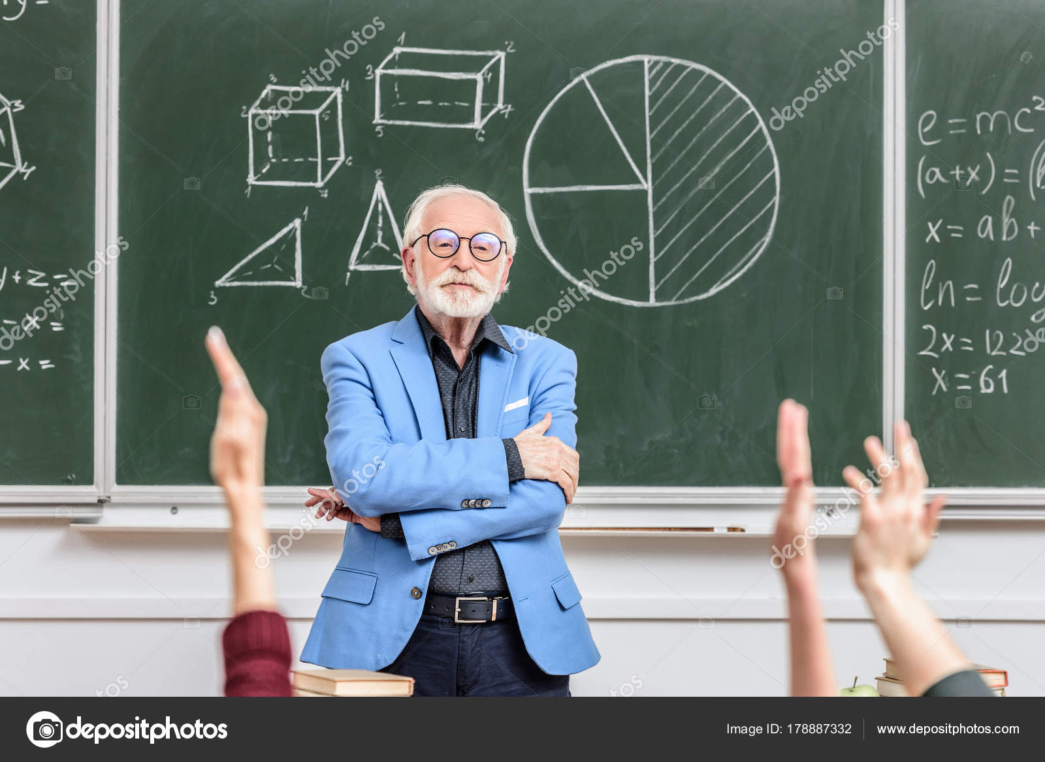
HOW HAS MATHEMATICS TEACHING BEEN IMPROVED IN POLAND?
Realities
- Mr. Jones, will I ever use this algebra?
- You won’t, but some smarter kids might!

Slide 15
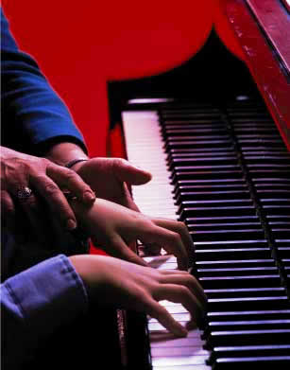
HOW HAS MATHEMATICS TEACHING BEEN IMPROVED IN POLAND?
Realities
Practice patiently – you will see why this makes sense later!

Slide 16
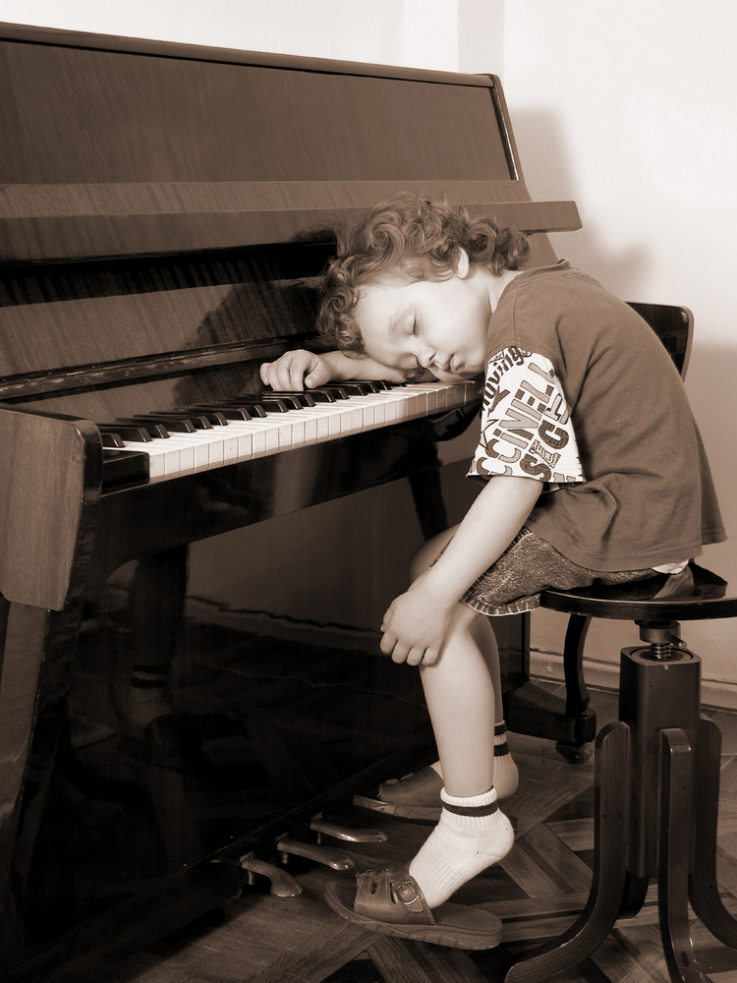
HOW HAS MATHEMATICS TEACHING BEEN IMPROVED IN POLAND?
Realities
Practice patiently – you will see why this makes sense later!

Slide 17
HOW HAS MATHEMATICS TEACHING BEEN IMPROVED IN POLAND?
Math teaching
concept oriented:
n=1
Introduce
concept nr n
Practice
concept n
Test
concept n
Time left?
NO
STOP
YES
n=n+1

Slide 18
HOW HAS MATHEMATICS TEACHING BEEN IMPROVED IN POLAND?
„What mathematics do people really need?”
„What do we de-emphasize and remove?”

Slide 19
HOW HAS MATHEMATICS TEACHING BEEN IMPROVED IN POLAND?
„What mathematics do people really need?”
„What do we de-emphasize and remove?”
„What literature do people really need?”
„What do we de-emphasize and remove?”

Slide 20
HOW HAS MATHEMATICS TEACHING BEEN IMPROVED IN POLAND?
„What mathematics do people really need?”
„What do we de-emphasize and remove?”
„What literature do people really need?”
„What do we de-emphasize and remove?”
Mathematics is, like literature and art, part of our cultural heritage

Slide 21
HOW HAS MATHEMATICS TEACHING BEEN IMPROVED IN POLAND?
Math teaching
concept oriented:
n=1
Introduce
concept nr n
Practice
concept n
Test
concept n
Time left?
NO
STOP
YES
n=n+1

Slide 22
HOW HAS MATHEMATICS TEACHING BEEN IMPROVED IN POLAND?
Math teaching
concept oriented:
process oriented:
n=1
Mathematical reasoning
and argumentation
Introduce
concept nr n
Practice
concept n
Strategic thinking
Test
concept n
Time left?
NO
STOP
Mathematical modeling
YES
n=n+1

Slide 23
HOW HAS MATHEMATICS TEACHING BEEN IMPROVED IN POLAND?
Conclusions for education
Prepare students to be ready to deal also with non-routine tasks
Strategic thinking
Prepare students to recognize and deal with lies
Mathematical reasoning
and argumentation

Slide 24
HOW HAS MATHEMATICS TEACHING BEEN IMPROVED IN POLAND?
Polish national curriculum (2008)
New
national
curriculum
General requirements,
Specific requirements

Slide 25
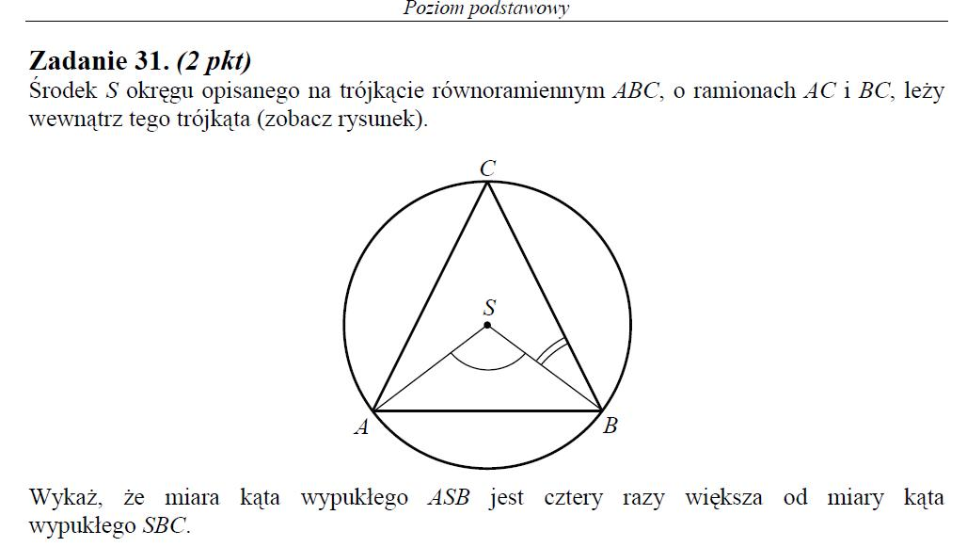
HOW HAS MATHEMATICS TEACHING BEEN IMPROVED IN POLAND?
Matura 2014
Prove that…

Slide 26
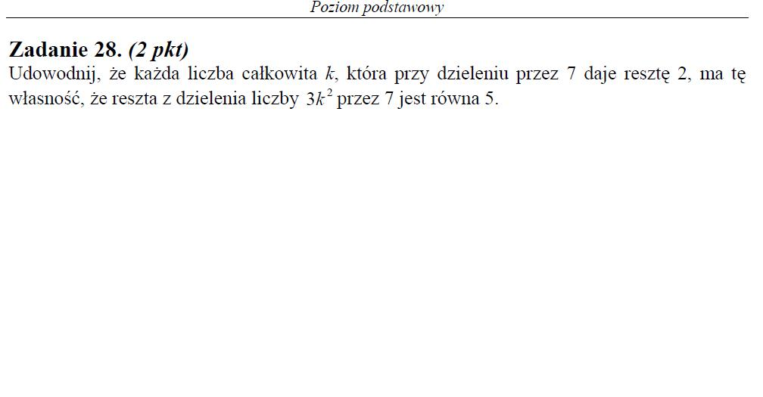
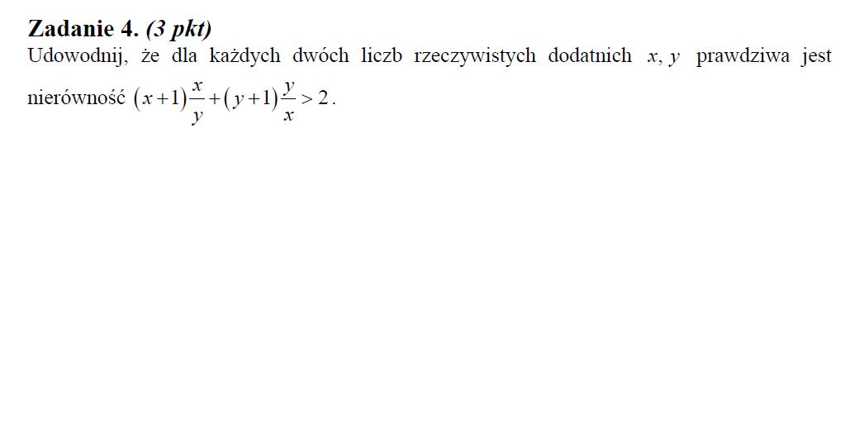
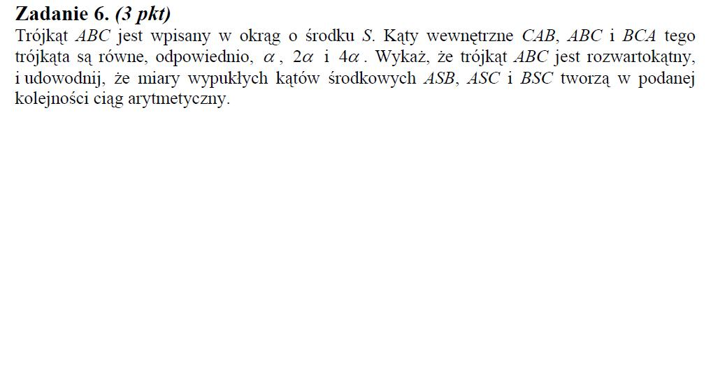
HOW HAS MATHEMATICS TEACHING BEEN IMPROVED IN POLAND?
Matura 2014
Prove that…
Prove that…
Prove that…

Slide 27
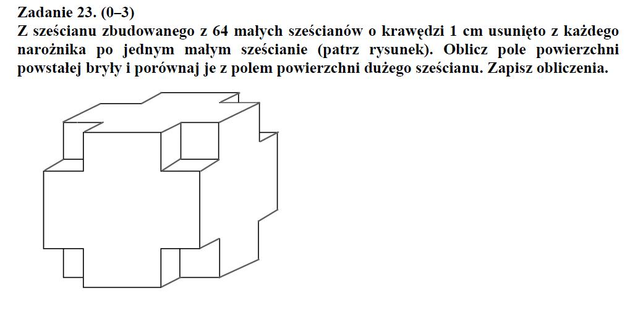
HOW HAS MATHEMATICS TEACHING BEEN IMPROVED IN POLAND?
Egzamin gimnazjalny 2014

Slide 28
HOW HAS MATHEMATICS TEACHING BEEN IMPROVED IN POLAND?
Egzamin gimnazjalny 2014
Internet: I calculated like crazy, while it was enough to think!

Slide 29
PISA – levels of math competences
HOW HAS MATHEMATICS TEACHING BEEN IMPROVED IN POLAND?
358
420
482
545
605
668
< 1
1
2
3
4
5
6
6,8%
5,0%
3,3%
2,3%

Slide 30
PISA – levels of math competences
HOW HAS MATHEMATICS TEACHING BEEN IMPROVED IN POLAND?
358
420
482
545
605
668
< 1
1
2
3
4
5
6
20,5%
16,7%
14,4%
10,4%

Slide 31
Students at level 1 or below in EU (math)
HOW HAS MATHEMATICS TEACHING BEEN IMPROVED IN POLAND?
2012
2009

Slide 32
HOW HAS MATHEMATICS TEACHING BEEN IMPROVED IN POLAND?
Students at levels 5 or 6 in EU (math)
16,7%
2012
2009
10,4%

Slide 33
Mathematical reasononing – the weakest point in 2003
HOW HAS MATHEMATICS TEACHING BEEN IMPROVED IN POLAND?

Slide 34
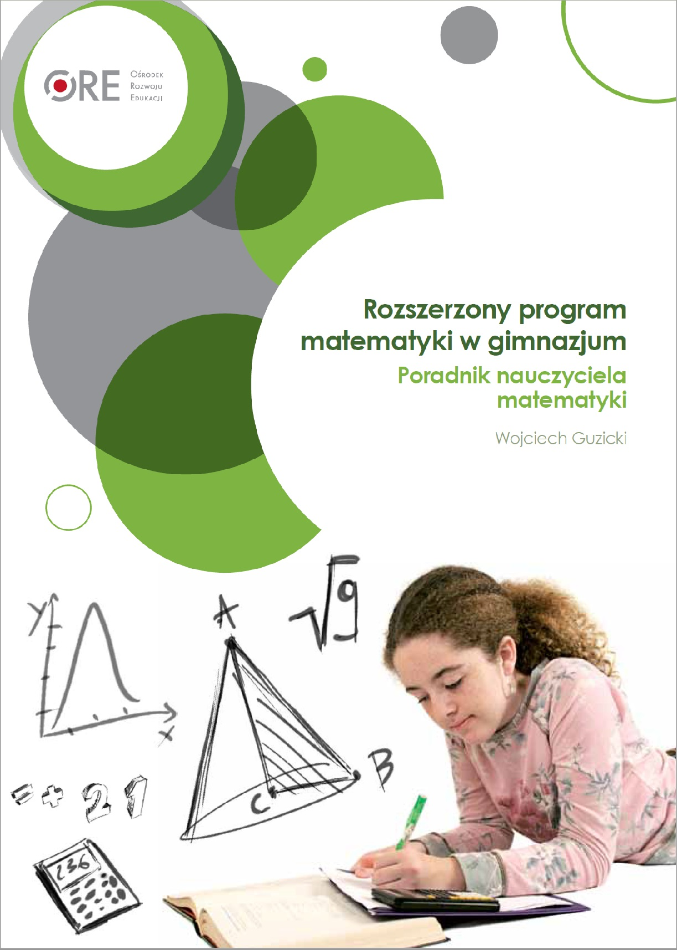
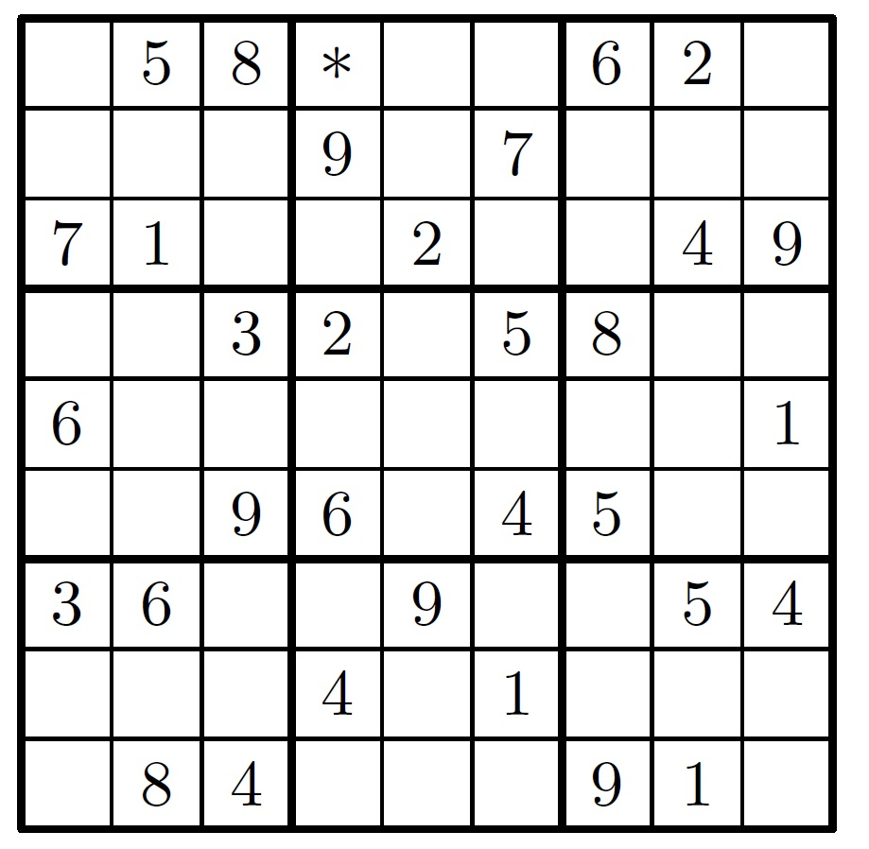
HOW HAS MATHEMATICS TEACHING BEEN IMPROVED IN POLAND?
How to teach mathematical reasoning?
Explain why you can start solving this Sudoku
by writing 1 in position *.

Slide 35
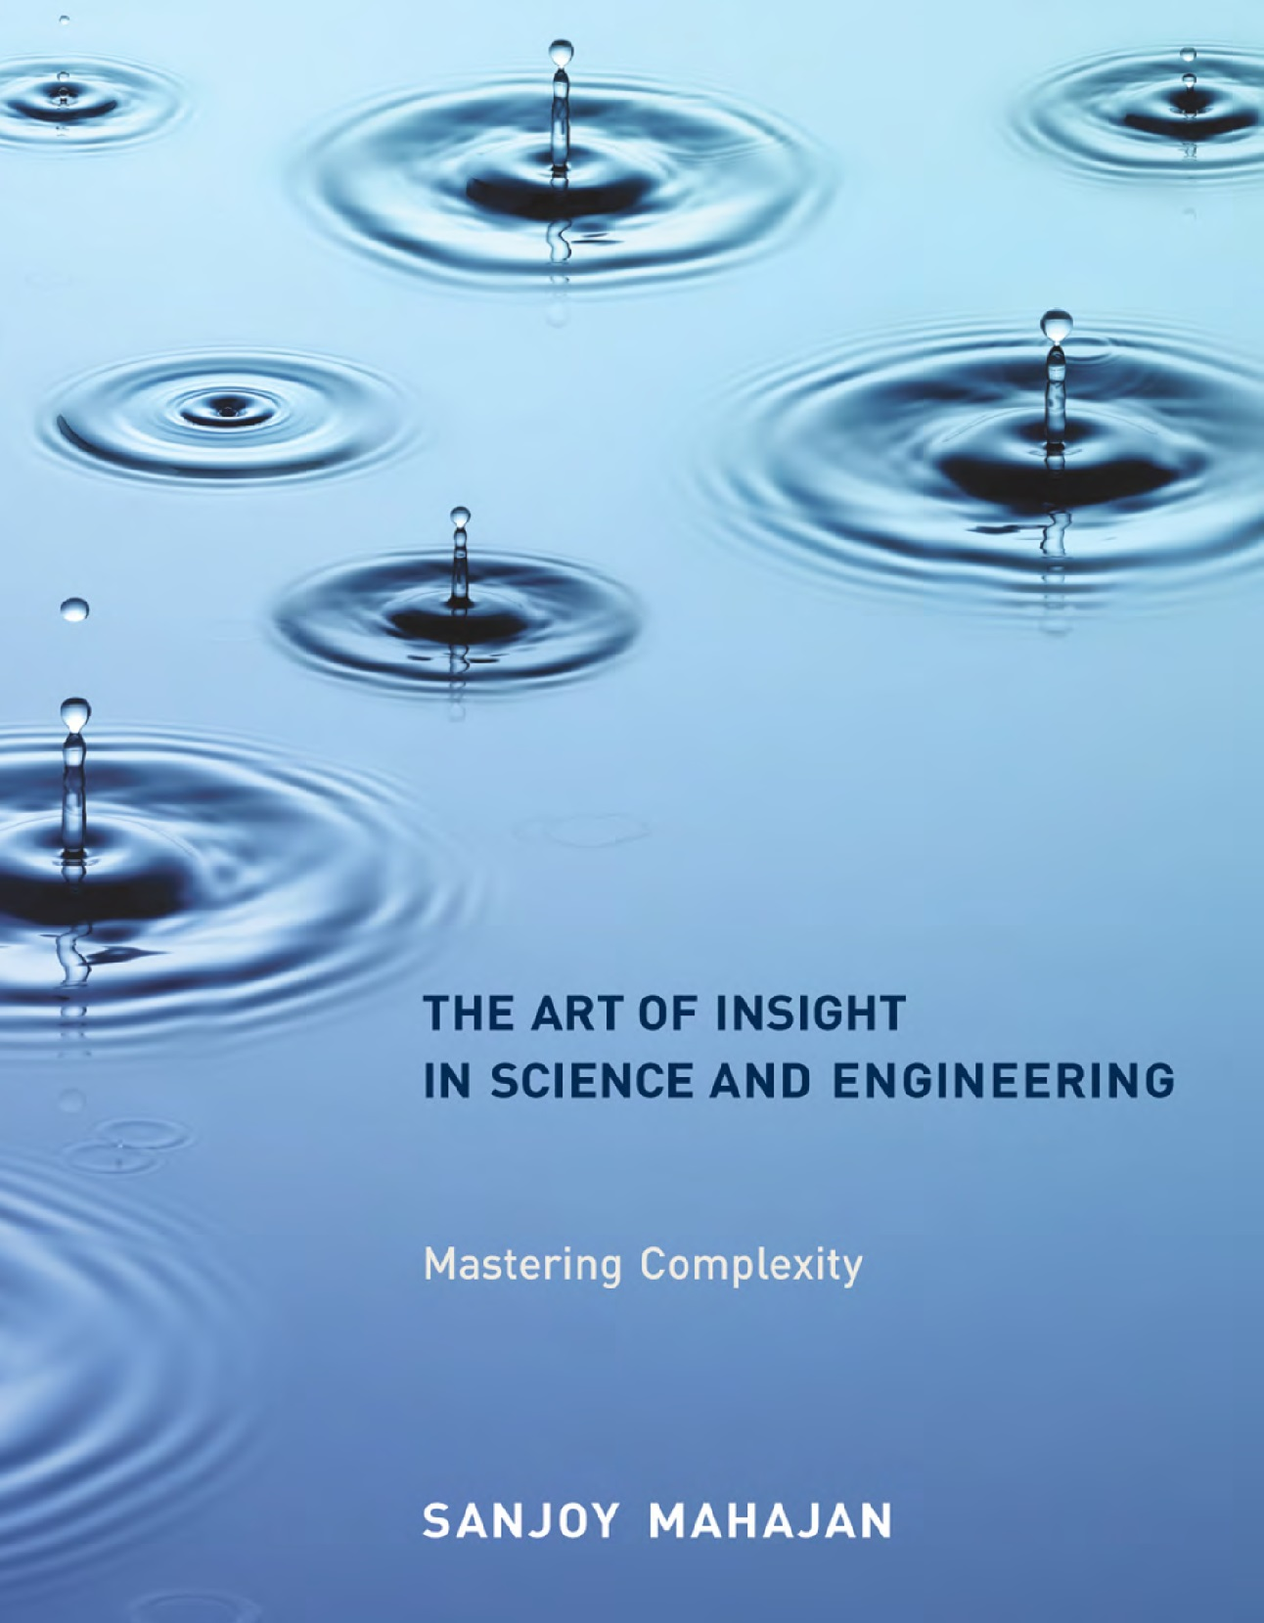

HOW HAS MATHEMATICS TEACHING BEEN IMPROVED IN POLAND?
How to teach mathematical reasoning?
What is, roughly, the volume of a dollar bill?

Slide 36
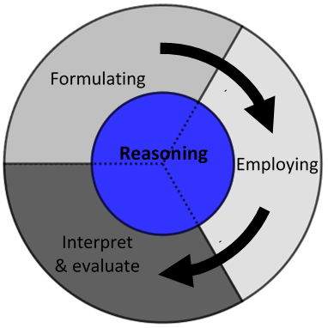
Development of the PISA 2021 Mathematics Framework
HOW HAS MATHEMATICS TEACHING BEEN IMPROVED IN POLAND?
Mathematical literacy is an individual’s capacity to reason mathematically and to formulate, employ, and interpret mathematics to solve problems in a variety of real-world contexts.
It includes concepts, procedures, facts and tools to describe, explain and predict phenomena. It assists individuals to know the role that mathematics plays in the world and to make the well-founded judgments and decisions needed by constructive, engaged and reflective 21st century citizens.

Slide 37
Development of the PISA 2021 Mathematics Framework
HOW HAS MATHEMATICS TEACHING BEEN IMPROVED IN POLAND?
Mathematical literacy is an individual’s capacity to reason mathematically and to formulate, employ, and interpret mathematics to solve problems in a variety of real-world contexts.
It includes concepts, procedures, facts and tools to describe, explain and predict phenomena. It assists individuals to know the role that mathematics plays in the world and to make the well-founded judgments and decisions needed by constructive, engaged and reflective 21st century citizens.
25% of items

Slide 38
Development of the PISA 2021 Mathematics Framework
HOW HAS MATHEMATICS TEACHING BEEN IMPROVED IN POLAND?
Mathematical literacy is an individual’s capacity to reason mathematically and to formulate, employ, and interpret mathematics to solve problems in a variety of real-world contexts.
It includes concepts, procedures, facts and tools to describe, explain and predict phenomena. It assists individuals to know the role that mathematics plays in the world and to make the well-founded judgments and decisions needed by constructive, engaged and reflective 21st century citizens.
25% of items
A new subscale reporting the ability to reason mathematically

Slide 39
Summary
HOW HAS MATHEMATICS TEACHING BEEN IMPROVED IN POLAND?
Mathematics is much more than a toolbox.

Slide 40
Summary
HOW HAS MATHEMATICS TEACHING BEEN IMPROVED IN POLAND?
Mathematics is much more than a toolbox.
Concept oriented teaching does not fit the present challenges.
Teach the method of mathematics.

Slide 41
Summary
HOW HAS MATHEMATICS TEACHING BEEN IMPROVED IN POLAND?
Mathematics is much more than a toolbox.
Concept oriented teaching does not fit the present challenges.
Teach the method of mathematics.
As it has always been, mathematics will then be the best answer
to problems we face today.

Slide 42
Summary
HOW HAS MATHEMATICS TEACHING BEEN IMPROVED IN POLAND?
Mathematics is much more than a toolbox.
Concept oriented teaching does not fit the present challenges.
Teach the method of mathematics.
As it has always been, mathematics will then be the best answer
to problems we face today.
It is so, because mathematics is one of the best parts
of the cultural heritage of humanity.

Slide 43
Summary
HOW HAS MATHEMATICS TEACHING BEEN IMPROVED IN POLAND?
Mathematics is much more than a toolbox.
Concept oriented teaching does not fit the present challenges.
Teach the method of mathematics.
As it has always been, mathematics will then be the best answer
to problems we face today.
It is so, because mathematics is one of the best parts
of the cultural heritage of humanity.
Thank you!

Slide 44
HOW HAS MATHEMATICS TEACHING BEEN IMPROVED IN POLAND?

