Slide 1

Can working memory and executive control be trained –
Potential implications for math learning
Torkel Klingberg
Dept. Neuroscience
Karolinska Institute, Stockholm, Sweden

Slide 2
Science of Learning of Math
Cognitive abilities correlate with math
performance, learning and development
IQ / non-verbal reasoning
  (Geary, 2011; Kyttälä and Lehto 2008)
Spatial abilities / 2-D mental rotation
  (Casey et al. 1995; Gundersson, 2012; Viarouge et al. 2014; Mix and Cheng 2012)
Working memory
  (Gathercole et al. 2004; Geary, 2007; Raghubar et al. 2010; Dumontheil and Klingberg, 2012)
Shared neural substrates (e.g. math – WM)
(Knops et al. 2009; Rotzer et al. 2009; Schel and Klingberg, 2017)

Slide 3
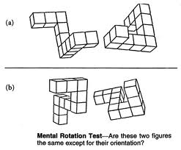
Training on Spatial abilities is encouraged by educators
Ontario Ministry of Education, Paying Attention to Spatial Reasoning, K-12 Support Document for Paying Attention to Mathematics Education, 2014.
NCTM, Learning to think spatially: GIS as a support system in the K-12 curriculum, The National Academies Press, Washington, DC, 2005.
Spatial skills can be improved
D.H. Uttal, N.G. Meadow, E. Tipton, L.L. Hand, A.R. Alden, C. Warren, N.S. Newcombe, The malleability of spatial skills: a meta-analysis of training studies, Psychol. Bull. 139 (2013) 352–402.

Slide 4
Spatial training and mathematics
Author | Method | Participants | N | Effect size (S,M,L)
Cheng & Mix, 2014 | 1 x 40 min rotation vs Literary training | TD , age 7.1 | 58 | eta² = 0.14 * (M)
Hawes et al. 2015 | 18 x 15 min rotation vs literary training | TD, age 7.2 | 61 | eta² = 0.02 ns
Lowrie et al. 2017 | 20 h classroom activities vs. passive control | TD, age 11.2 | 186 | d = 0.23 * (S)
Hawes et al. 2017 | 32 w spatial training activities vs. active control | TD, age 6.2 | 67 | eta² = 0.10 * (M)
Rodan et al. 2019 | 3 x 30 min sessions vs. passive control | TD, age 7 | 92 | eta² = 0.01 ns
Notes:
Mention explanation

Slide 5
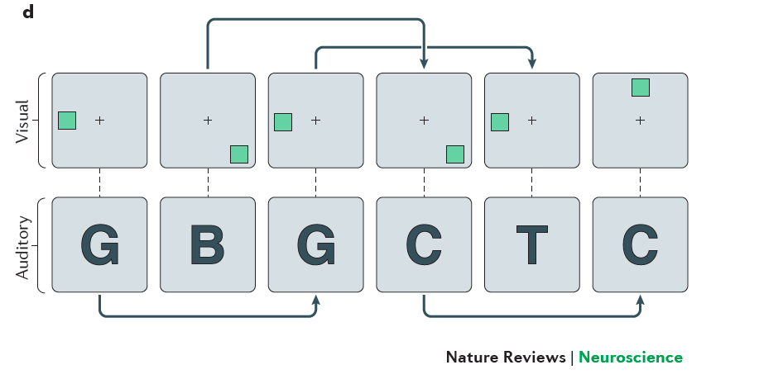
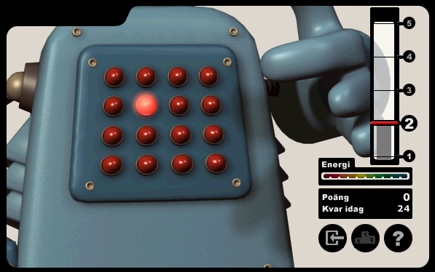
Working memory training
≈ 500 articles
Klingberg et al. 2002, 2005 Cogmed. Visuo-spatial WM
Jaeggi et al. 2008 Dual n-back
Dahlin et al. 2008, Li et al. 2008 N-back lists
Chein and Morrison, 2010 Complex WM tasks

Slide 6
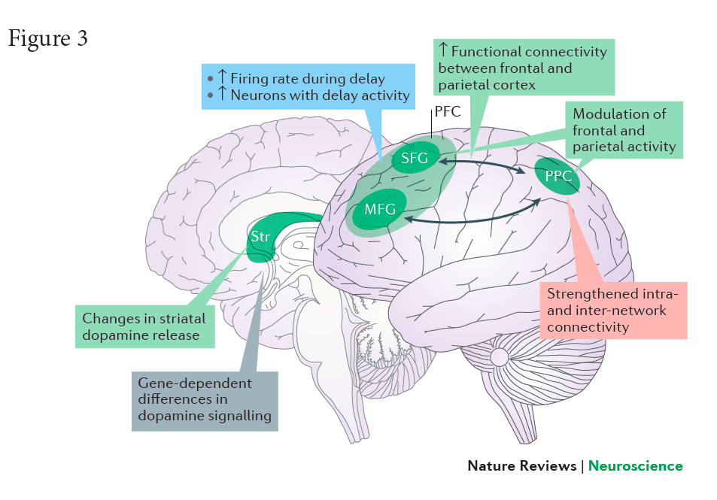
What we know
Working memory can be improved
(e.g. remembering instructions)
Basic neuroscience of cognitive plasticity
5 RCT + 1 meta-analysis of Cogmed WM training shows improvement in attention (ADHD symptoms) in everyday life

Slide 7
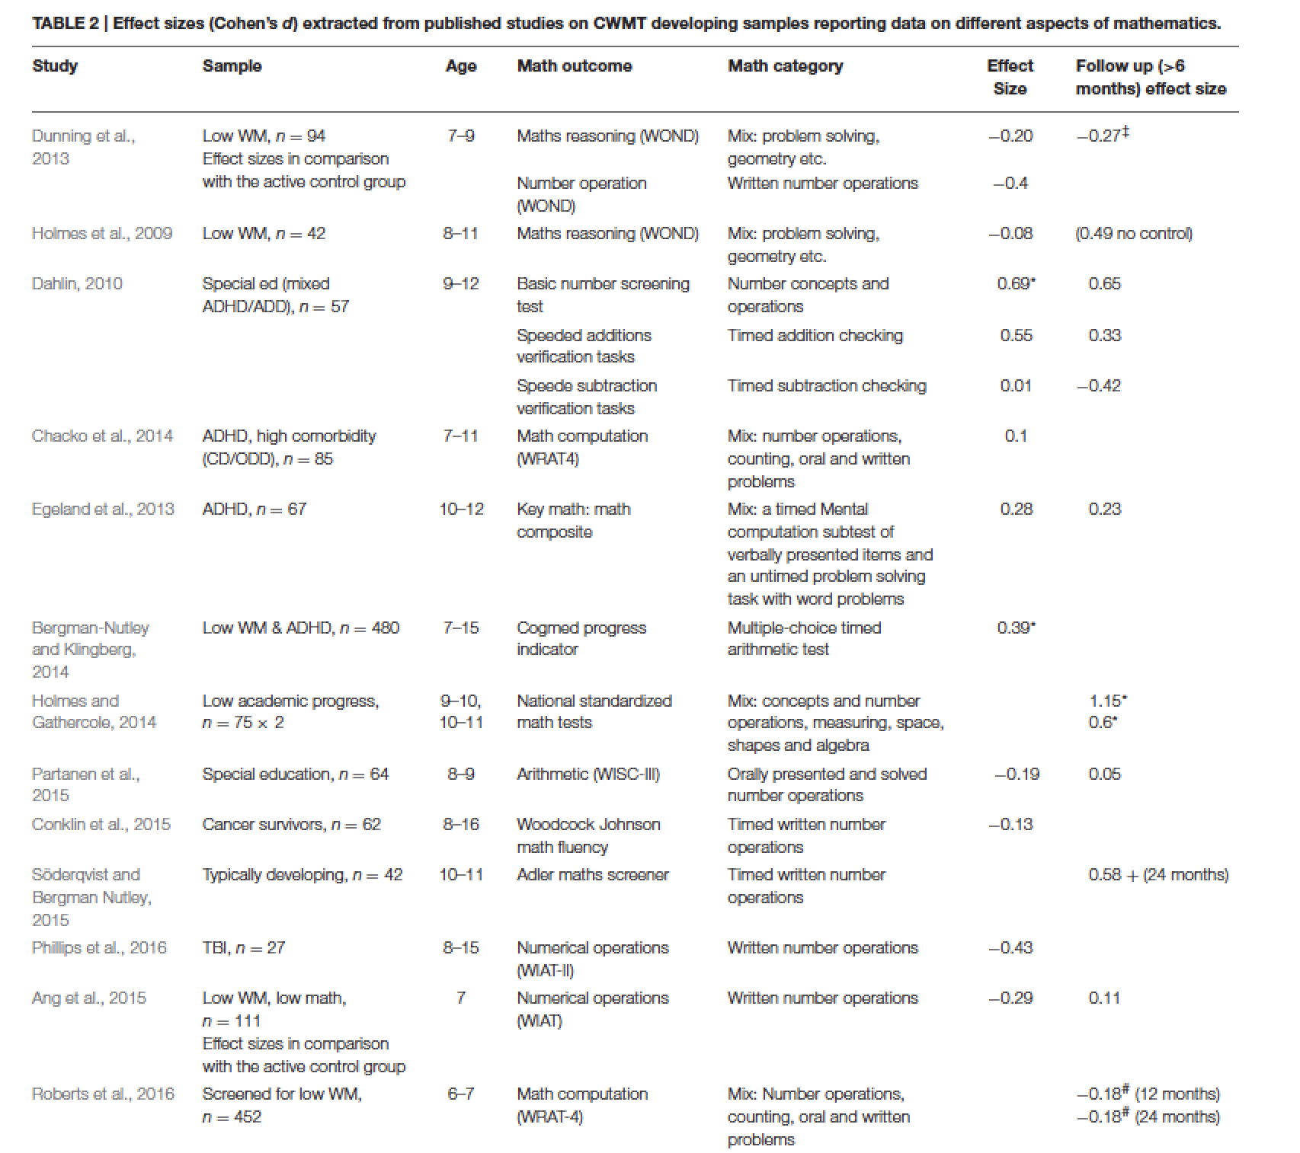
Effect of Cogmed WM training on mathematics (Bergman-Nutely, Söderqvist 2017)
ES
< -0.25
> 0.25
*
p < 0.05
*
Potential reasons for differences
Power and p-values
Differences in outcome measures?
Differences in population characteristics?
*
*
*

Slide 8
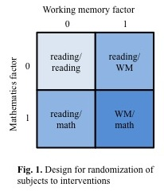

Study 1: WM and Maths training
Nemmi et al. 2016 Dev Cogn Neurosci
Federico Nemmi
Participants
Age: 6-year olds N = 308
Outcome
Composite math measure (add, sub, verbal)
Daily training: 30 min/day
Duration: 8 weeks
Average training 38.1 (3.4) days
About 19 h training

Slide 9
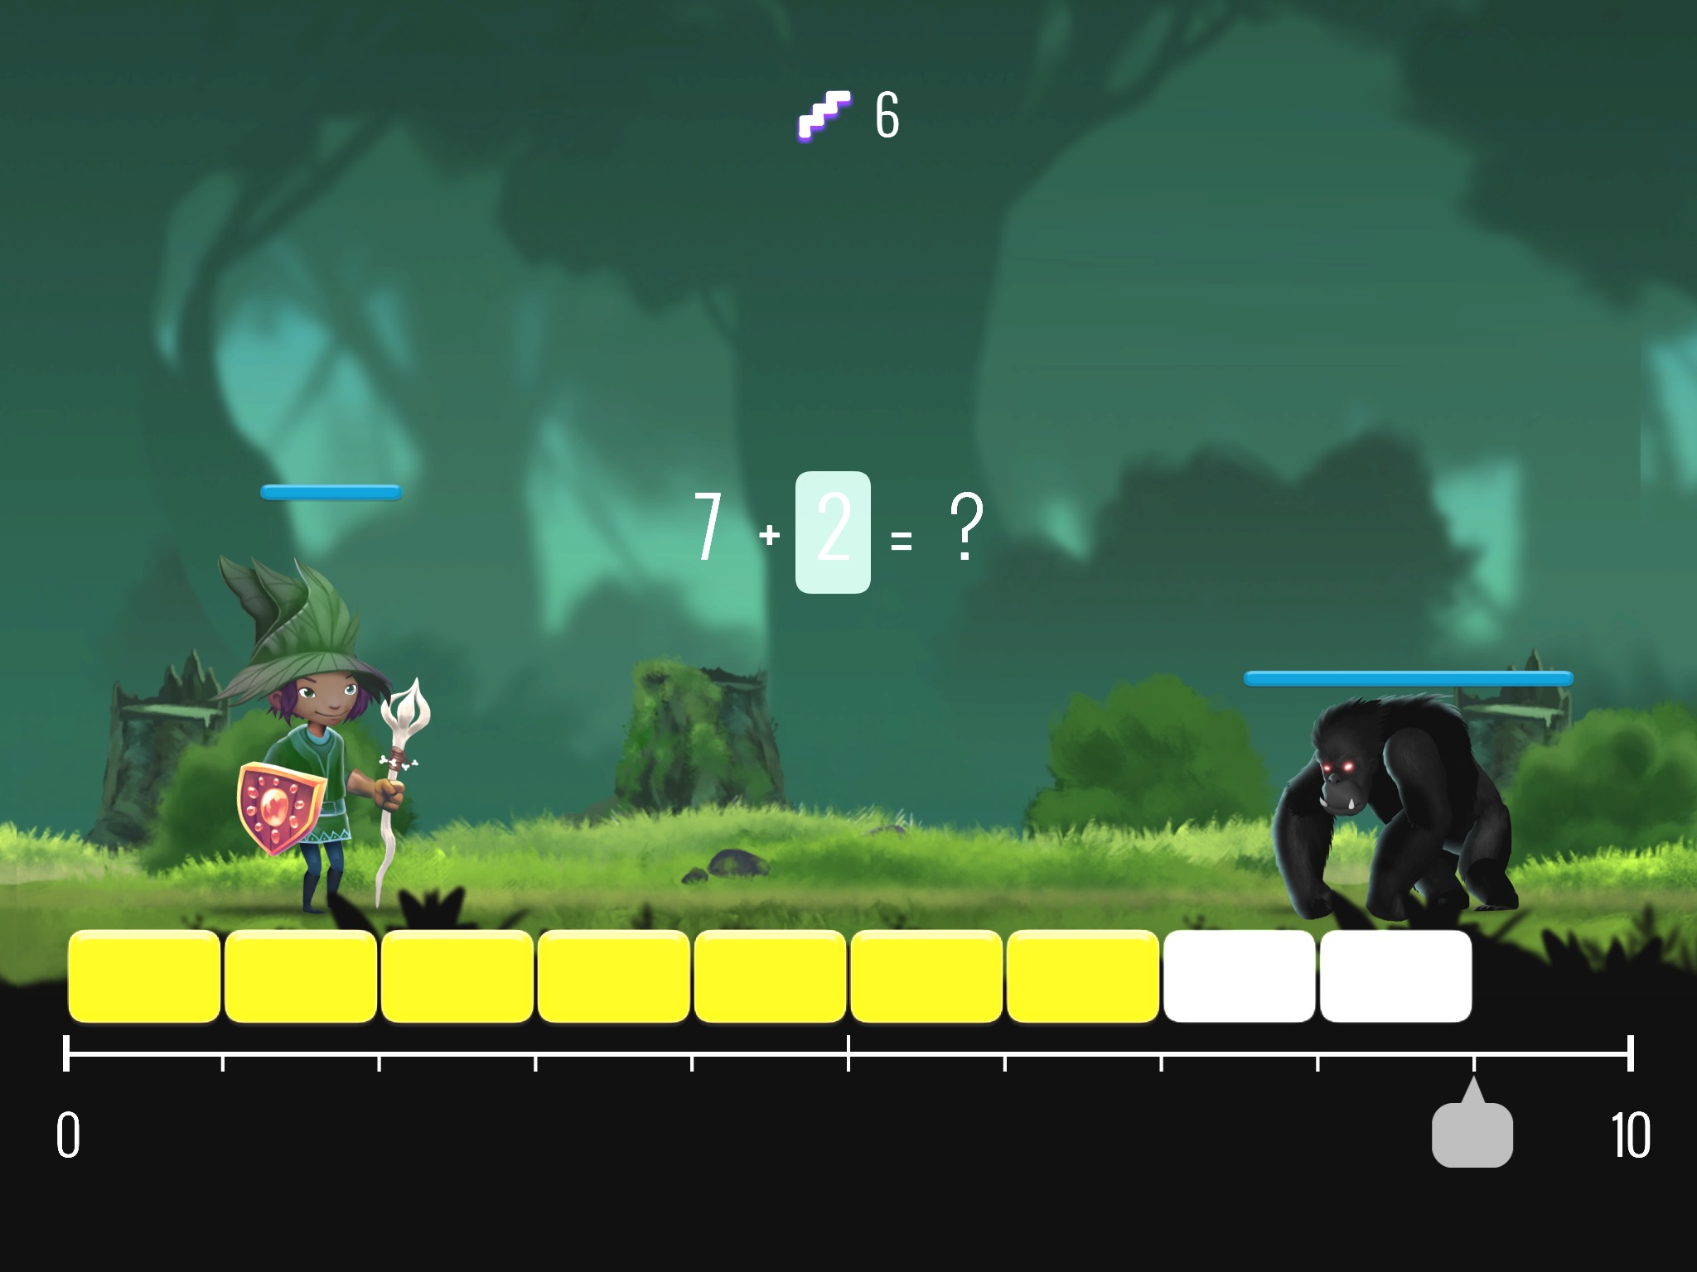
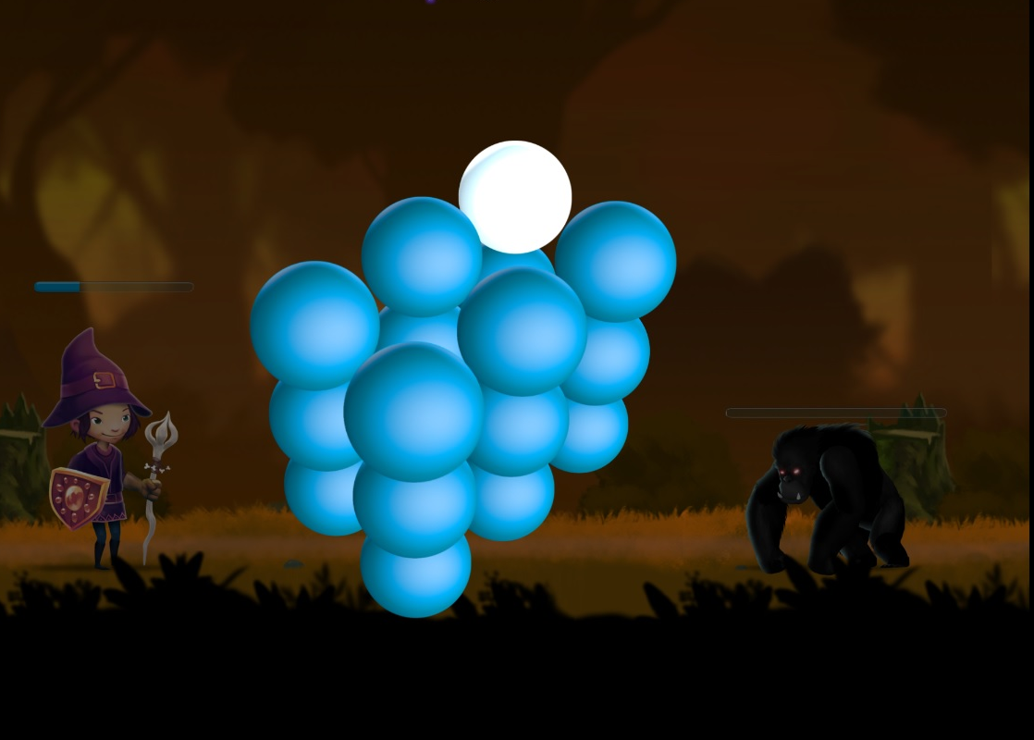
Training tasks
  Numberline tasks
  (addition, subtraction, fractions, decimals
  From CognitionMatters.org)
  Visuo-spatial WM
  (6 different tasks)

Slide 10
Pre- and post measures
Working memory
Span-board forward
Span-board backwards
Grid task (visuo-spatial WM)
Mathematics
WISC verbal arithmetics
Addition (without numberline)
Subtraction (without numberline)
Magnetic resonance imaging (n=58)
functional MRI during WM performance
structural MRI
Standardized and averaged
to one composite WM measure
Standardized and averaged
to one composite Math measure

Slide 11
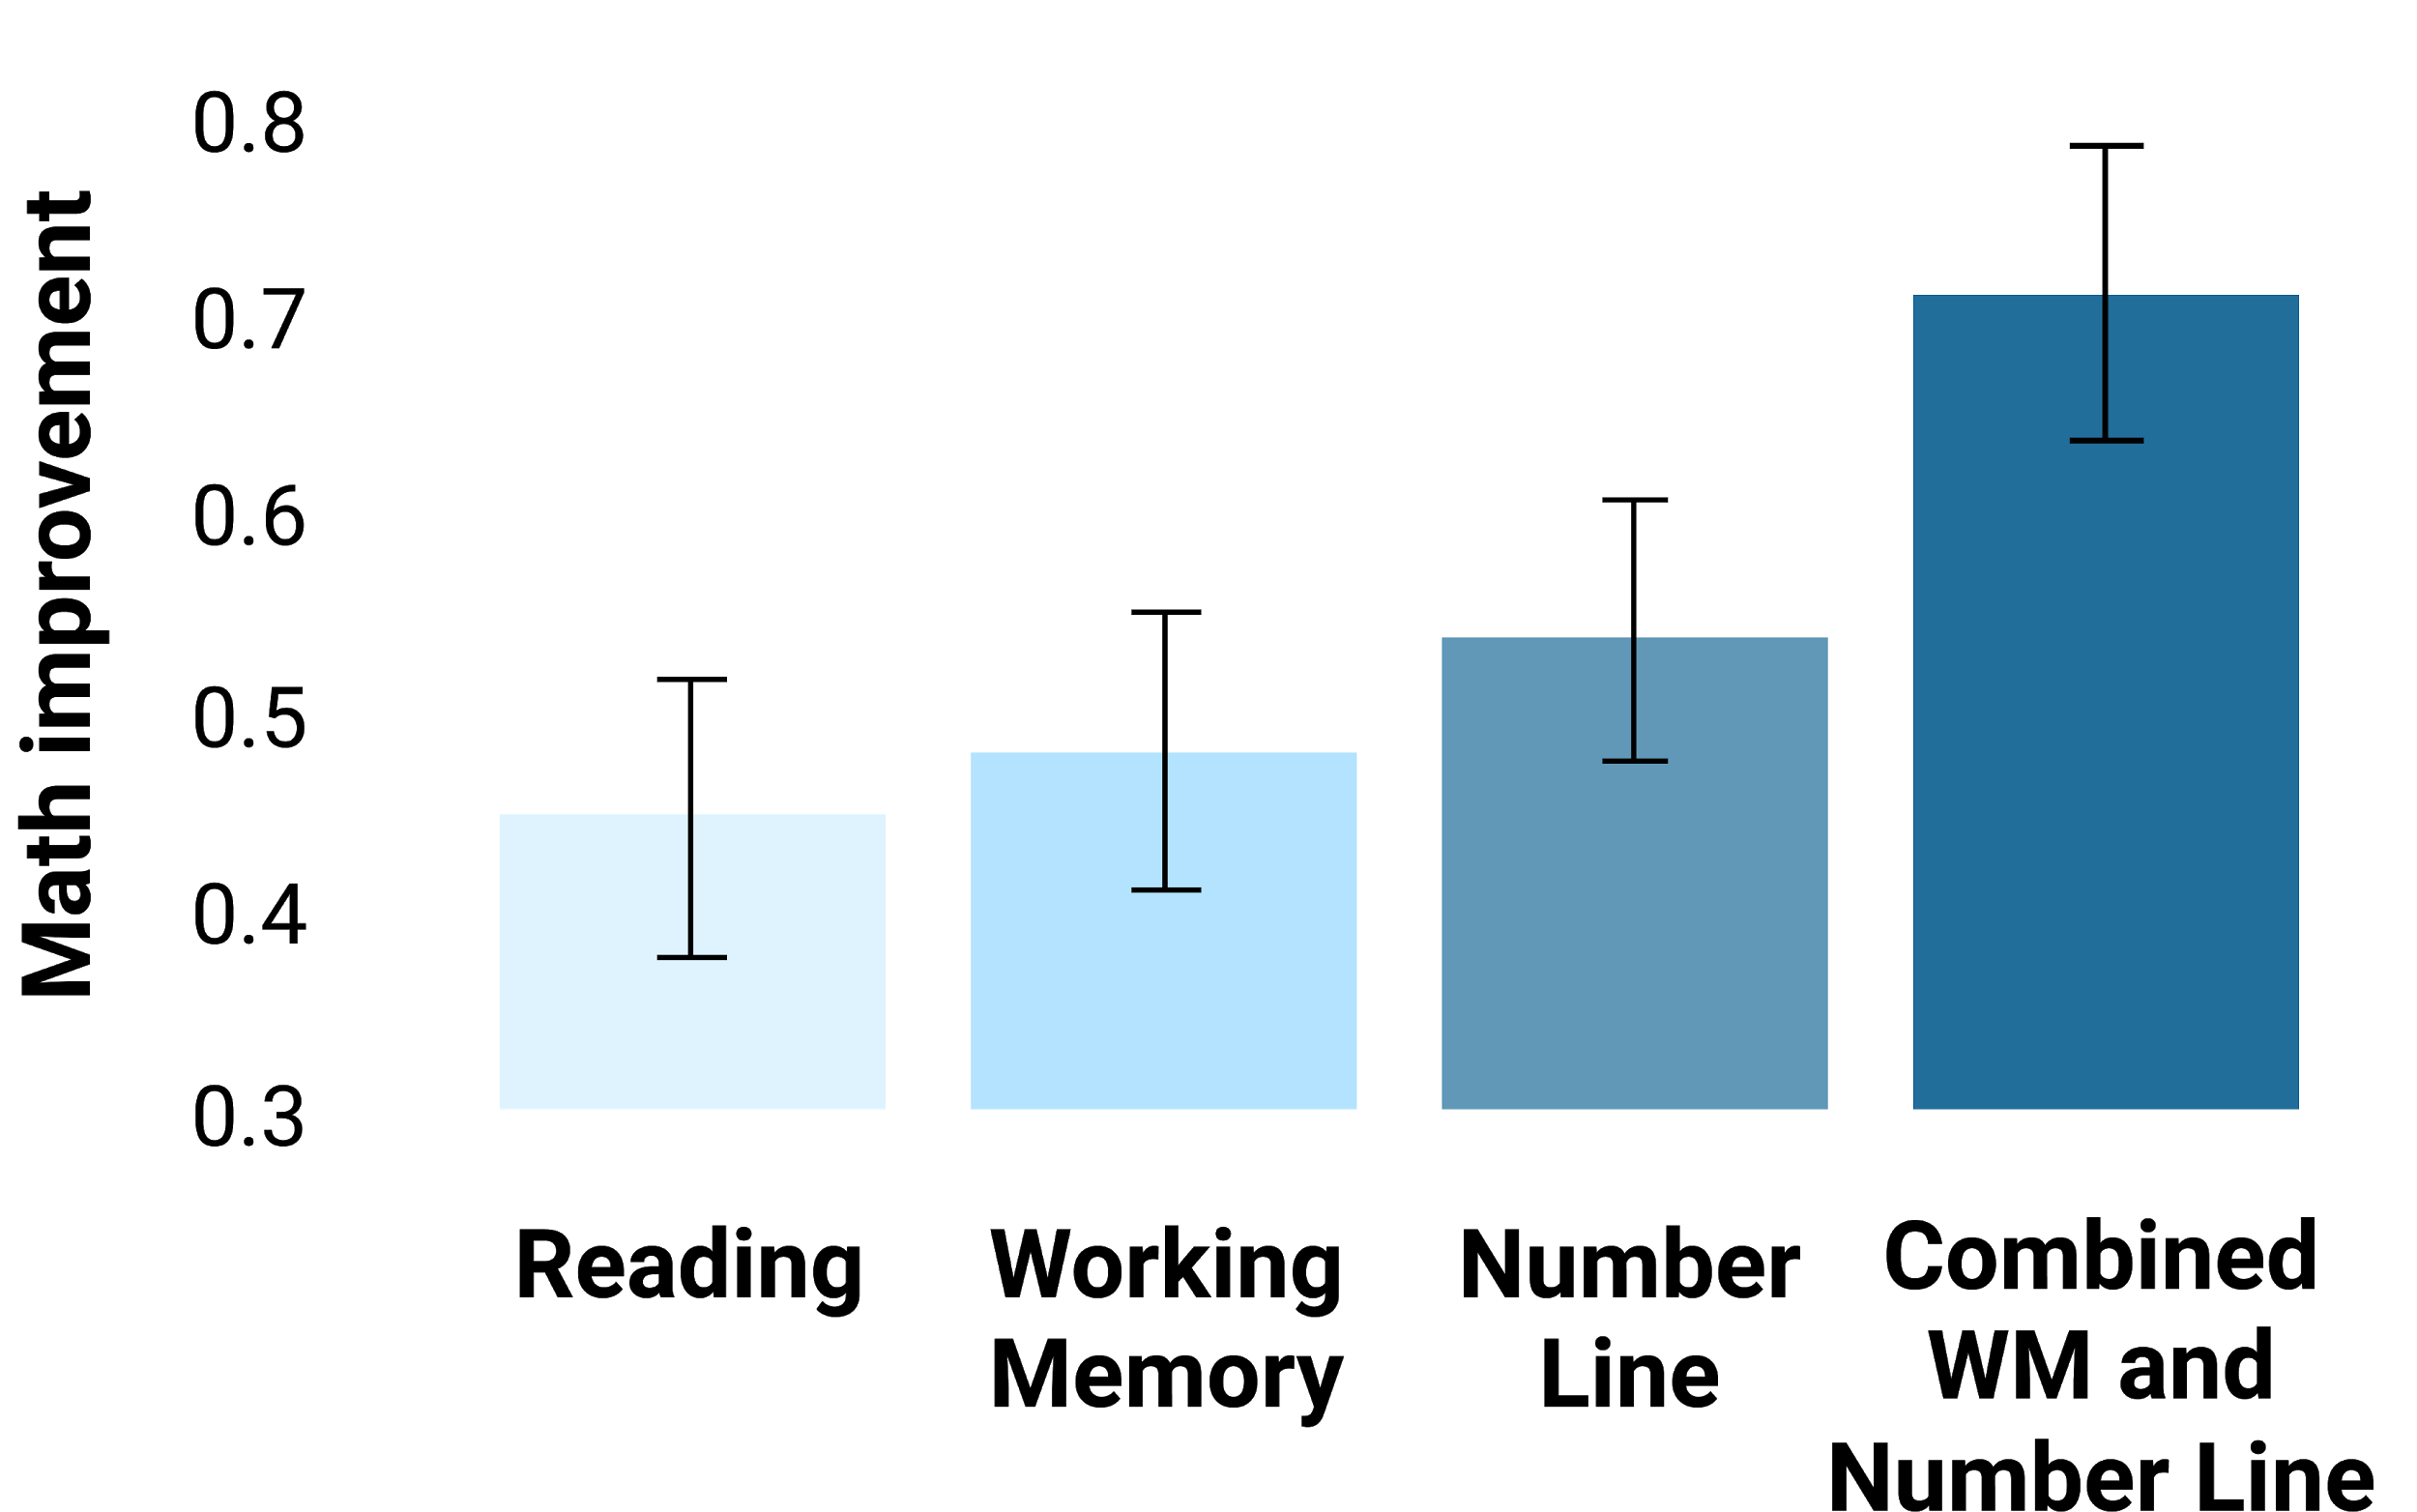
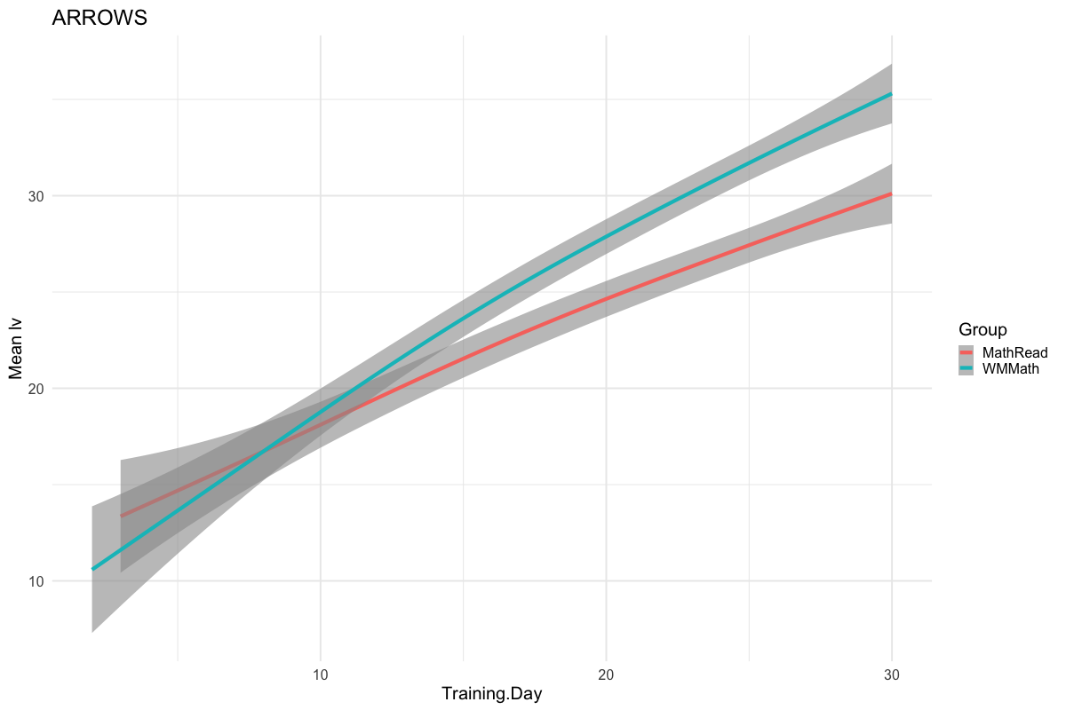
Math improvement
Nemmi et al. 2016 Dev. Cogn Neurosci.
Math+WM
Math learning progress
Math+reading
Read
+
Read
Read
+
WM
Math
+
Read
Math
+
WM
0
10
20
30
Training days
> .7 SD improvement ≈ 1 year math learning in school
Notes:
Same interface and functionality, but different modules: reading, etc

Slide 12
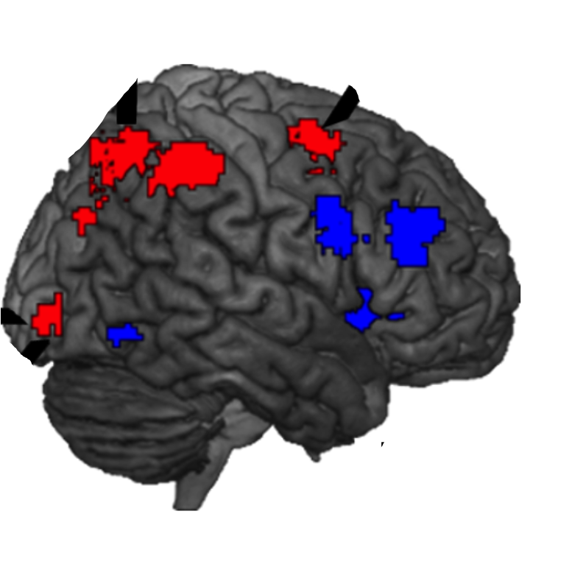
Baseline performance predicts benefit of cognitive training
Notes:
0 represents the mean improvement

Slide 13
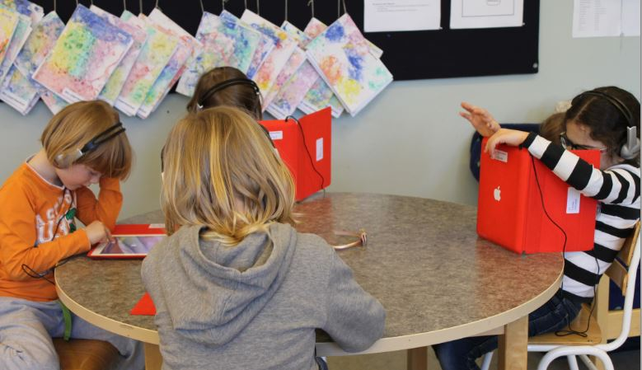
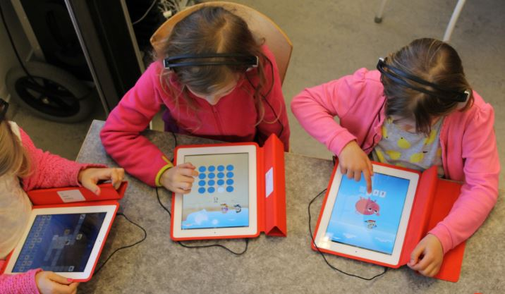
Usage of Vektor
Freely available
> 350.000 users
≈ 30% of 6-year-old children in Swedish schools use it
98 % of teachers would recommend other schools to use Vektor

Slide 14
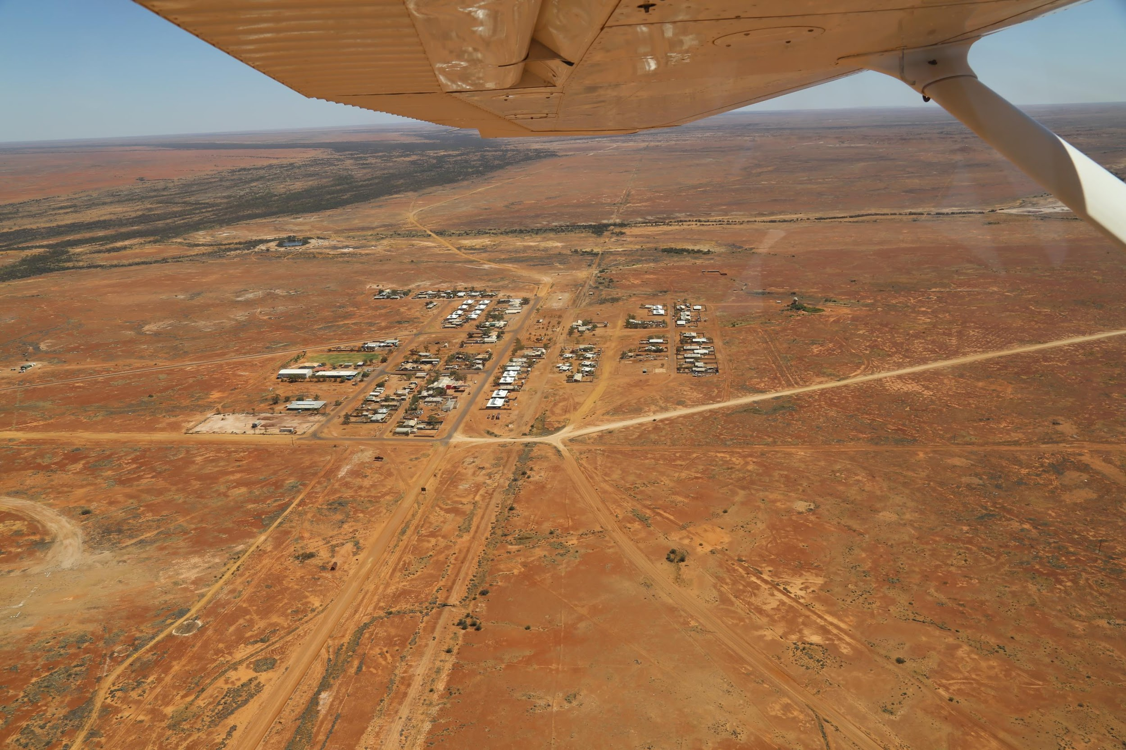
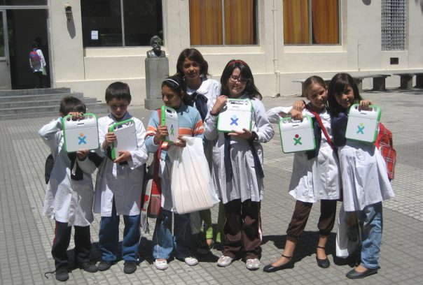
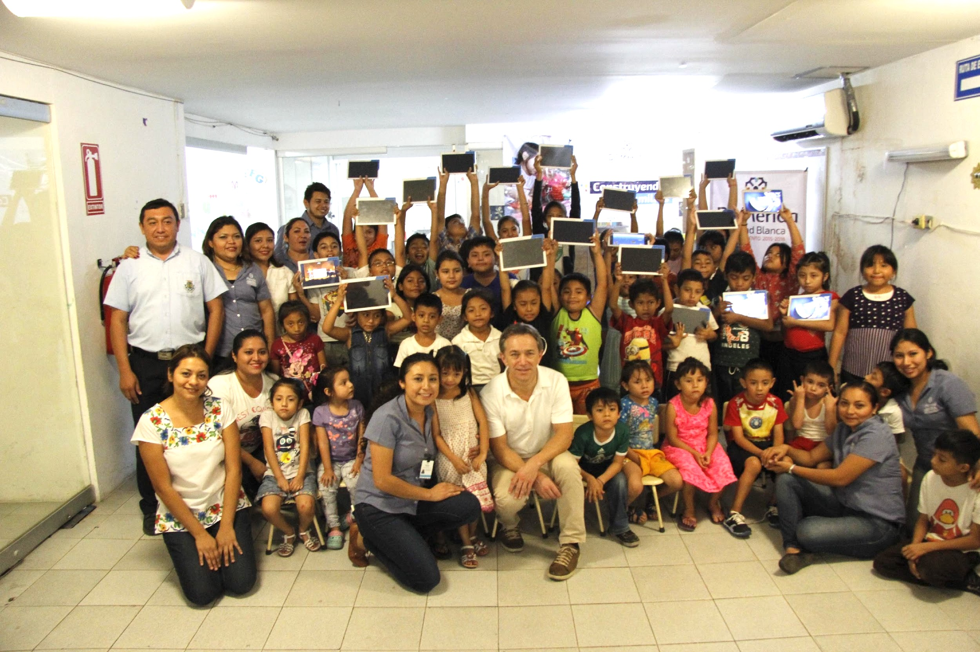
Global
Projects
Vektor is language free
Mexico, India, Argentina

Slide 15
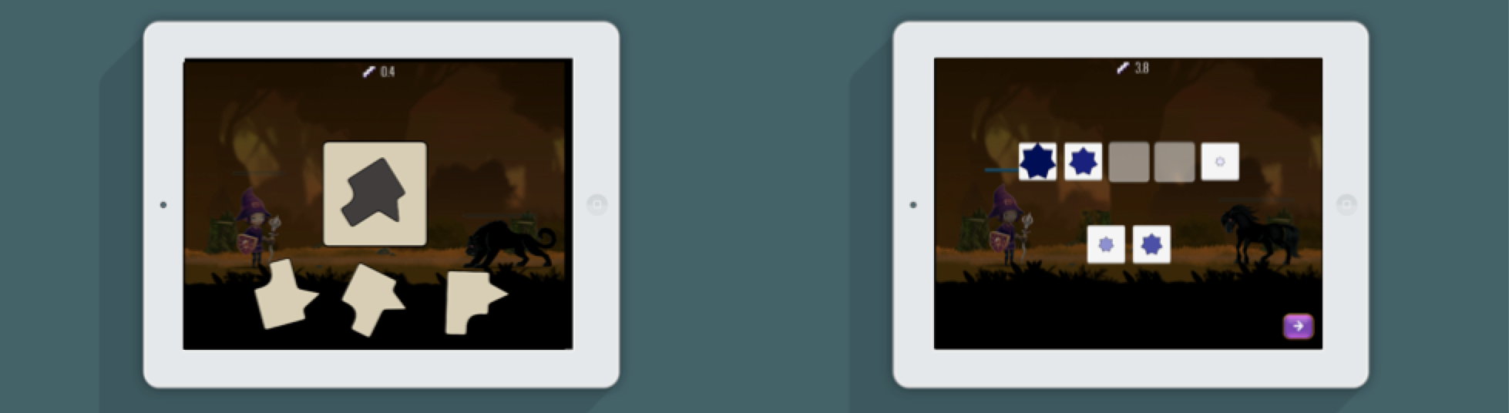
Next steps:
Rotation training
Analysis of databases: individual-task-outcome
(n ≈ 350.000)
Introduce new tasks, mutate training
Reasoning training
Notes:
Currently, we are also evaluating the benefit of rotation training and reasoning.
Experimenting is something we couldn’t do with Cogmed.
Fast, large studies. Gets around the problem with small sample sizes

Slide 16


Study 2: Cognitive and Math training
Nicholas Judd
Participants
3599 children aged 5.5-7.5 years. Fall 17-spring 18
Using Vektor software in schools, minimum 26 days.
Outcome measures
Built in tests of addition, subtraction, numerosity, numb. comp.
Progress in trained math tests
Notes:
Extend by using the the same training as before, and explore spatial and reasoning training

Slide 17
Training tasks
  Numberline tasks
  (addition, subtraction, fractions, decimals)
  Visuo-spatial WM
  (6 different tasks)

Slide 18
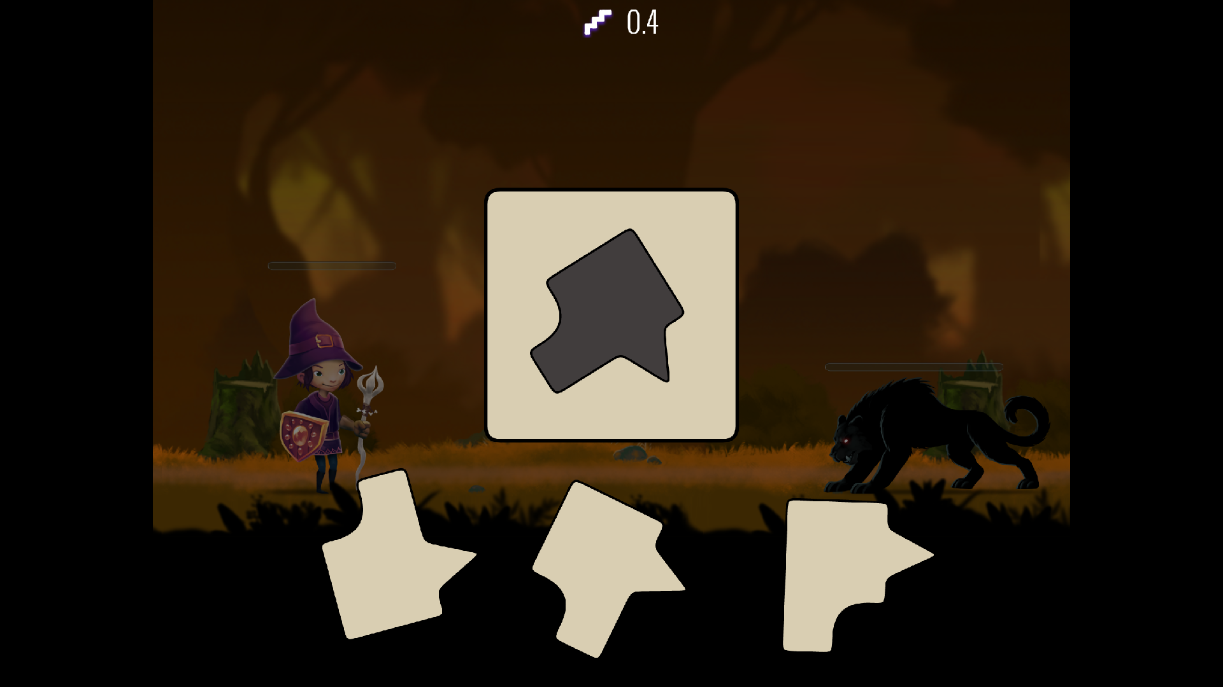
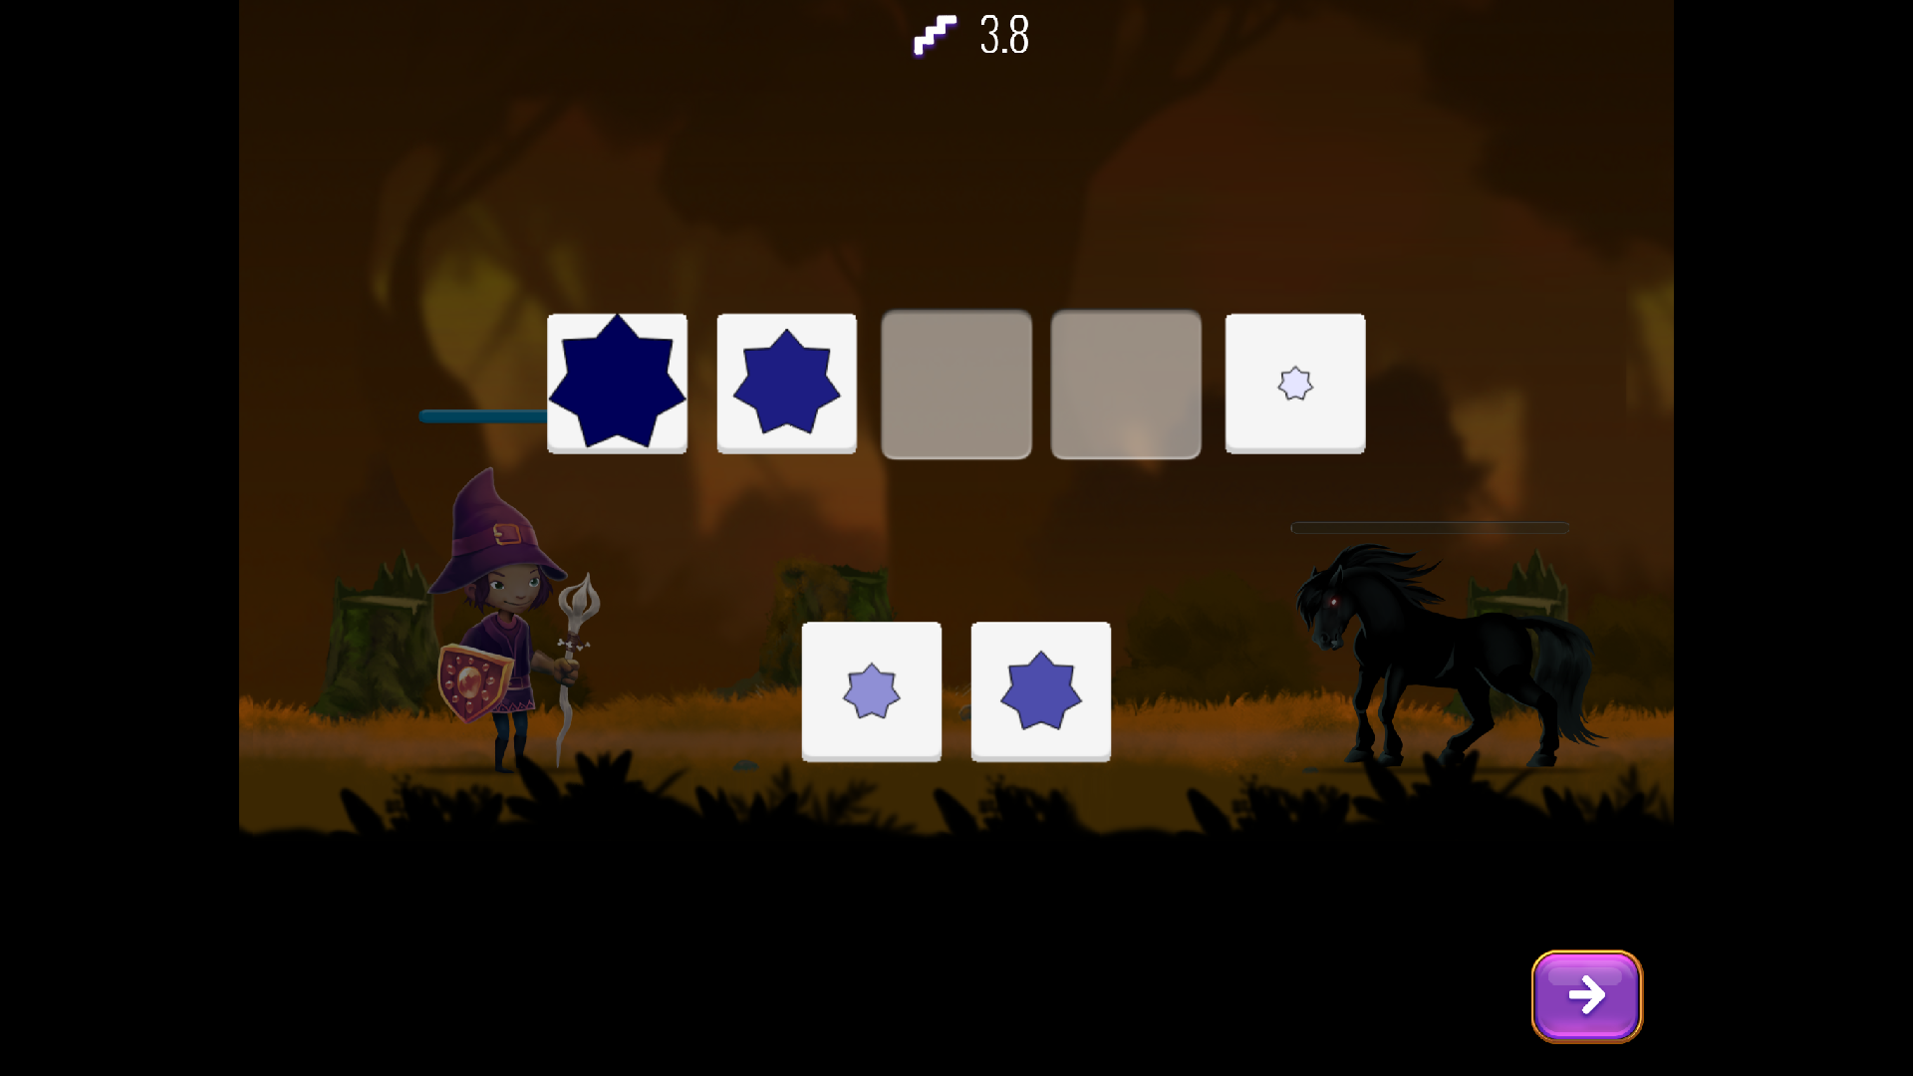
Training tasks
Rotation training
Reasoning training
“sequential order”
from Bergman-Nutley et al. 2011

Slide 19
1st week
= baseline
M
WM
Default
= Nemmi 2016
M
WM
R
M
WM
R
Rotation
15% of time
M
WM
S
Sequential order
15% of time
Is cognitive performance correlated to mathematics?
Is cognitive performance improved by training?
Is improvement in cognitive performance correlated with improvement in math?

Slide 20
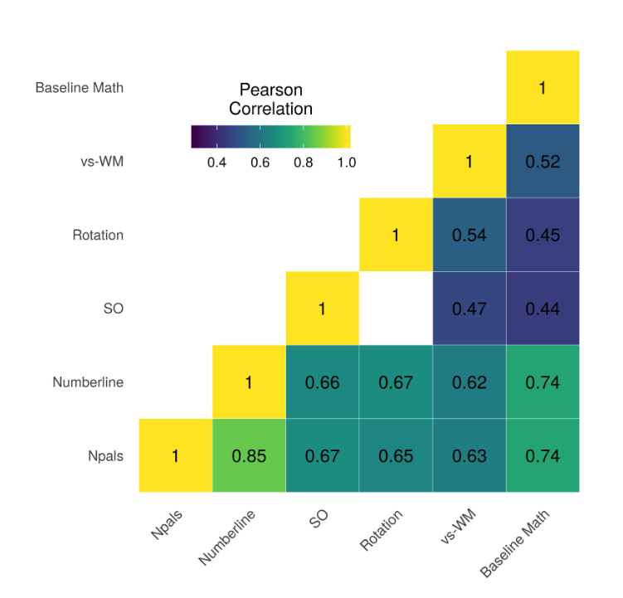
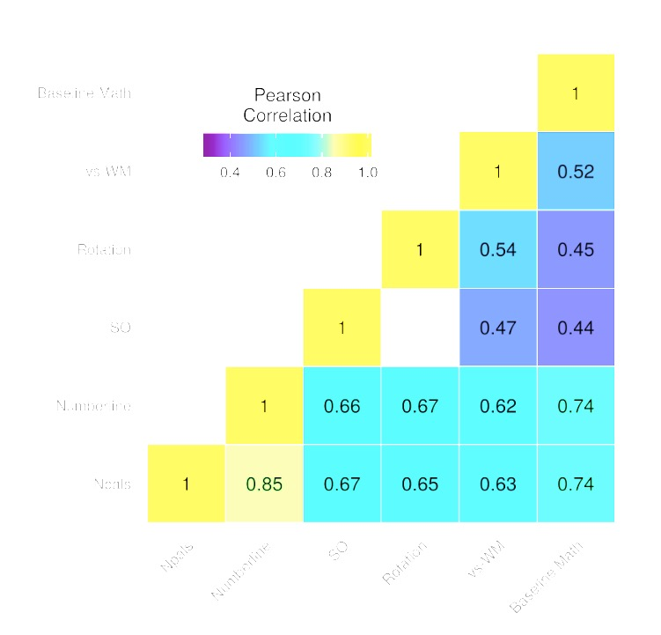
Baseline correlations
n=3599

Slide 21
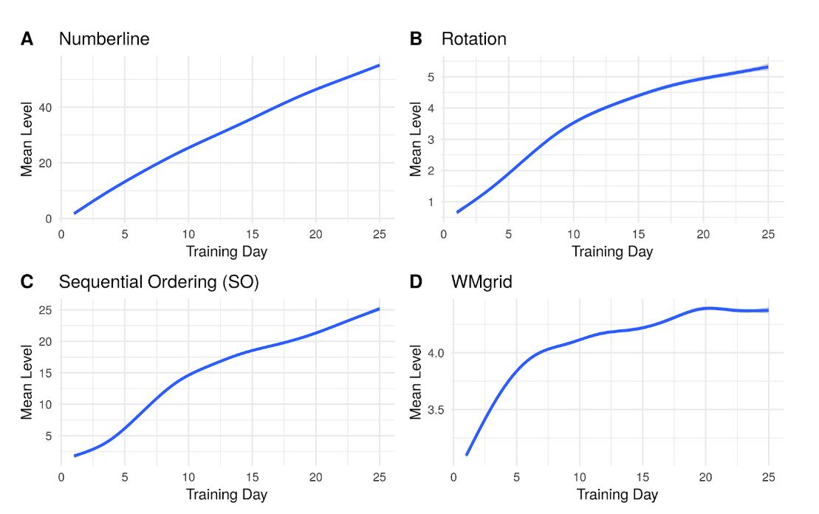
Improvement during training
n=3599
n=1024
n=1013
n=1562

Slide 22
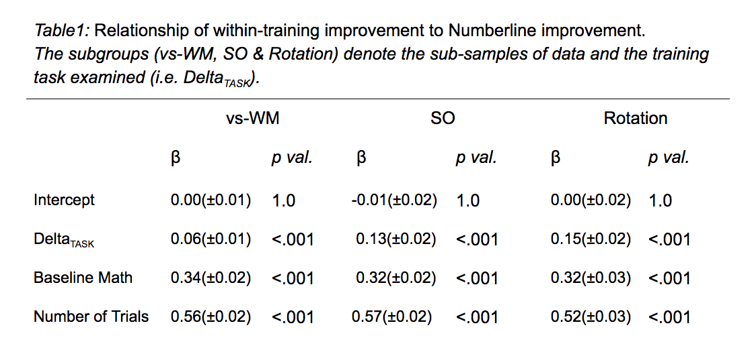
Cognitive improvement correlates with math improvement
Dependent measure: math factor week 5 (addition, subtraction, numerosity, numb comp)

Slide 23
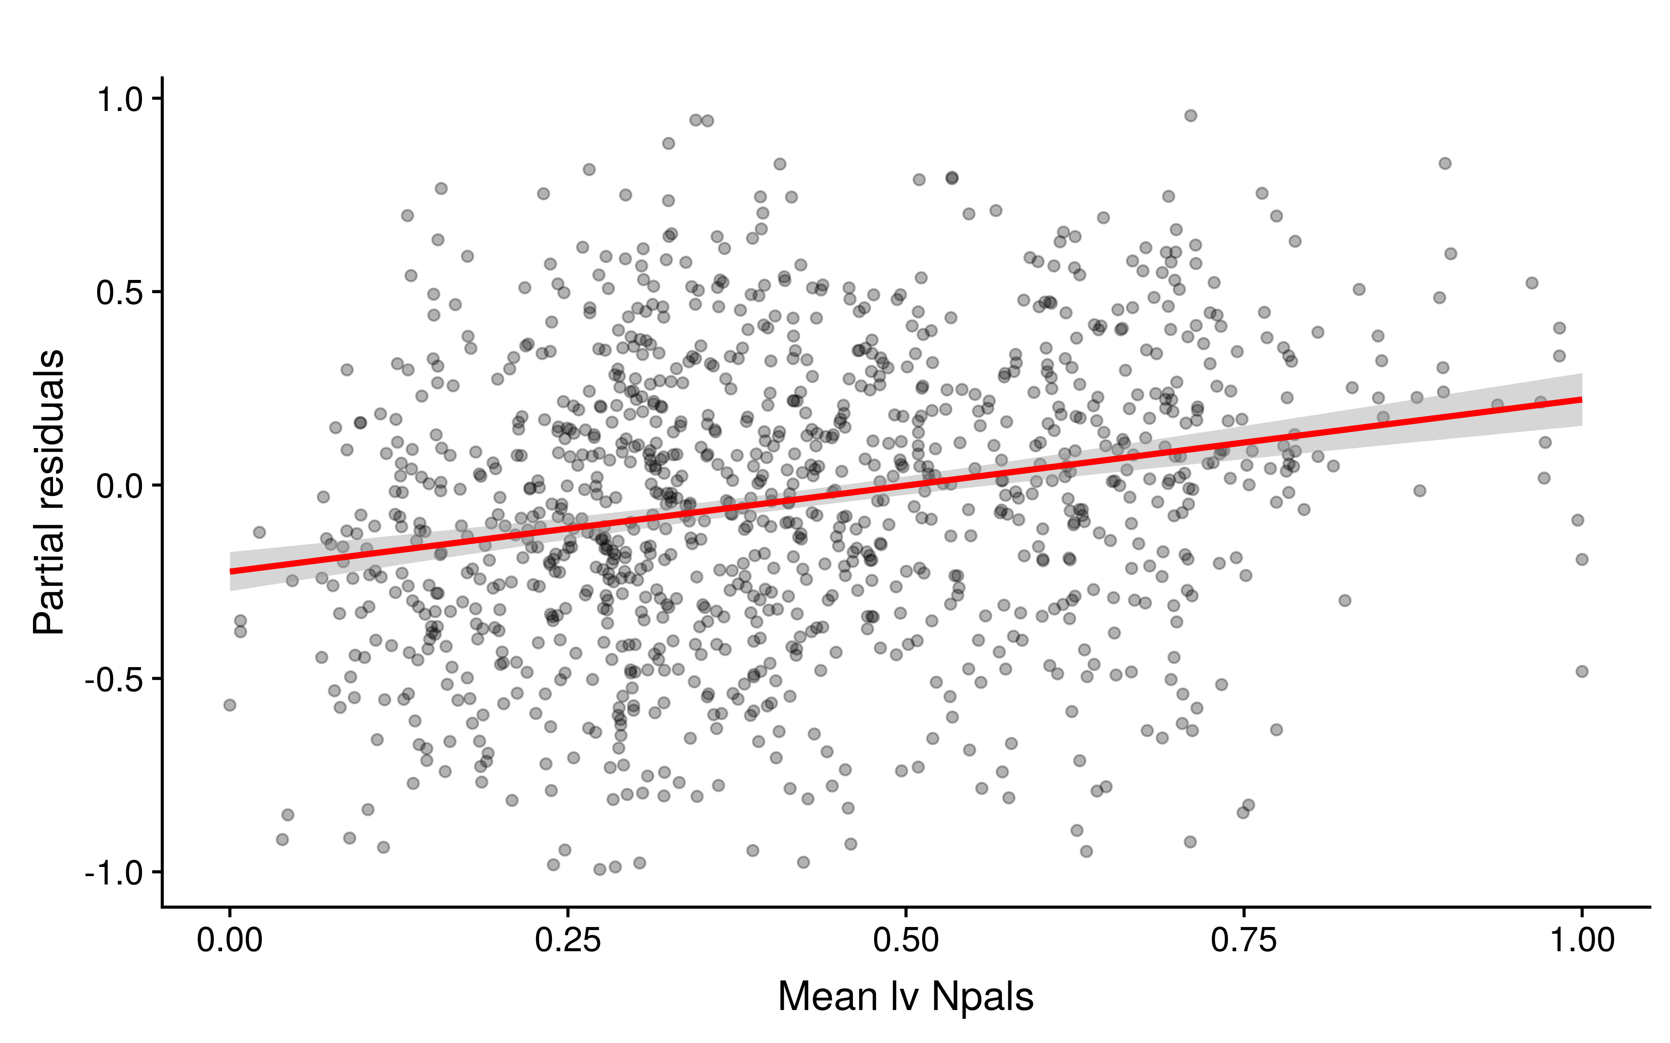
Inter-individual differences
Larger math improvement with
Higher baseline math
Higher baseline WM
“Rich-gets-richer effect”

Slide 24

Conclusions
Results suggests that there might be beneficial effect of spatial cognitive training for math learning
Dose might be dependent on the individual
Future research on inter-individual differences in response to intervention and differences in outcome

Slide 25


Nicholas Judd
Federico Nemmi
Rita Almeida
Margot Schel
Ola Helenius
Pekka Räsänen
Thanks!
www.klingberglab.se

Slide 27
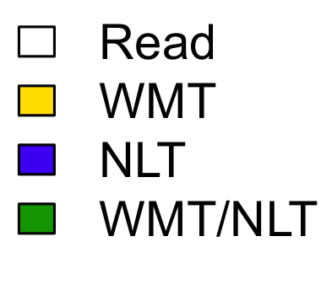
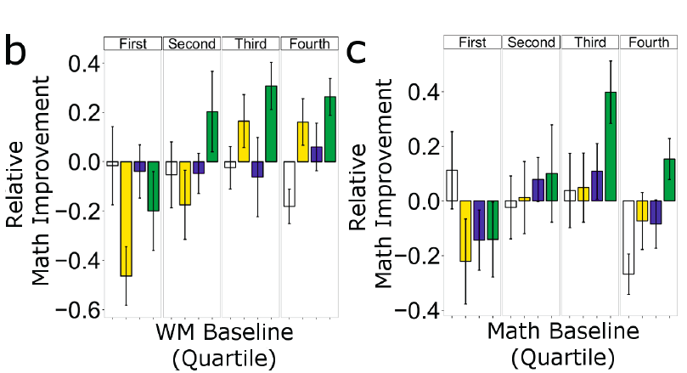

Slide 28
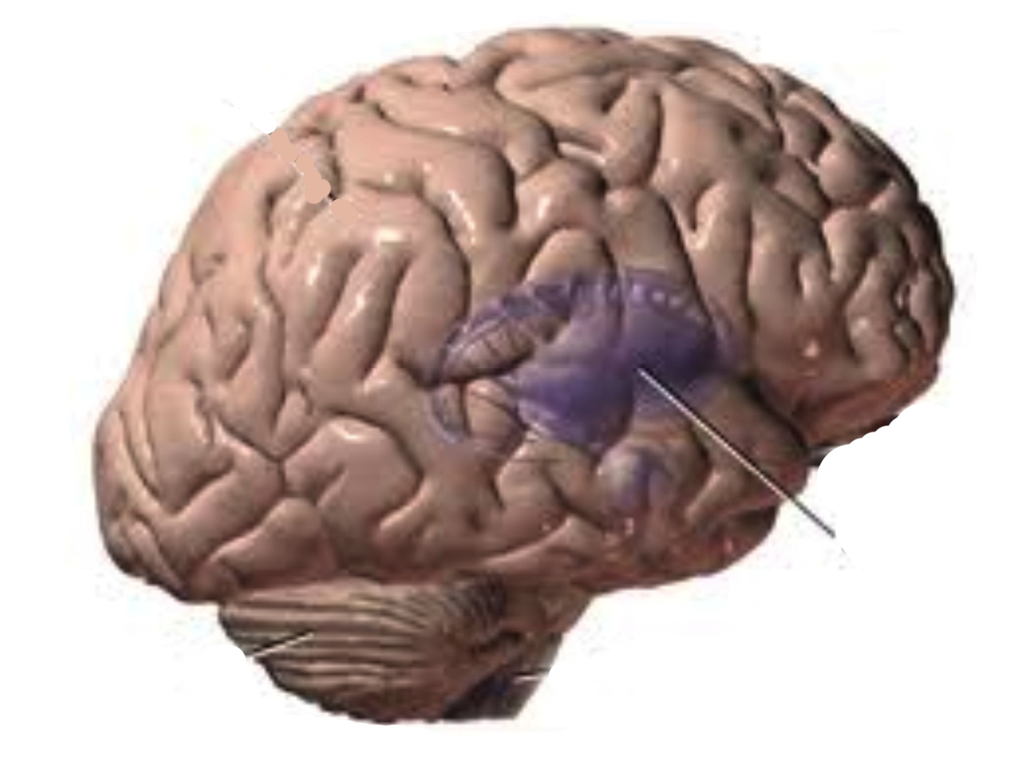
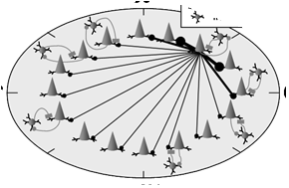
Positive interactions and cognitive development as a skill
DRD1
COMT
DRD2
DAT-1
low benefit from
environmental stimulation
low WM capacity
at baseline
DAT-1
DRD2
Striatum
Local cortex
..
low plasticity
low benefit from
interventions
?
high plasticity
Klingberg, TICS, 2014; Klingberg, Curr Opionion Beh Sci, 2016

