Slide 1
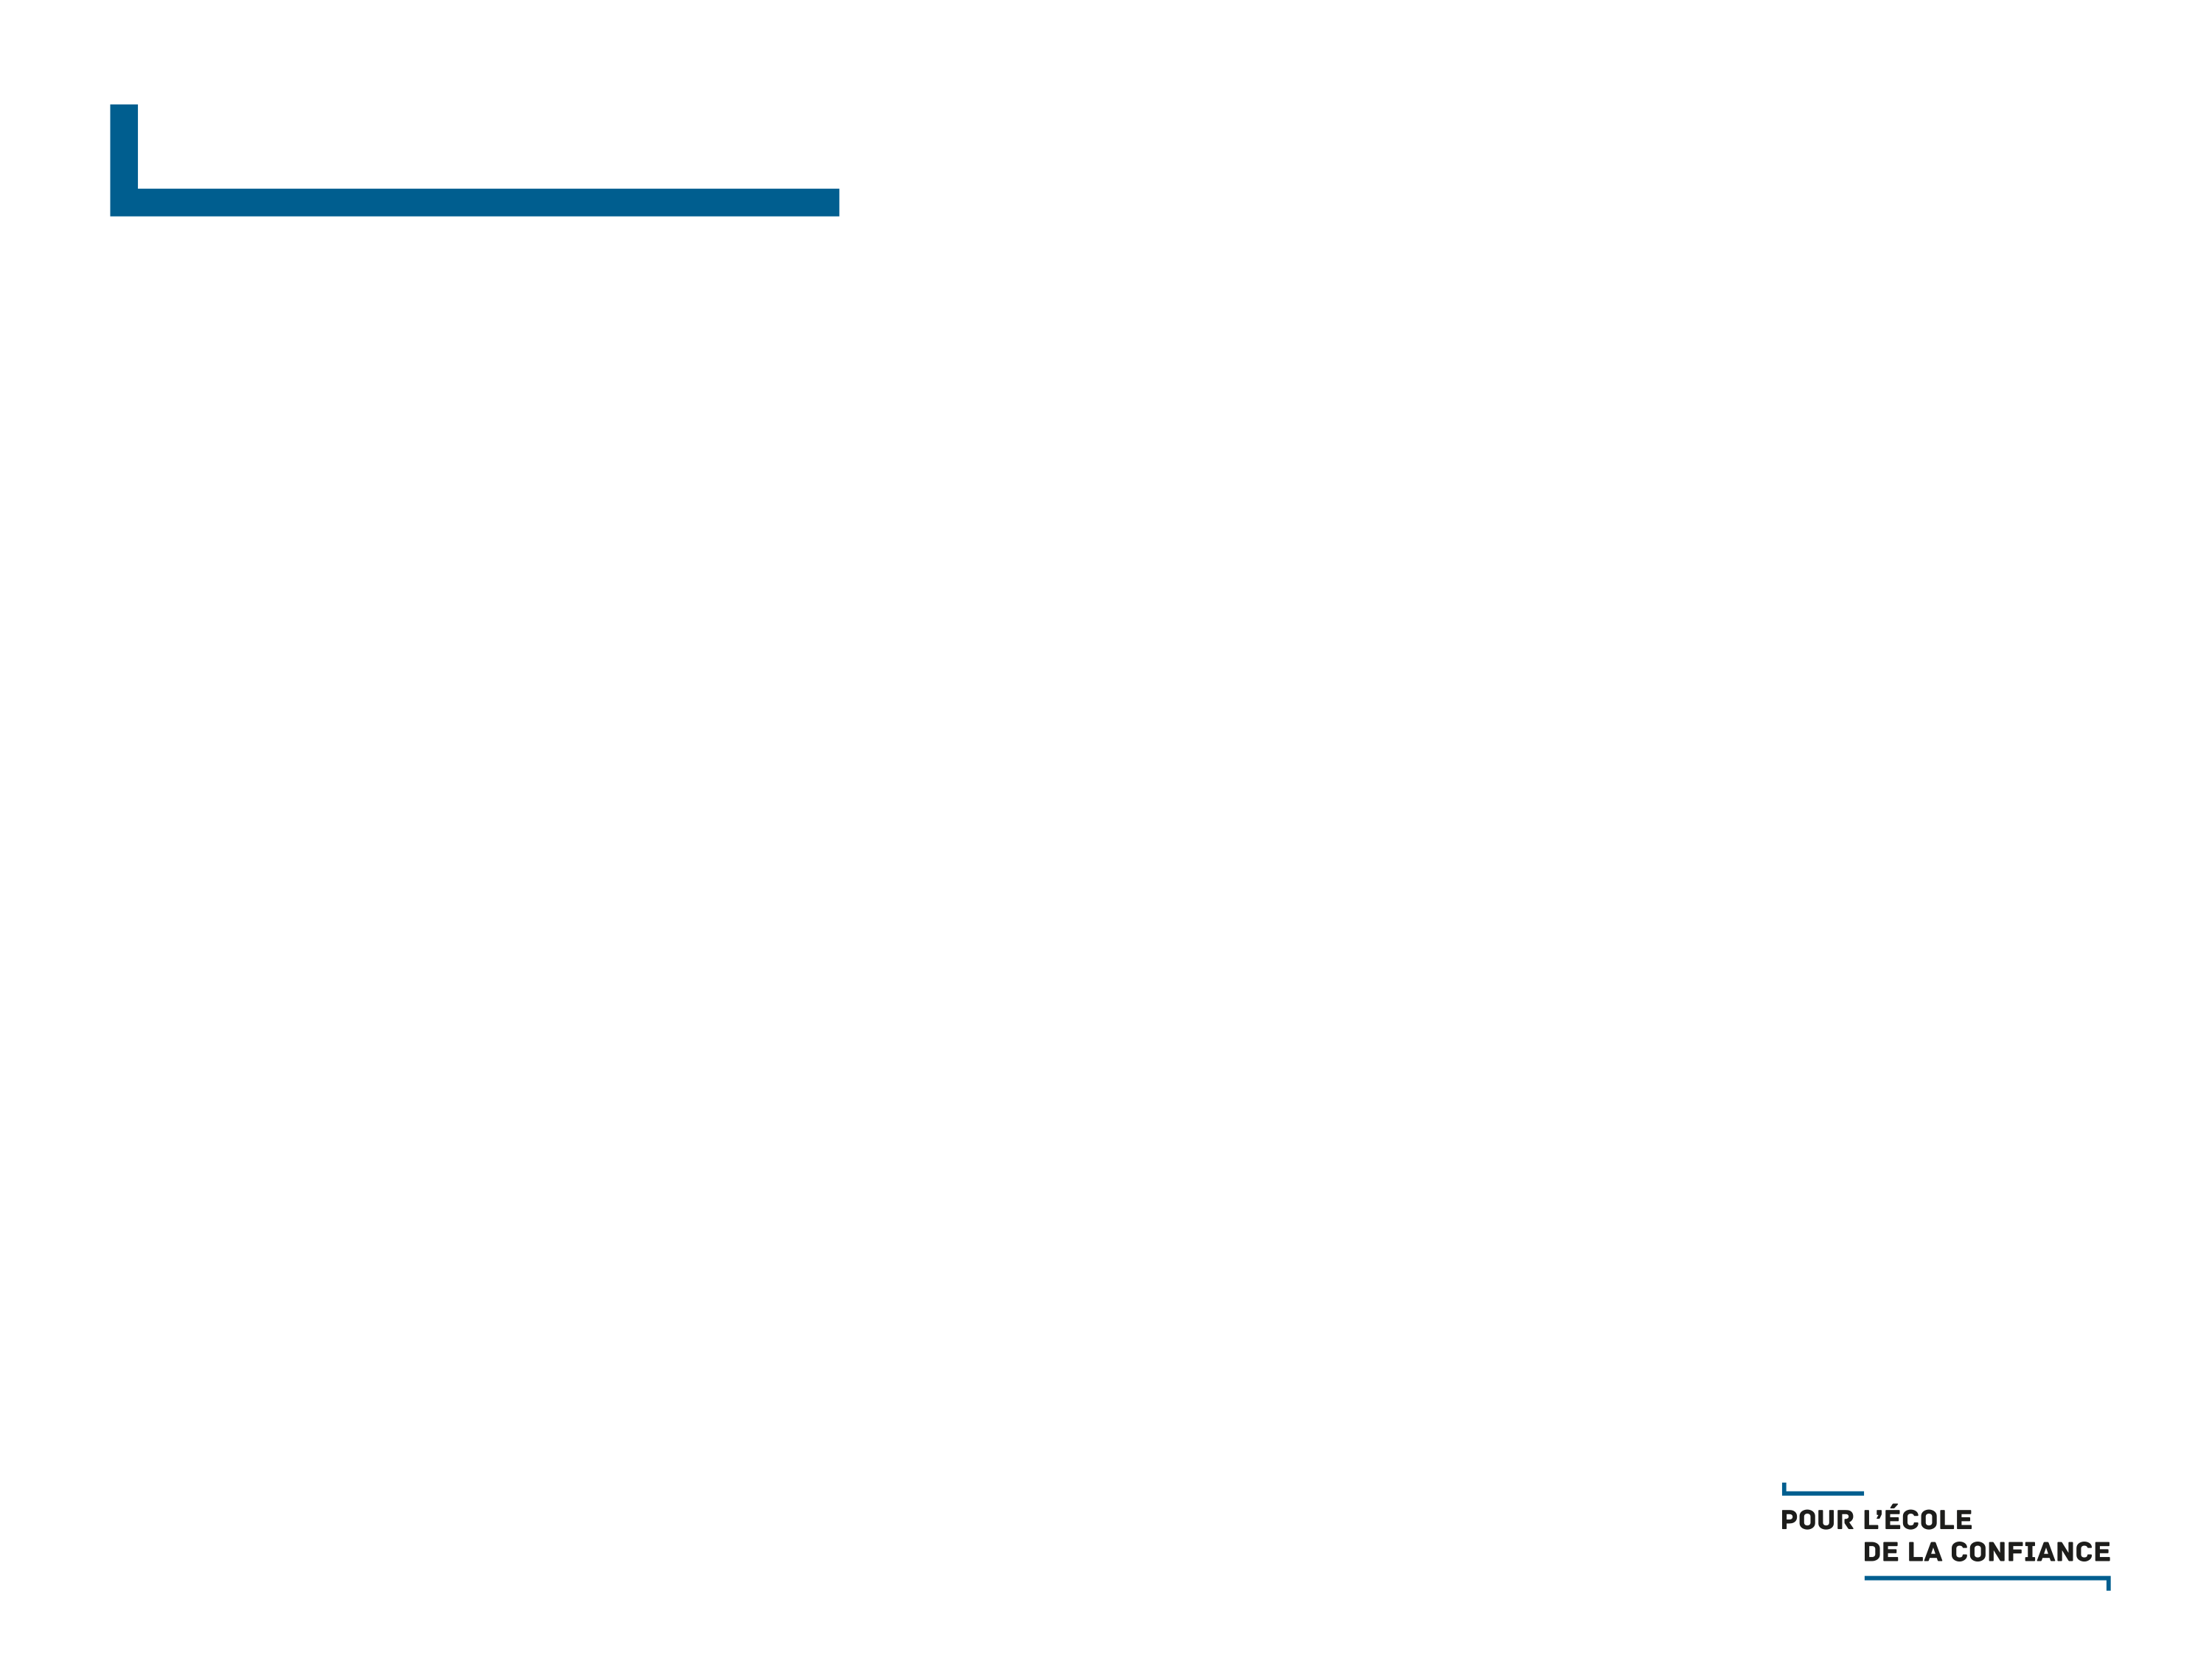

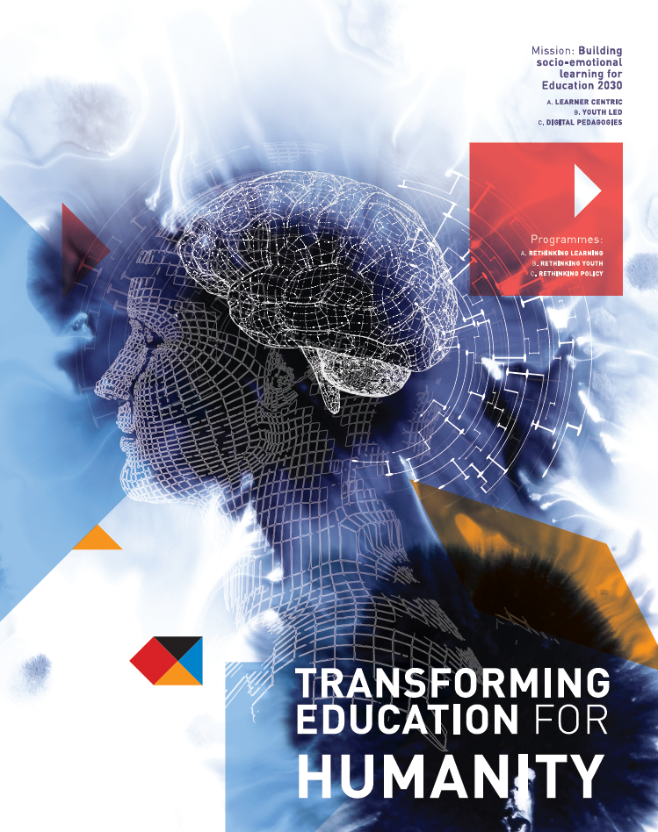
Cross cultural perspective on performance assessments
Nandini Chatterjee Singh
n.chatterjee@unesco.org

Slide 2
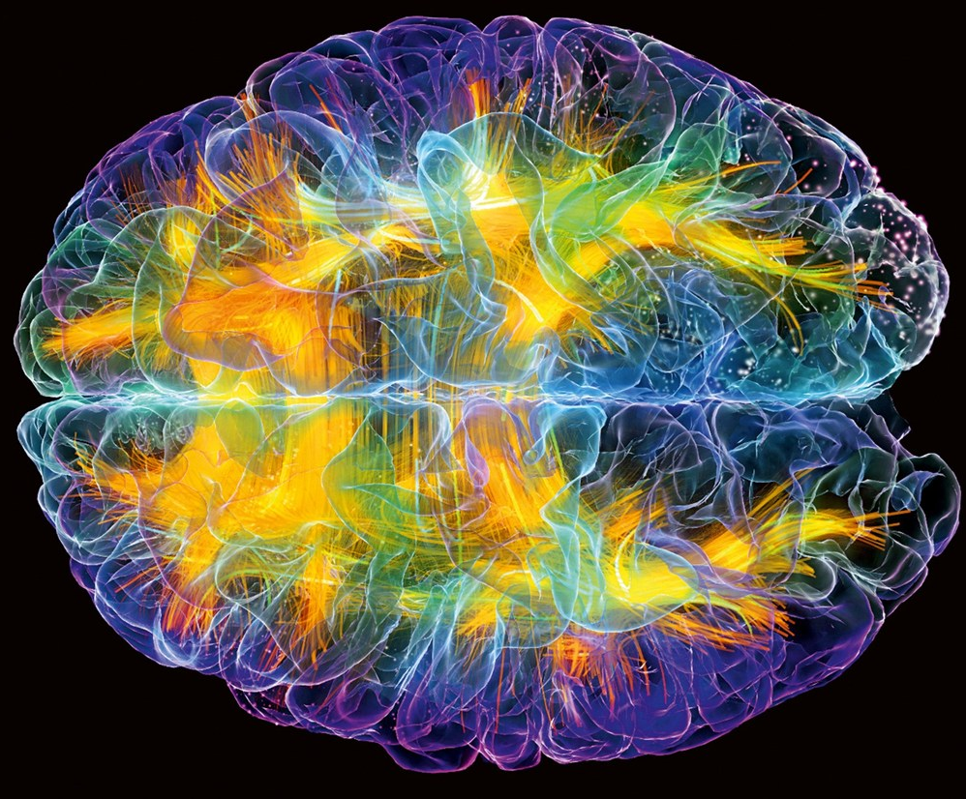
Science-Education-Policy
Brain – the seat of learning – no longer a black box.
Urgent and necessary that neuroscience evidence informs learning in the classroom – both for the learner and the educator.
Two examples to illustrate how evidence can inform education policy.

Slide 3
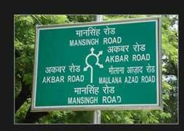
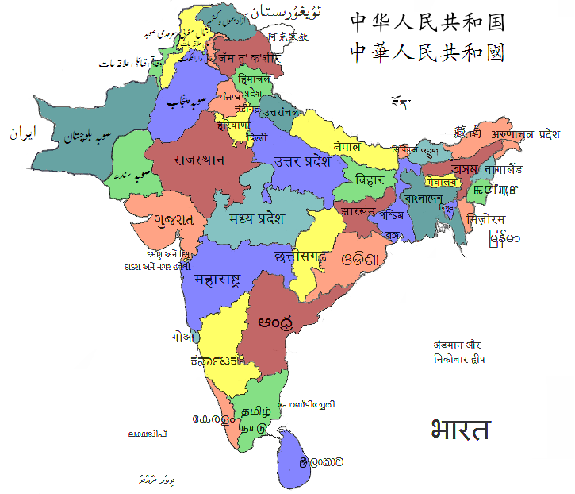
Inclusive Education
Cultural Différences in Learning to Read
Multi-literate school system of India
20 officially recognized spoken languages
11 Officially recognized scripts
2 Official Languages - Hindi and English

Slide 4
The Biliterate Reading Study
Simultaneous reading acquisition in Hindi and English)
Matched skills for both languages
Strong significant correlations in skills across the two languages
Cherodath et al, Bilingualism (Language and Cognition, 2016)

Slide 5
Structural Imaging
Gray Matter Volume (GMV) correlations with phonological measures
Distinct neural correlates for syllable and phoneme
Cherodath et al, Bilingualism (Language and Cognition, 2016)

Slide 6
Functional Imaging
Shared circuitry for reading in biliterate children
Effect of orthographic depth
Native (yellow) and Second (red),
Overlap (green)
Cherodath et al, Bilingualism (Language and Cognition, 2016)

Slide 7
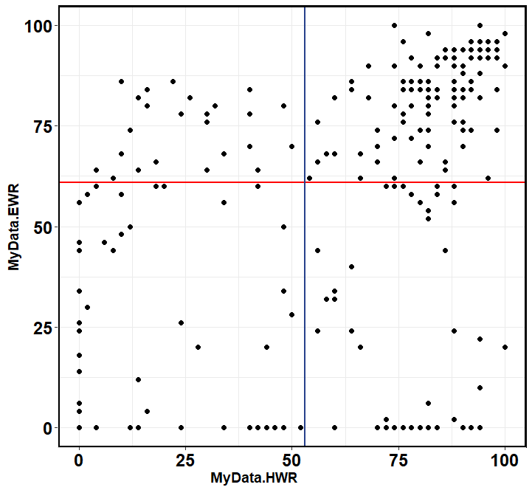
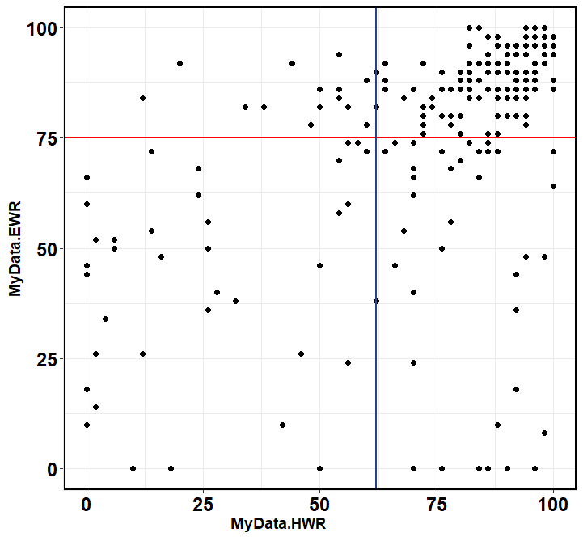
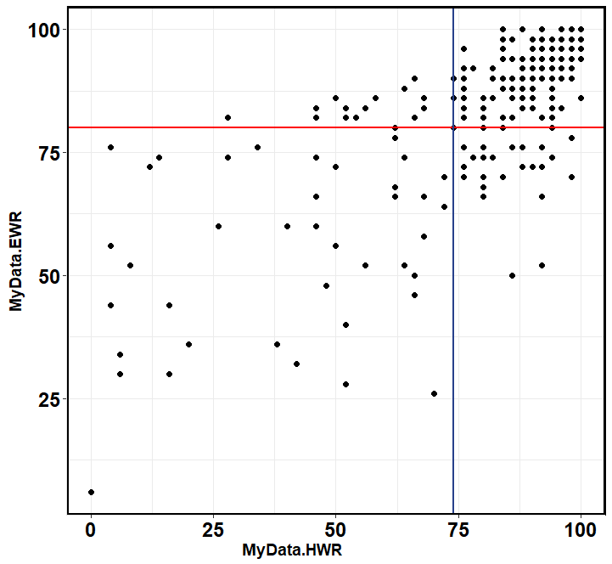
Identifying children at risk for dyslexia (8-10 years)
Total N = 691
Class 3, N=231
Class 4, N=218
Class 5, N=242
Poor native
Good
readers
Performance in English (%)
At risk
Poor Eng
Performance in Native Language (%)
Under review

Slide 8
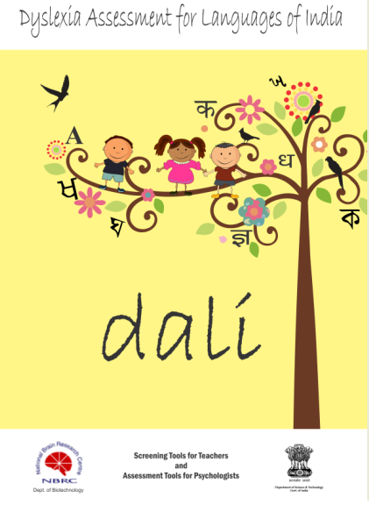
Dyslexia Assessment for Languages of India
The first standardized validated screening and assessment tool in Indian Languages.
Four Languages – Hindi, Marathi, Kannada and English
4840 children in five cities – were tested for this tool.

Slide 9
Policy Implications
Literacy assessments in multiliterate societies should mandate assessments in all languages of instruction and must include assessment in the mother tongue.
Critical to achieve literacy and identify children at risk for learning disabilities like dyslexia.
 | Multiple official languages
 | Single official language, functionally multilingual
 | No official language, functionally multilingual

Slide 10
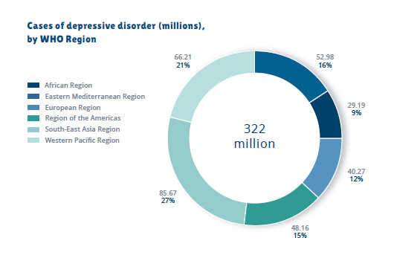
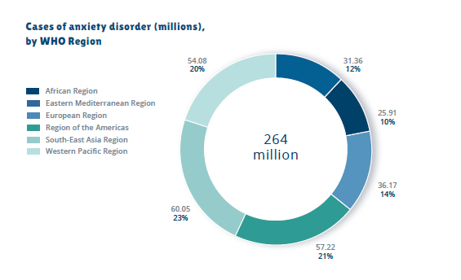
The Mental Health Crisis in Adolescence
WHO Report, 2017

Slide 11

Prosocial Behaviour and Socio-Emotional Learning
Prosocial behavior is positively associated with intellectual outcomes (Wentzel, 2015), negatively correlated with adolescent depression (Forbes, 2017) and supports well-being (Wentzel, 2015)
To promote and develop pro-social behavior children need Social and Emotional Learning skills
Neuroscience research shows that prosocial behavior can be taught in the classroom similar to literacy and numeracy (Feinberg et al, 2005)

Slide 12
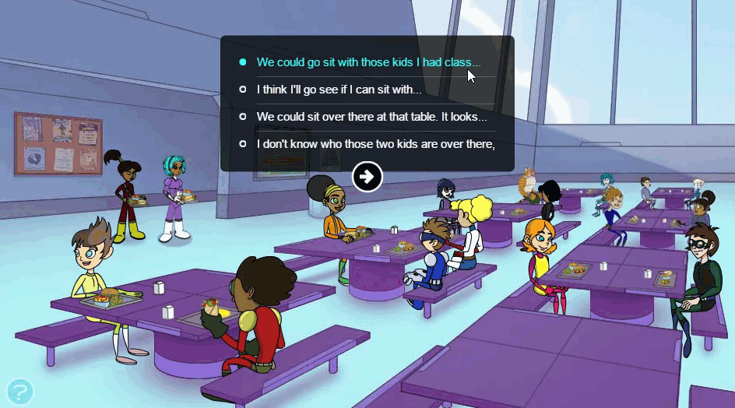
Social and Emotional (SE) behavior is cultural and contextual
Assessment of SE skills is a big challenge
Questionnaire - long, boring, accuracy (stated preference!)
Digital interactive Games provide a novel medium for SEL assessment
Assessment - Stealth mode, Contextual, Continuous, Engaging
“Hall of Heroes” (De Rosier et al, 2015), “Crystals of Kador” , “Tenacity”, are game based social skills assessment system that assesses children’s social problem solving strategies' and aptitudes

Slide 13



DICE – Digital Inter-Cultural Exchange in adolescents (12- 14 years)
200 students engaged in Online dialogue for 6 weeks.
The dialogue included discussions on migration, climate change, citizenship and identity.
Assessments of SEL skills were carried out using Hall of Heroes
USA
NORWAY
MALAYSIA
S. AFRICA
INDIA

Slide 14
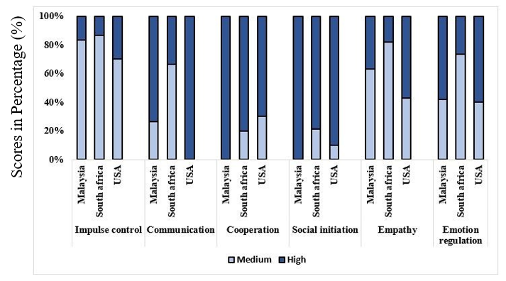
Cultural Differences in socio-emotional skills
Significant differences across cultures (p < 0.001)
Communication –
US and Malaysia > South Africa
Co-operation –
Malaysia > US and South Africa
Social Initiation – Malaysia and US > South Africa
Similar results reported in 9-11 year olds (ZooU) from Japan and USA (Craig et al et al, 2017).
Irava, Pathak and Chatterjee, (in revision)

Slide 15
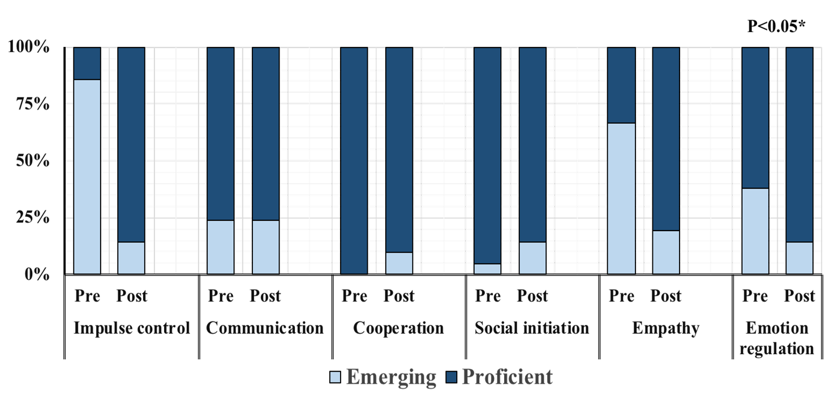
Effect of intercultural dialogue - Pre and post assessments of SEL skills (Malaysia )
Preliminary data suggests digital dialogue can be explored as a tool to build prosocial skills and improve multicultural perspectives

Slide 16
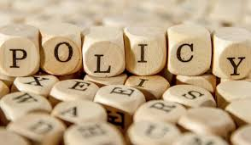
Key messages for policy
Social and Emotional Learning - urgently need to be mainstreamed into education policy.
Digital Dialogue can be explored as a tool to build prosocial skills
Games provide an objective but fun method for SEL assessments as opposed to behavioural questionaires.

Slide 17
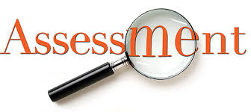
Gaps and Challenges
Wealth of neuroscience research has emerged in the last 30 years
Limited research on what is effective and what is not
More research required to establish baselines and monitor progress
Education needs an assessment !

Slide 18



Thank You
mgiep.unesco.org
/mgiep
@unesco_mgiep
unesco_mgiep

