Slide 1


Slide 2


The EEF approach
Sir Kevan Collins
25th March 2019

Slide 3
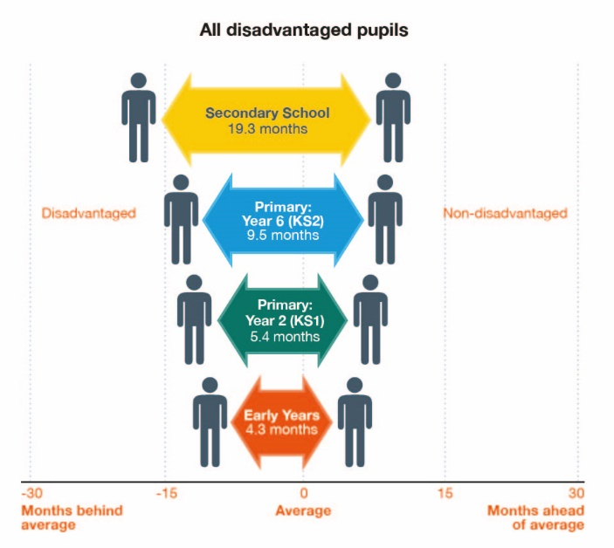

Context 1
The attainment gap is BIG & grows throughout school
There is a 19-month gap at the start of school between the most and least advantaged children.
This gap only widens as children get older.
Pupils who do not reach the minimum expected level in English and Mathematics aged 11 rarely catch up by the time they reach 16.
And without at least five good GCSEs most will struggle to achieve their goals, either for further study or in the world of work.

Slide 4
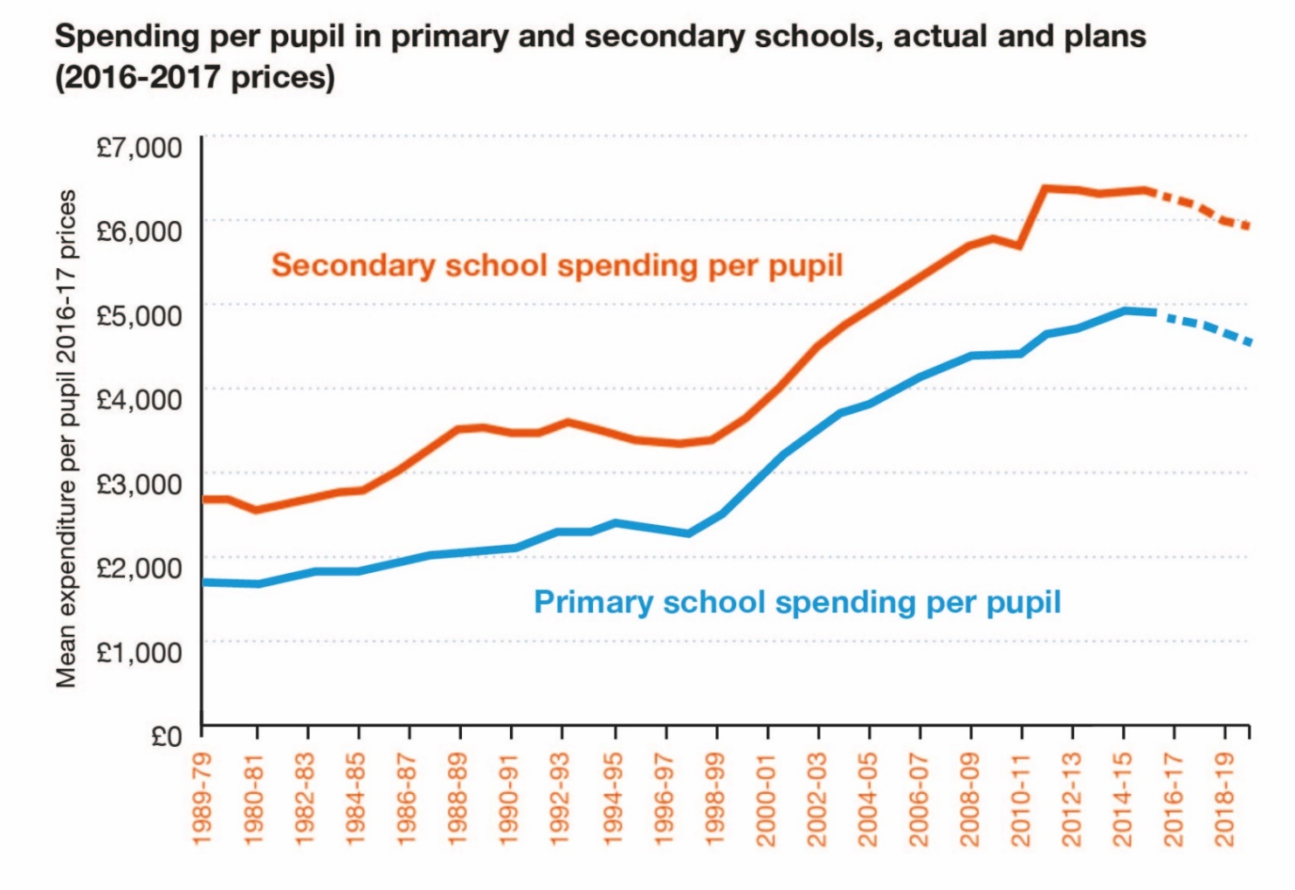
Delivering value for money

Slide 5


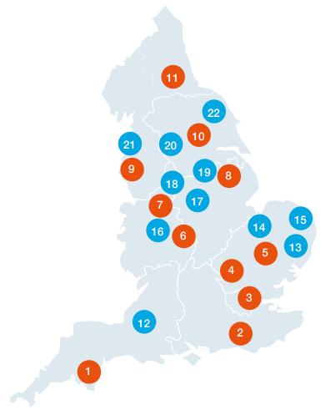
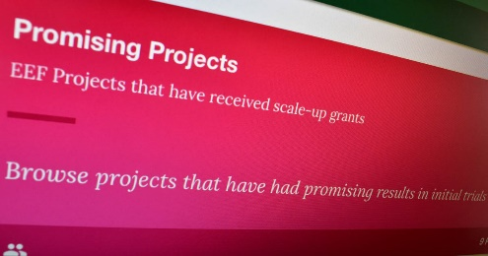
Improving attainment through better use of evidence
We support teachers and school leaders to use evidence to inform their decision making.
We are independent and can take a long-term, objective view.
We believe that evidence is strongest when used alongside professional judgement.
Evidence
synthesis
Evidence
generation
Evidence
scale-up

Slide 6
Tackling the attainment gap:
the EEF approach
Evidence
synthesis
Evidence
generation
Evidence
scale-up

Slide 7
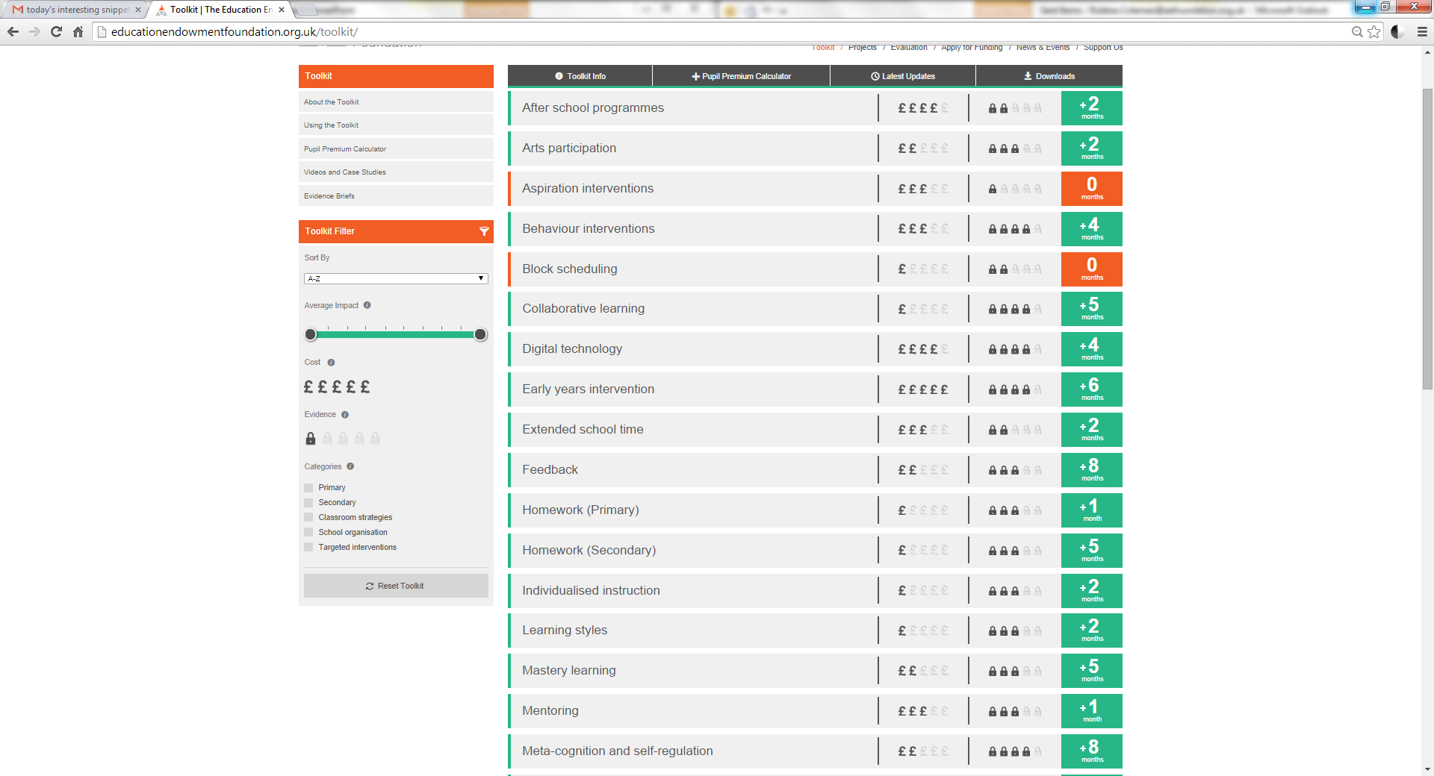
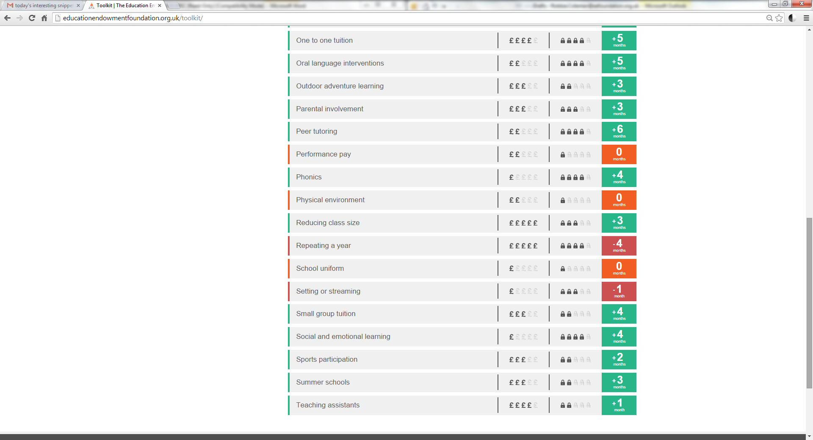
Starting from what we know…

Slide 8
What happens in the classroom makes the biggest difference

Slide 9
Tackling the attainment gap:
the EEF approach
Evidence
synthesis
Evidence
generation
Evidence
scale-up

Slide 10

EEF-funded work since 2011
190
children and young people reached
EEF-funded projects
1.2 million
12,000
£100
million
schools, nurseries, colleges involved
total funding committed

Slide 11



EEF Findings: metacognition
Project | Summary | Students | Impact | Cost | Security
ReflectED | Using technology to promote meta cognition and independent learning | 1,200 pupils 9-10 years old | +4 months | £19
Philosophy for Children | Helping children become more willing and able to question, reason, construct arguments, and collaborate with others | 3,159 pupils 8-10 years old | +2 months | £16
Thinking, Doing, Talking Science | Making science lessons in primary schools more practical, creative and challenging. | 655 pupils 9-10 years old | +3 months | £26
Let’s Think Secondary Science | Testing a cognitive development programme for science. | 8000 pupils 11-12 years old | 0 months | £4
Peer Tutoring in Secondary Schools | A paired reading programme for pupils in Years 7 and 9. | 2,736 pupils 11-14 years old | -1 months | £10.50

Slide 12
Tackling the attainment gap:
the EEF approach
Evidence
synthesis
Evidence
generation
Evidence
scale-up

Slide 13



National School Breakfast Programme launched following EEF trial of Magic Breakfast
Magic Breakfast
Large-scale effectiveness trial (published 2016)

Slide 14

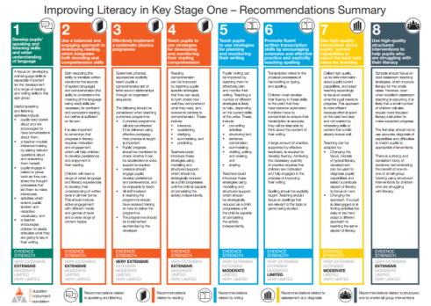
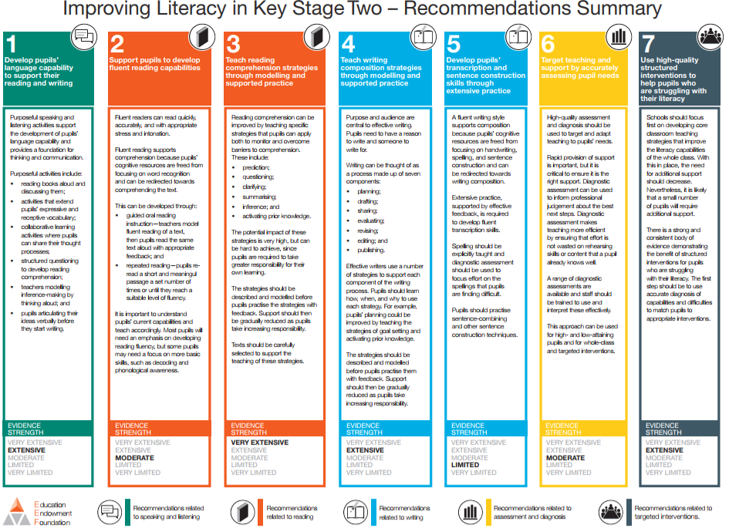
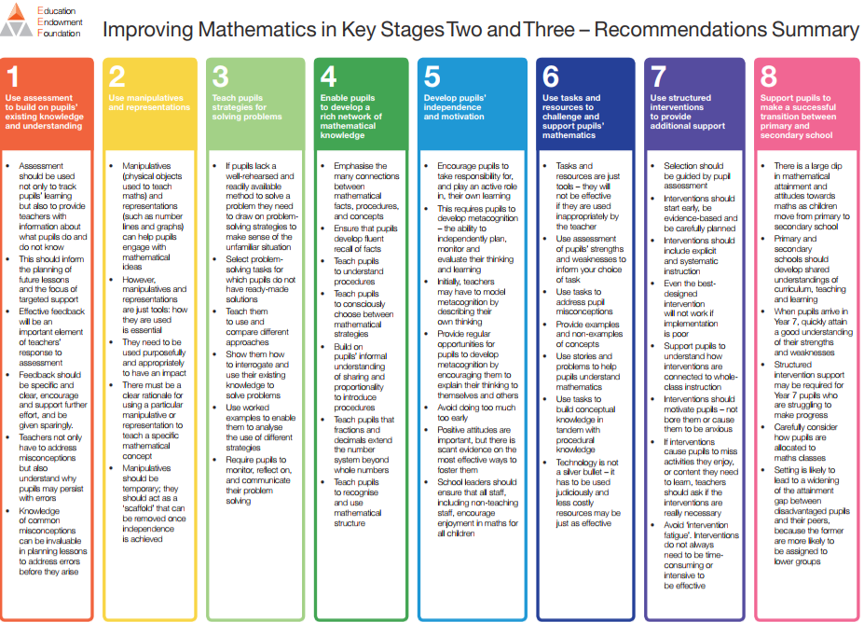
We know enough in key areas of teaching and learning to start making a positive difference now.
EEF guidance reports provide clear and actionable recommendations for teachers and senior leaders on a range of high-priority issues.

Slide 15
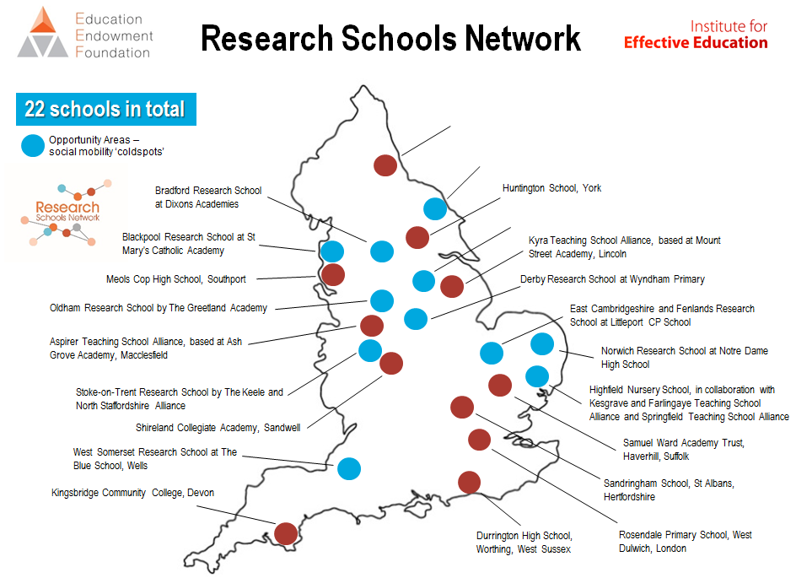
Sharing effective practice between schools – and building capacity and effective mechanisms for doing so – is key to closing the gap.
A national network of 22 schools which aim to lead the way in the use of evidence-based practice and bring research closer to neighbouring schools.

Slide 16





Our starting position for international partnerships…
A shared focus on closing the equity gap.
A commitment to mutual benefit – breadth, depth and pace of evidence generation.
Free access and high standards of evidence (4 As - accurate, actionable, accessible, appropriate).
Empowered practitioners – evidence in the hands of those making decisions about teaching and learning.
Building local expertise and capability, across partners, practitioners and academia.

Slide 17


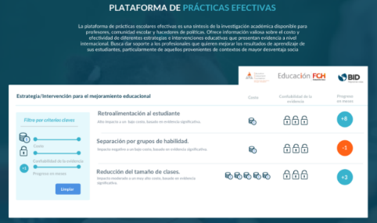


Our existing partnerships…
Established partnerships:
Australia
Scotland
Chile (Latin America)
Prospective partnerships:
France
Ireland
Japan
Jordan
New Zealand
South Africa and sub-Saharan Africa
Spain
Wales

Slide 18

Keep in touch with the EEF
Sign up for our EEF News Alerts
Hear about our latest news via email
Visit: bit.ly/EEFsignup
on Twitter @EducEndowFoundn
by liking Facebook.com/EducEndowFoundn

