Slide 1


Slide 2

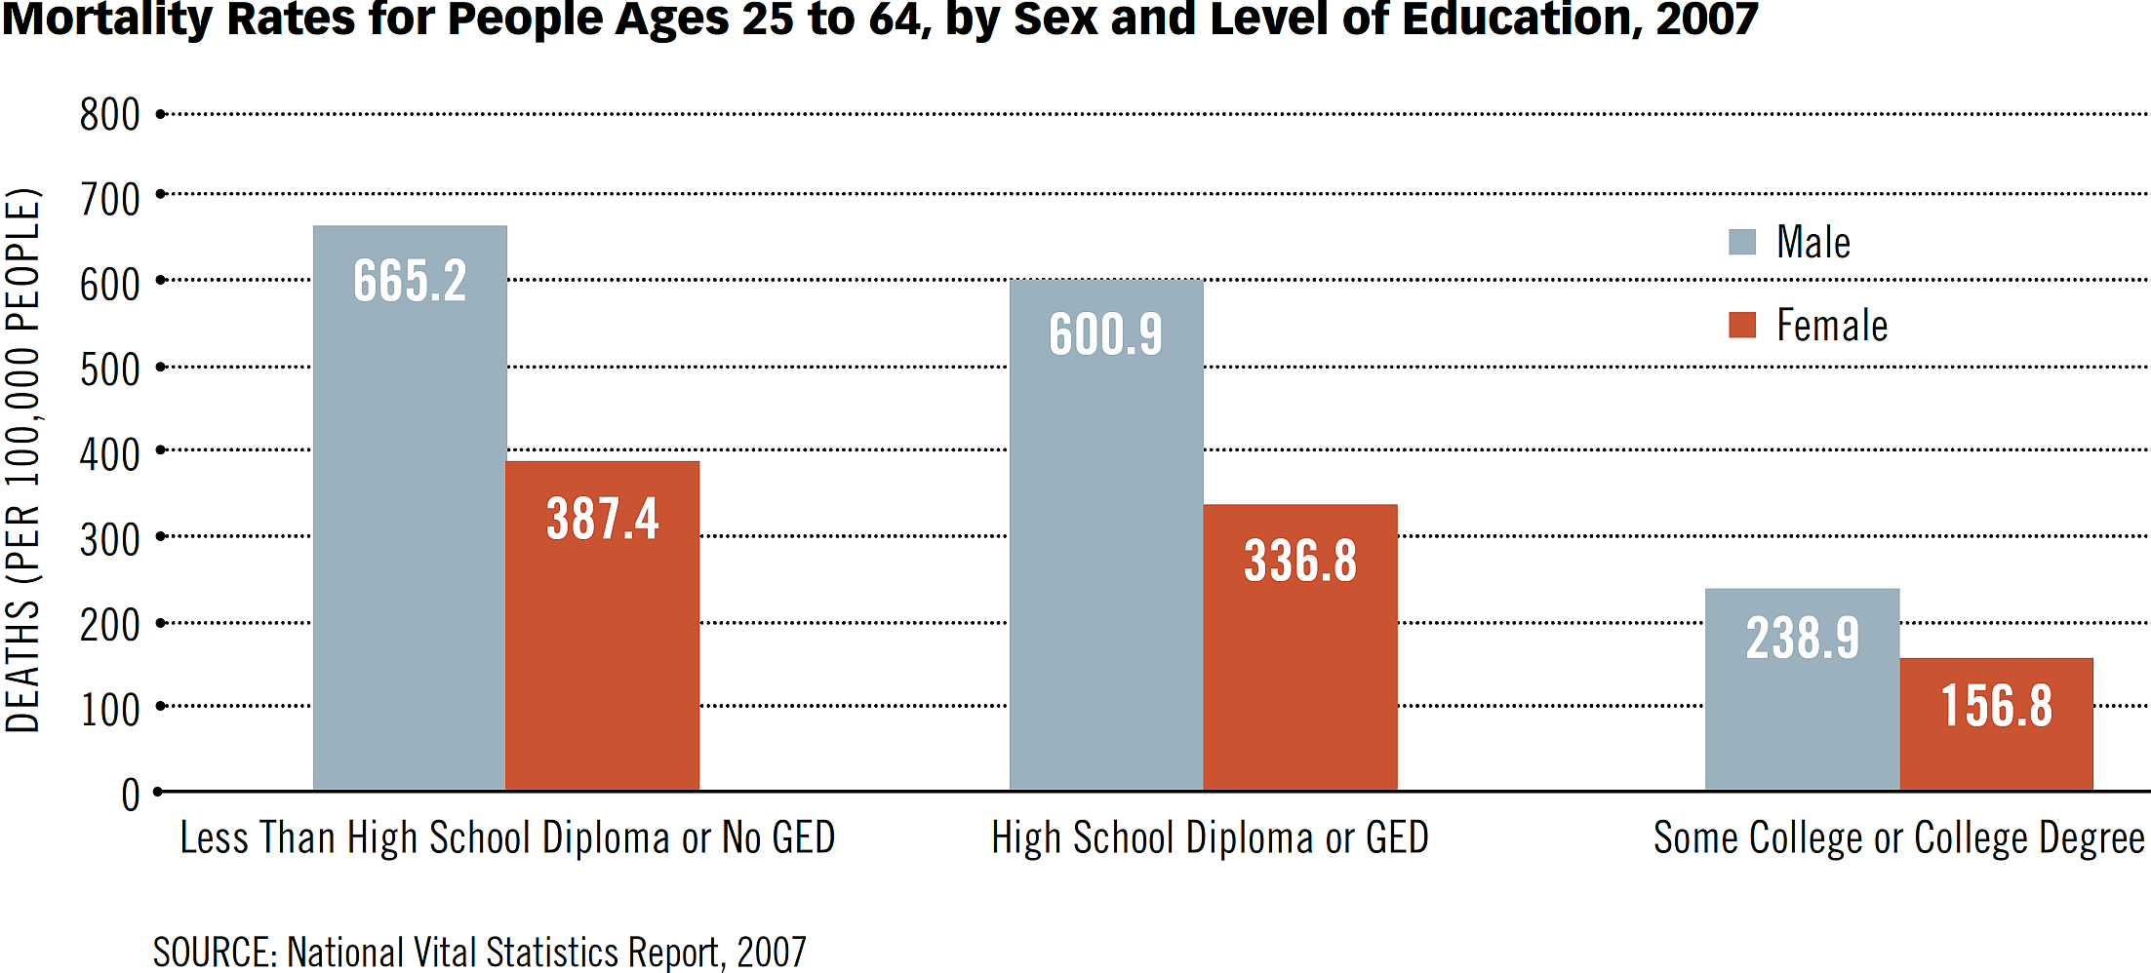
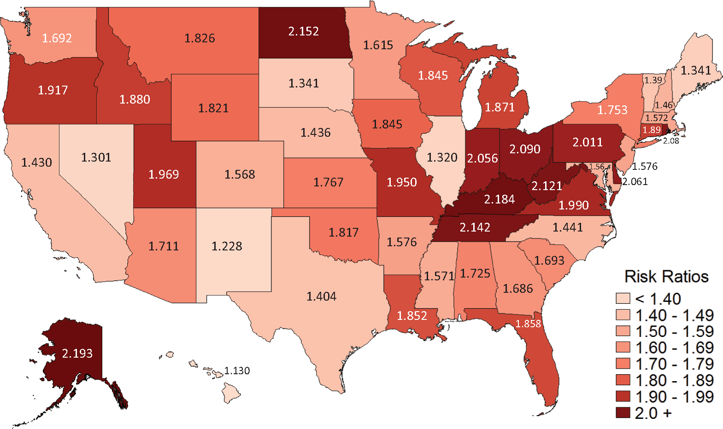
EDUCATION AND HEALTH INTERACTION IS CRUCIAL FOR EARLY COGNITIVE DEVELOPMENT & LEARNING
FETUS BIRTH PRESCHOOL SCHOOL COLLEGE
MOTHER EDUCATION
Relative Risk of Infant Mortality by Maternal Education
<12 Years Schooling vs.
4 Years of college
(Sosnaud, 2019)

Slide 3
EDUCATION AND HEALTH INTERACTION IS CRUCIAL FOR EARLY COGNITIVE DEVELOPMENT & LEARNING
FETUS BIRTH PRESCHOOL SCHOOL COLLEGE
PREMATURITY
17% TIPICAL MENTAL DEV. AT 30 MONTHS
(Glass et al, 2015)
READING FAILURE
EARLY SPEECH DELAY
(Lyytinen et al, 2015)

Slide 4
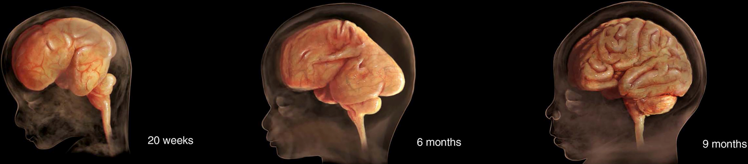
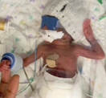
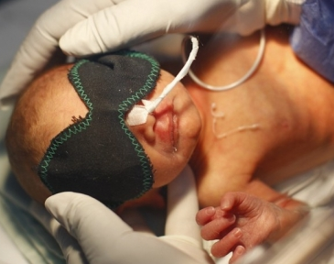
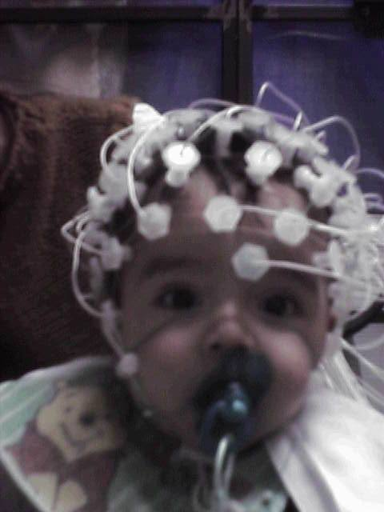
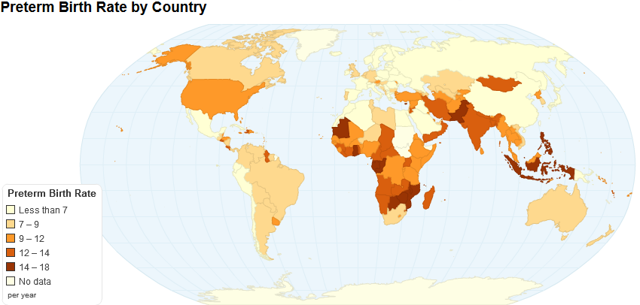
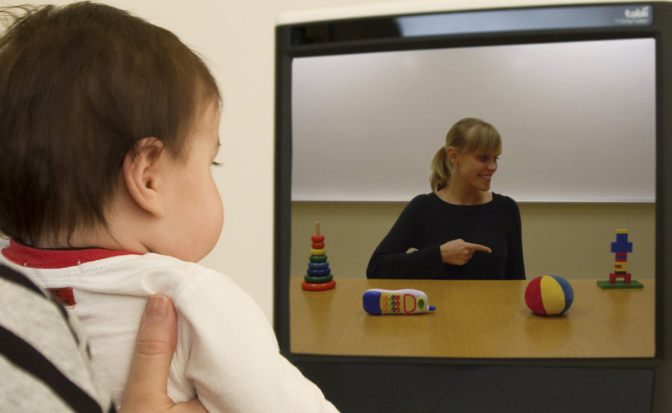
PREMATURITY
5 - 18 %
15 million infants are born preterm.
It is the main preventable cause of death under 5y (Liu et al, 2016).
AGE
DATA
ACTION
PT NEWBORN
INMATURE
CLINICAL SUPPORT
+ MIMIC WOMB ENV. CIRCADIAN R
(Mark et al, 2017)
6-12 months
SPEECH
DOES NOT ACCELERATE
(Peña, Werker & Dehaene-Lambertz, 2012; 2010;
But also see Nazzi et al, 2015)
IS EXTERNAL STIMULATION NEGATIVE FOR COGNITION?
ARE PRETERMS FORCED TO ACCELERATE LEARNING?
CONSEQUENCES FOR LEARNING & EDUCATION?
6-7 months
VISUAL
SOCIAL
((Jando et al, 2012; Peña, Arias & Dehaene-Lambertz, 2015)
DOES ACCELERATE

Slide 5
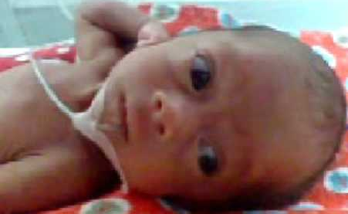
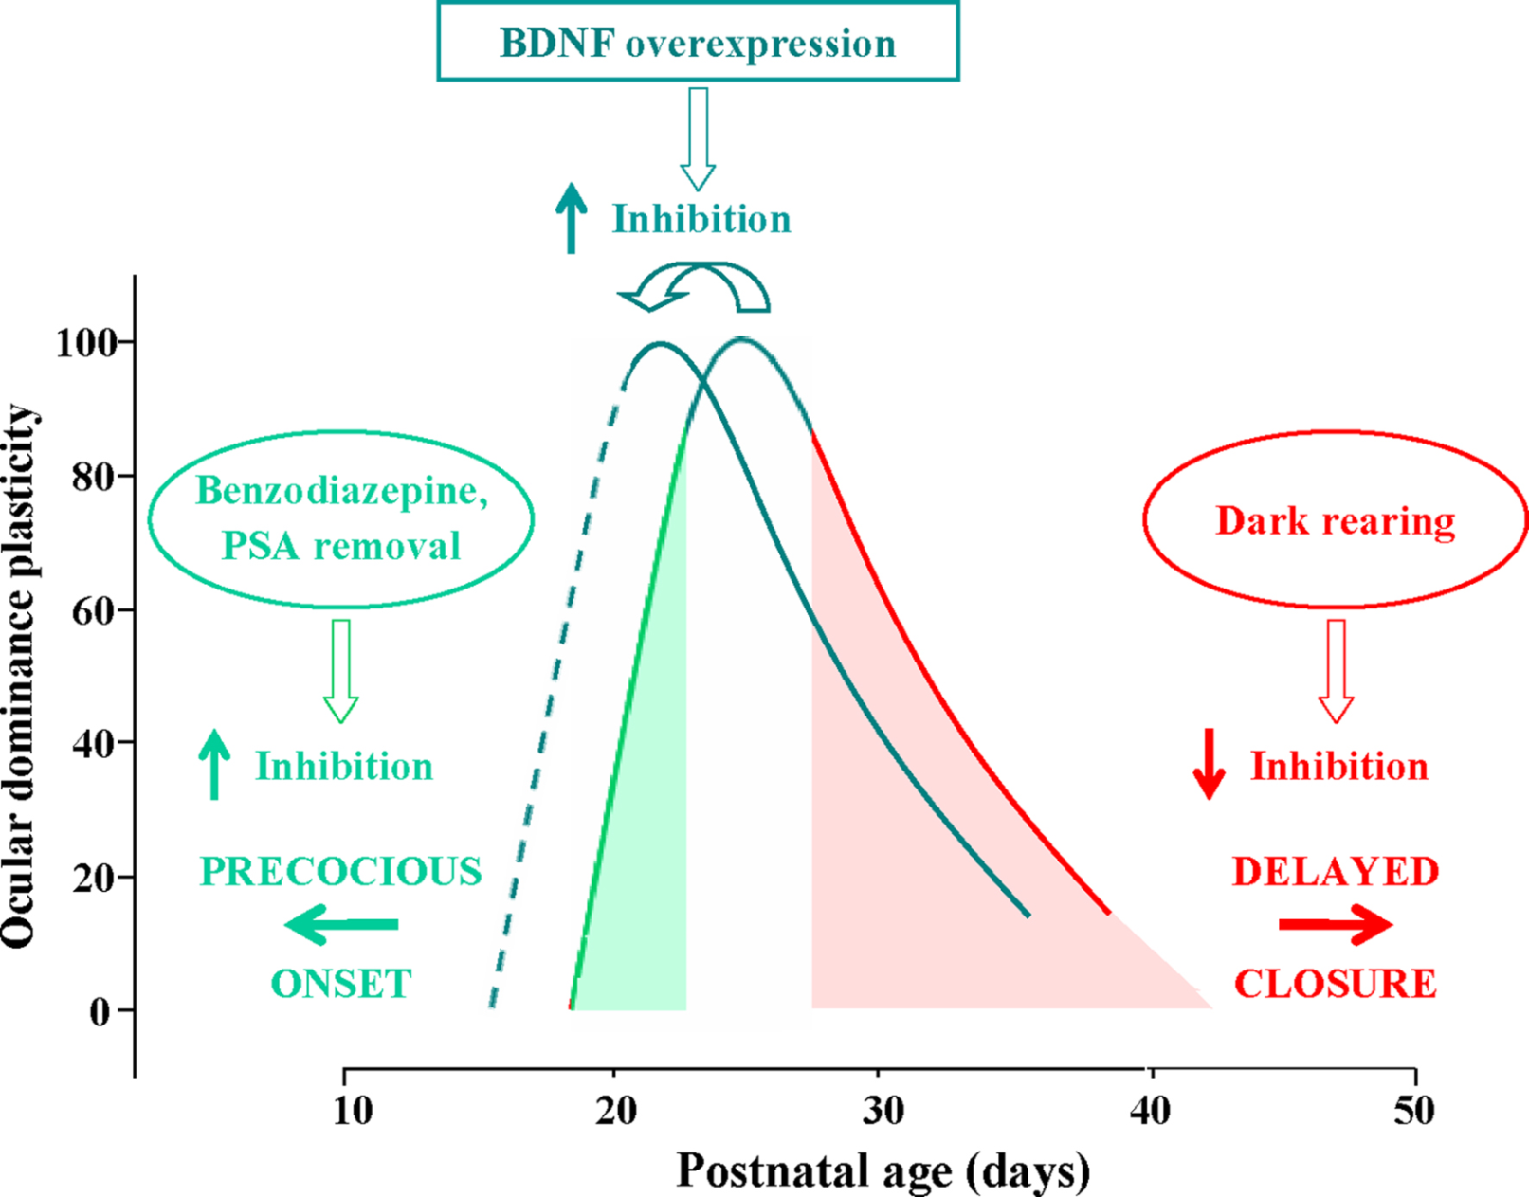
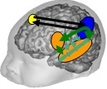
NON HUMAN ANIMAL ➔ HUMAN CRITICAL PERIODS
VISUAL
SOCIAL
SENSORIAL DEPRIVATION
NATIVE LANGUAGE
PHONOLOGY
Valproato
Videogame
ReOpen
Takao Hensh 2005--
17% TIPICAL DEVELOPMENT
MORE QUESTIONS THAN ANSWERS
MULTIDISCIPLINARY RESEARCH AGENDA
To understand how best to scale up interventions

Slide 6
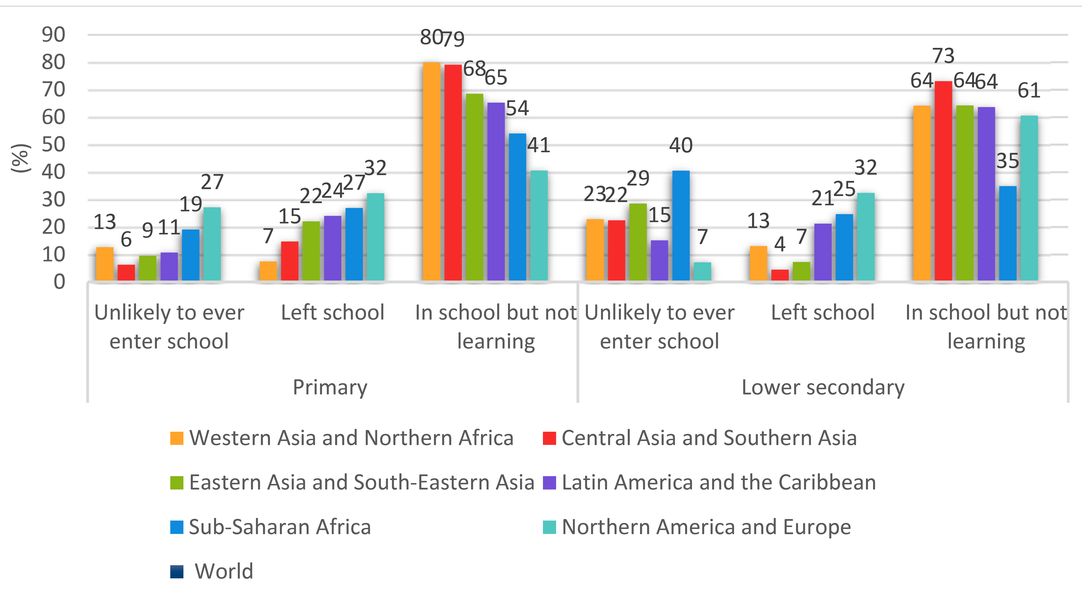
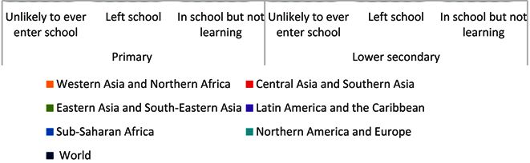
READING FAILURE = WORLD CRISIS
617 million children and adolescents are not achieving minimum proficiency levels (MPLs) in reading
(UNESCO, statistics, 2017)
LOW ACCESS TO SCHOOL
QUALITY OF EDUCATION
BIOLOGY
(15%)
DYSLEXIA
Deafness

Slide 7

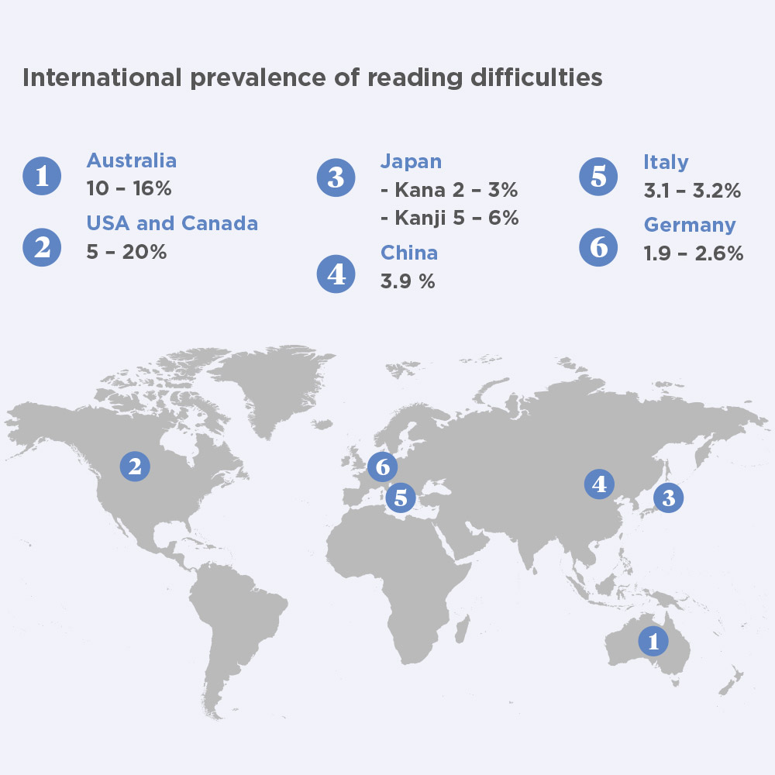
DYSLEXIA
Average 10 %
AGE
SIGN
ACTION
FETUS
FAMILY HISTORY
BE ALERT
NEWBORN
+ EEG PHONEME
+ RHYTHM ??
2 YEARS
+ SPEECH
COMPREHENSION
DIFFICULTIES
+ VOCABULARY
PRESCHOOL
+ LETTER KNOWLEDGE
+ RAPID NAMING
+ PERSISTENT LATE TALKER
+ PHONEME AWARNESS
DIFFICULTIES
EARLY SPEECH DELAY
+ GAMES
+ PHONEME AWARNESS
SCHOOL
+ FAILURE ON READING
BY 2nd GRADE
➔ DIAGNOSIS
+ INTERVENTION
+ GRAPHOGAME

Slide 8
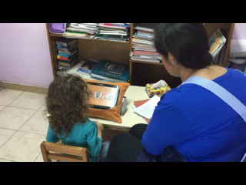
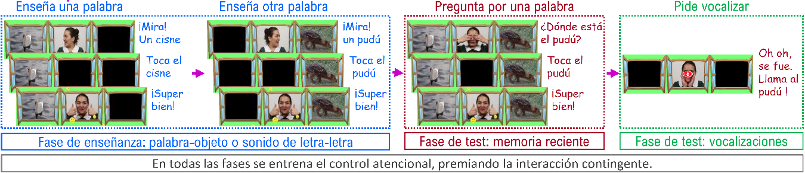
SIELO = SOFTWARE
INCREASE VOCABULARY
LEARN LETTER SOUND
PROMOTE VOCALIZATIONS
(Guevara, Pittaluga, Pino, Dehaene, Dehaene-Lambertz, Peña, in preparation)
WORD 1 WORD 2
WORD RECOGNITION
VOCALIZE
ENCODING
RECALL
VOCALIZATIONS
PRE-POST DESIGN
CONTROL GROUP = WAITING LIST
2 MONTHS DURATION

Slide 9
ASQ-3 - COMMUNICATION – 2 YEARS OLD
F_{(1,81)} = 4.73
p = .032
***
**
**
RESULTS
COGNITIVE GAIN
(POST-PRE)
SDpre
Control (n=37) Exp. (n=46)
VOCABULARY COMPREHENSION – 3.5 YEARS OLD
F_{(1,104)} = 7.59
p = .007
***
**
**
**
Control(n=59) Exp. (n=47)

Slide 10
EDUCATION AND HEALTH INFLUENCE EARLY DEVELOPMENT
FETUS BIRTH PRESCHOOL SCHOOL COLLEGE
MOTHER EDUCATION
HIGH QUALITY HEALTH EDUCATION
HIGH QUALITY SCHOOL EDUCATION
HEALTH & EDUCATION INTEGRATED RESEARCH AGENDA
OPEN SCIENCE OPEN HEALTH OPEN EDUCATION
IDEAS LABORATORY → TRANSFER
SUSTAINABLE

Slide 11
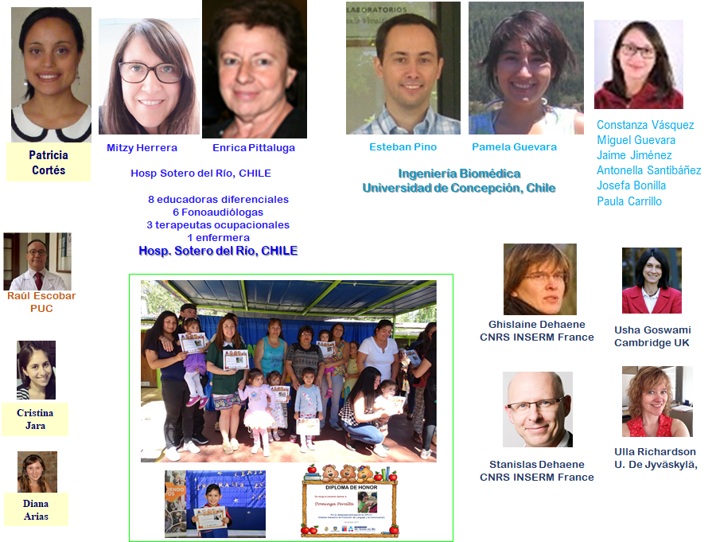

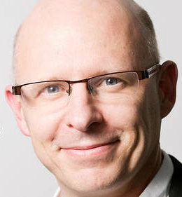

THANKS
MERCI
CONSEIL SCIENTIFIQUE DE L’ÉDUCATION NATIONALE
FRANCE

Slide 12
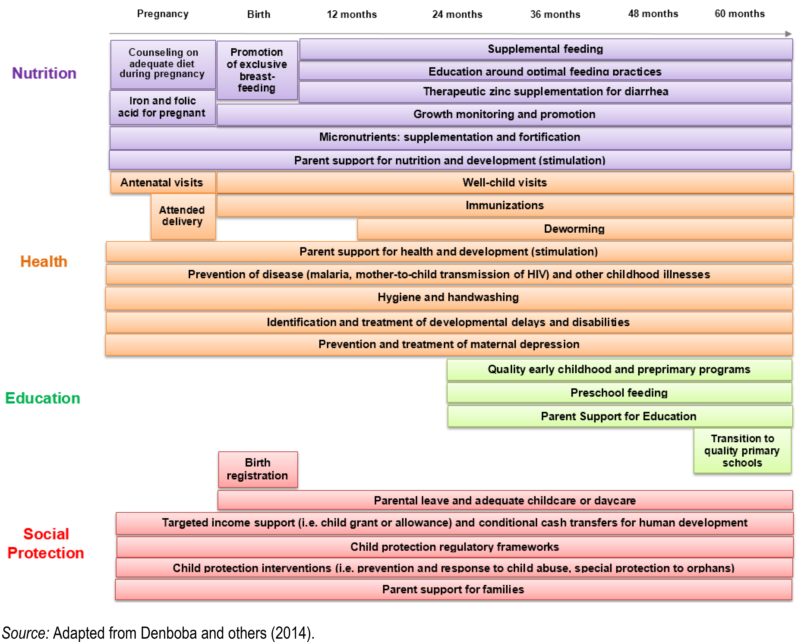
EDUCATION AND HEALTH INFLUENCE EACH OTHER

Slide 13
RESULTS GAME
INTEREST TO PLAY
ACCURACY
Correct responses (%)
Encoding Test Encoding Test
LONG-TERM MEMORY (~4.5M)
VOCALIZATIONS
Correct responses (%)
Correct responses (%)
Letter Word Letter Word
n=41 n=53 n=68 n=61.

Slide 14
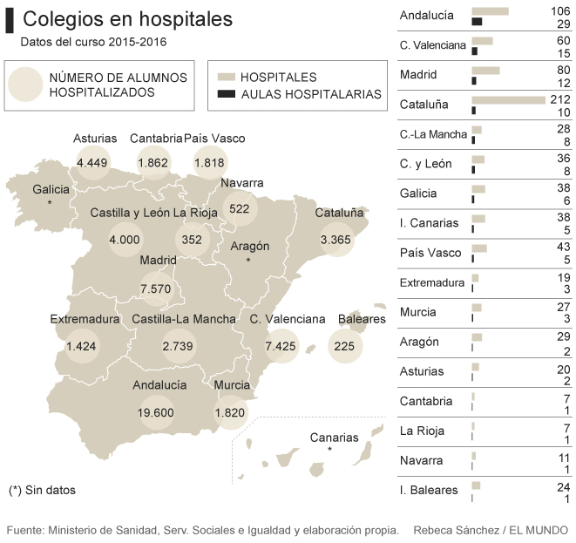
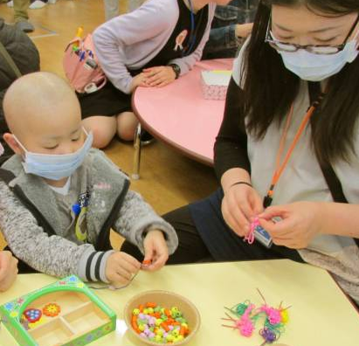
EDUCATION AND HEALTH INFLUENCE EACH OTHER.
Poor education ➔
unhealthy behaviors:
smoking, drinking, obesity.
Poor health ➔
limits the access to school.

Slide 15
