Slide 1
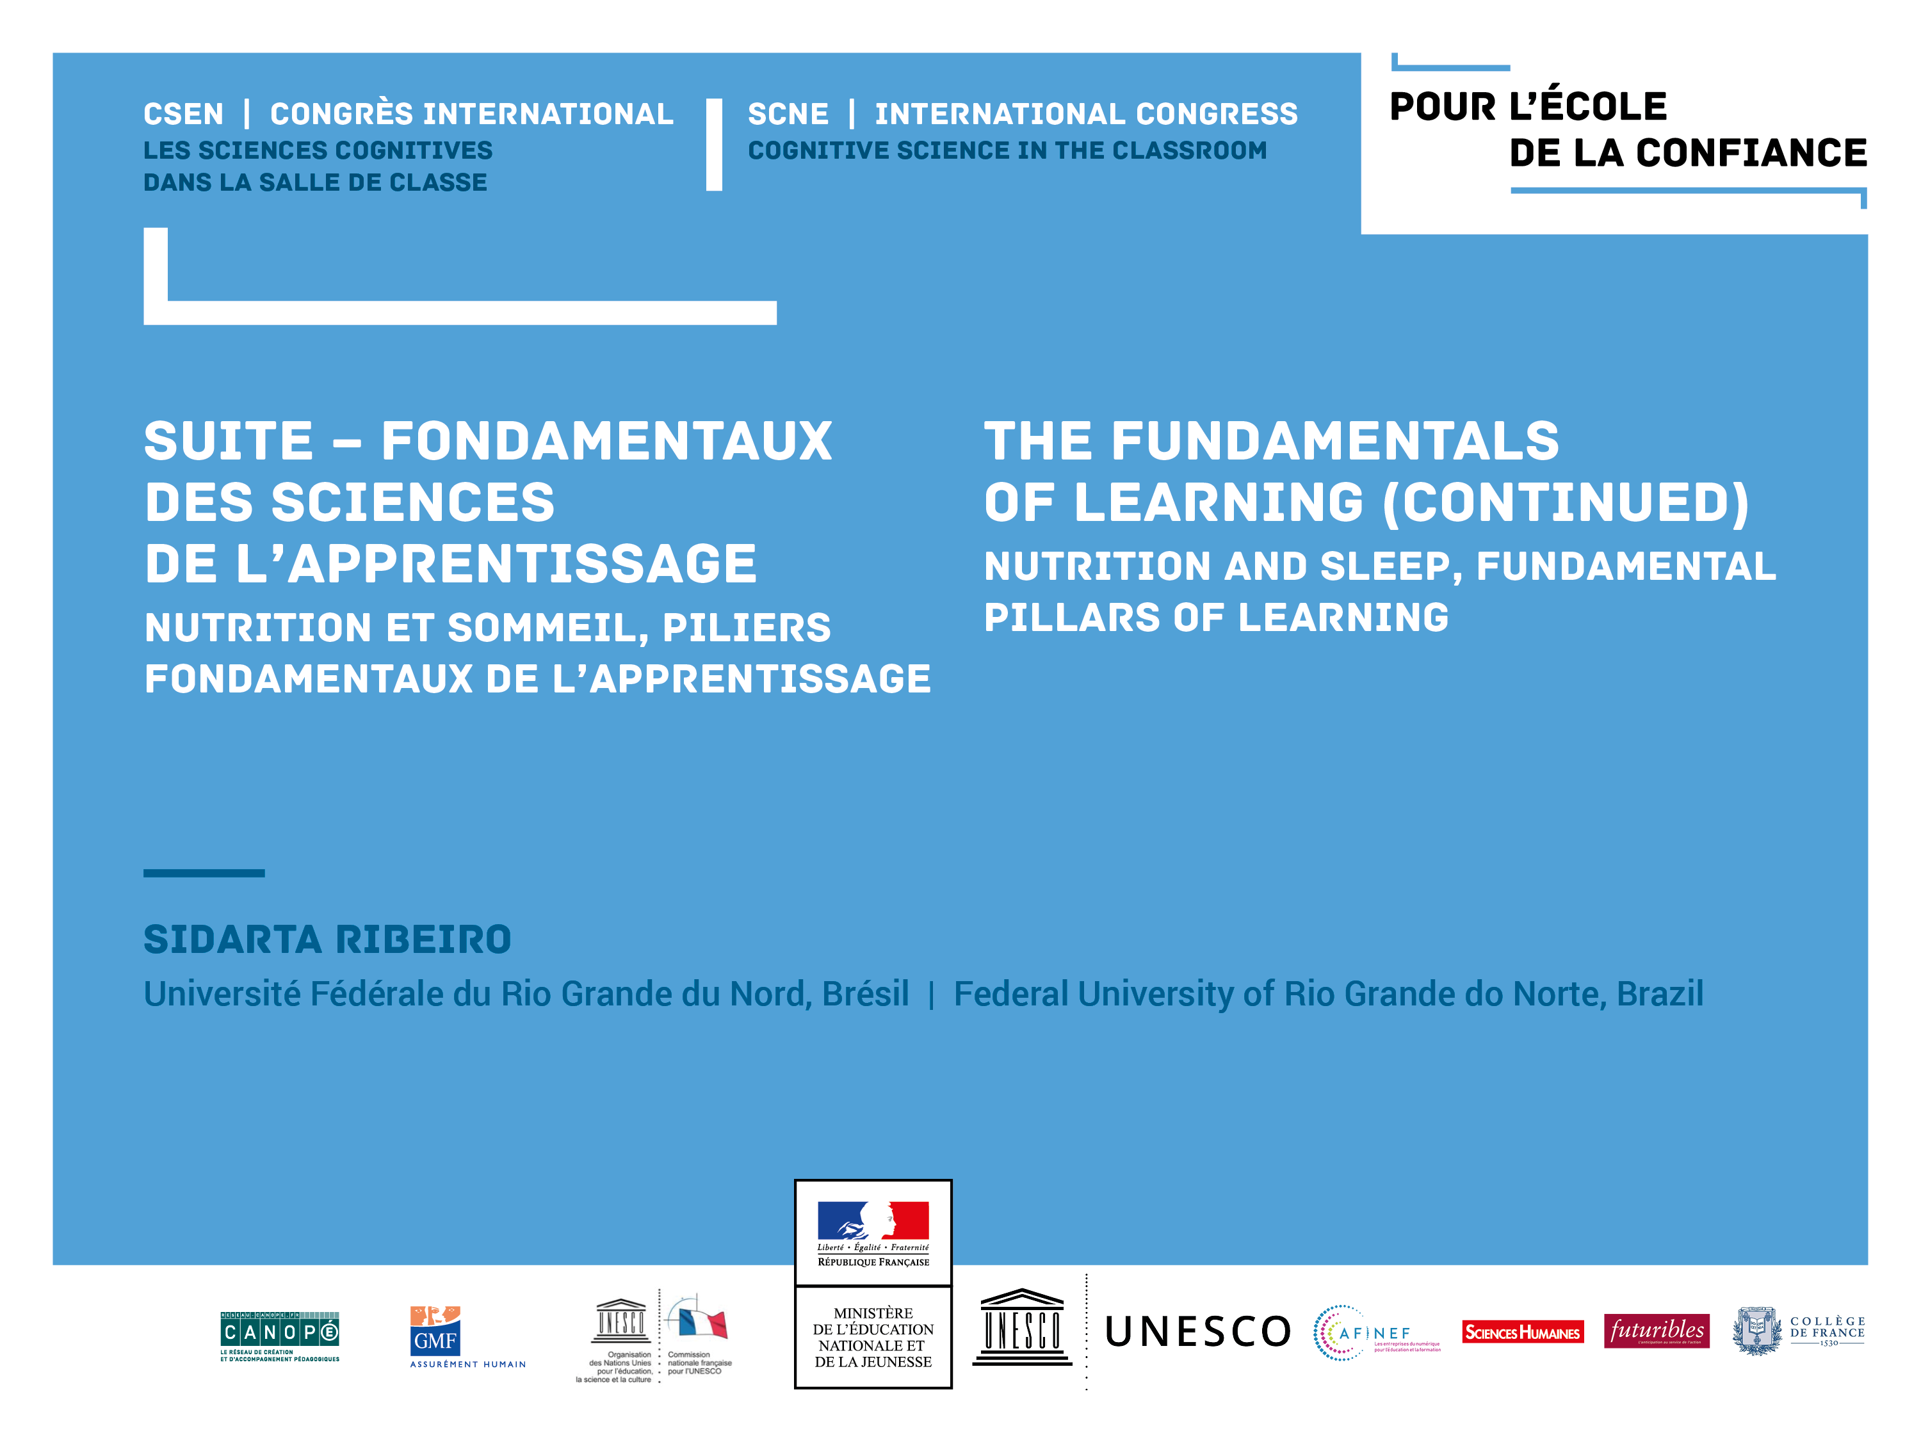

Slide 2
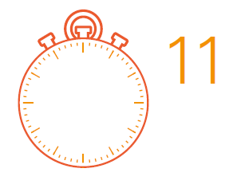
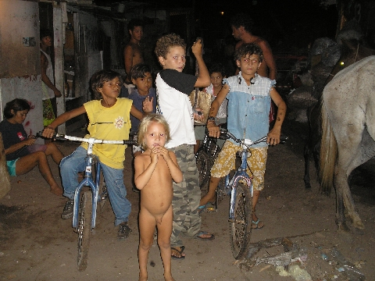
UNICEF 2015
21
children below 5 years of age die in the world
for causes related to poverty
EVERY
MINUTE
https://www.unicef.org/mdg/childmortality.html

Slide 3
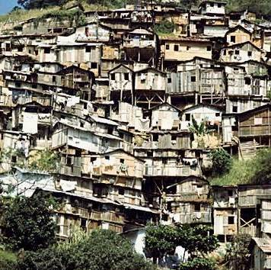
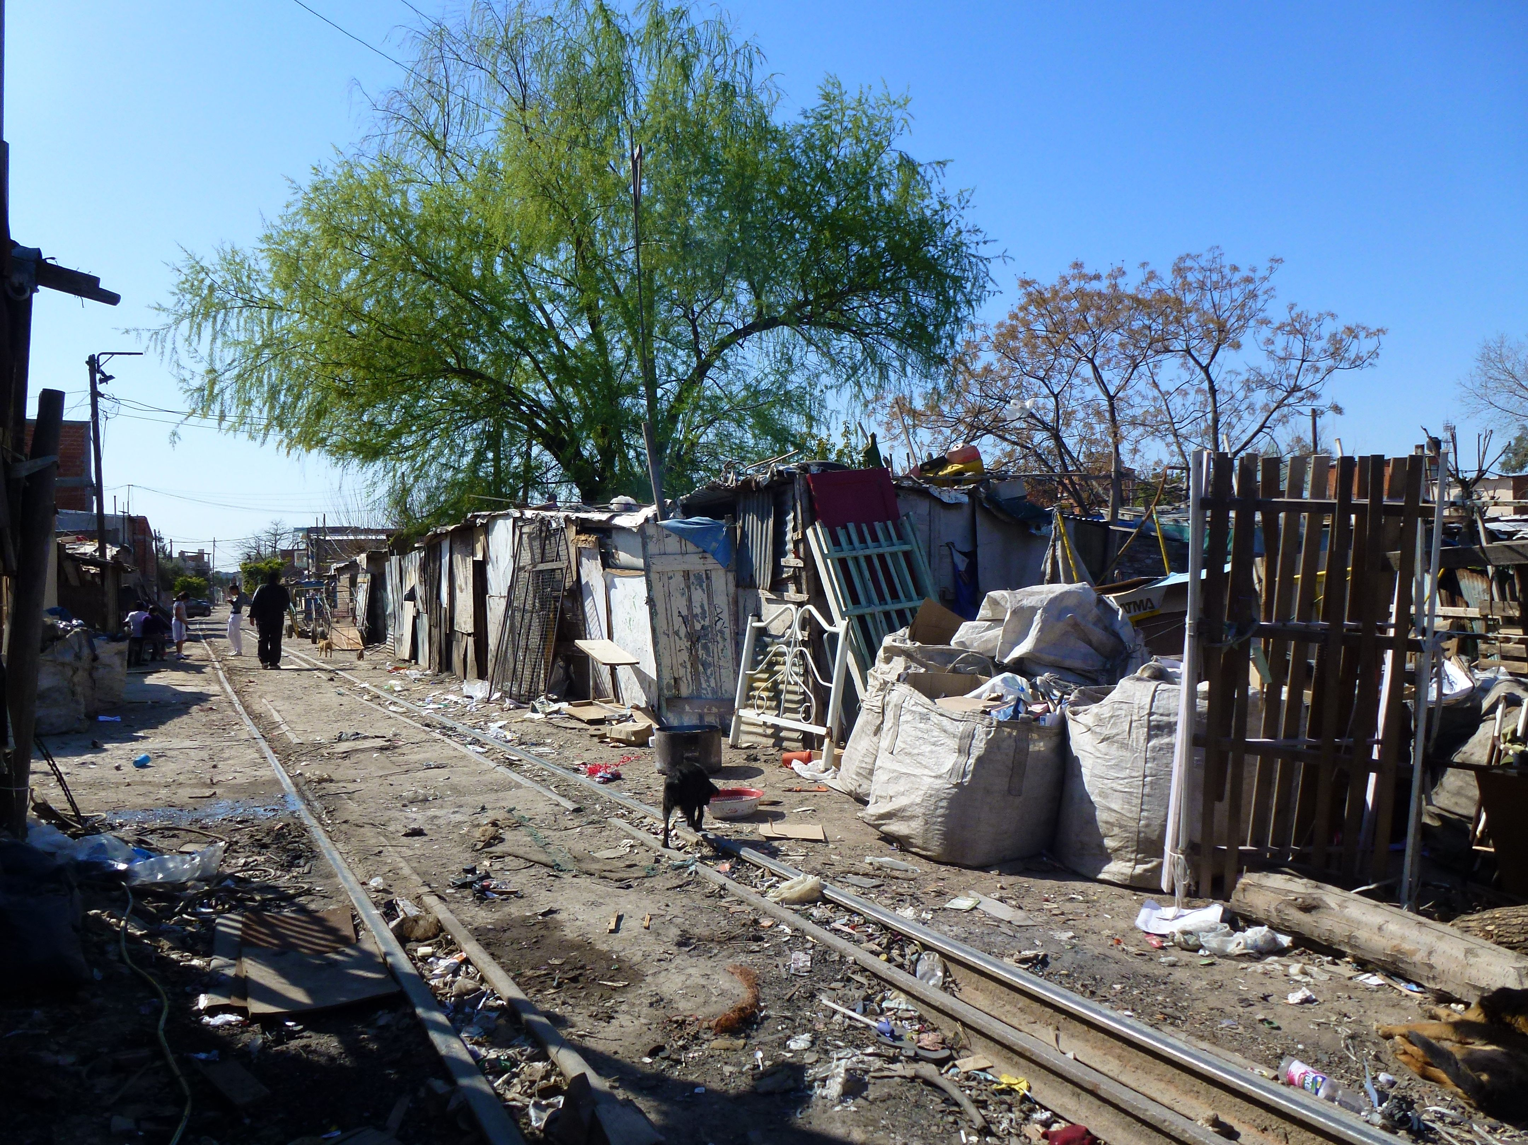
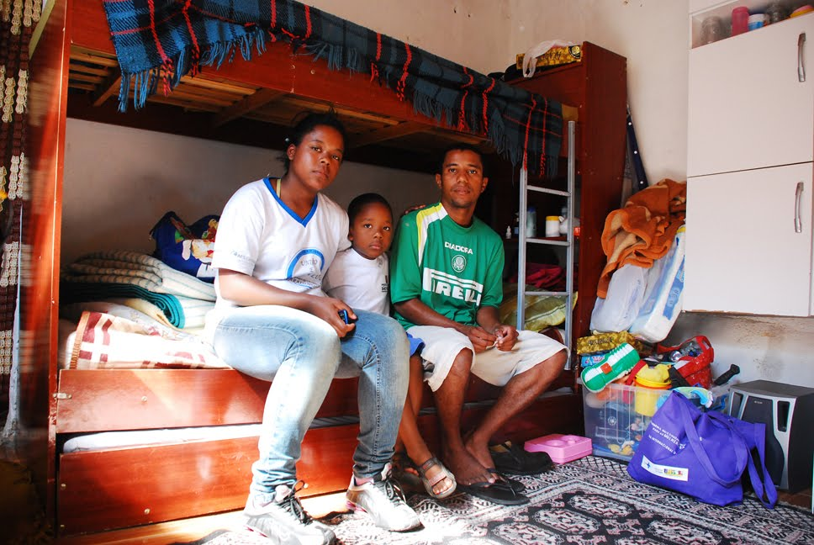
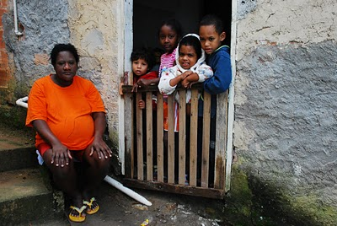

Slide 4
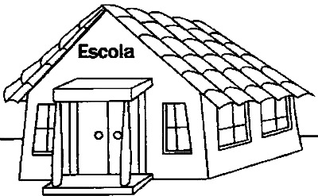
Everyone agrees that the solution
must come from the school,
but how to reach a really effective school?
School

Slide 5
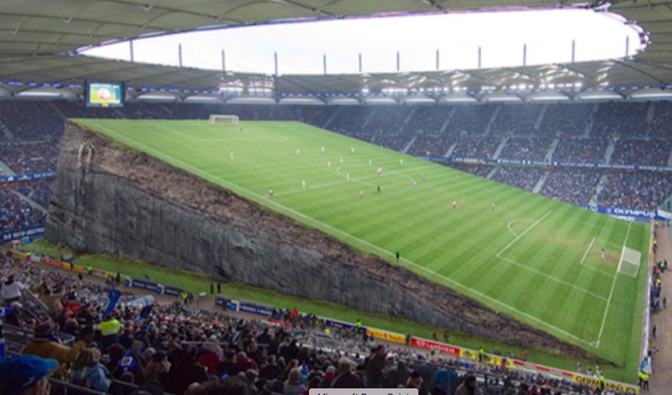
In the game of education,
the court is neither fair nor balanced

Slide 6
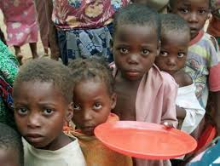
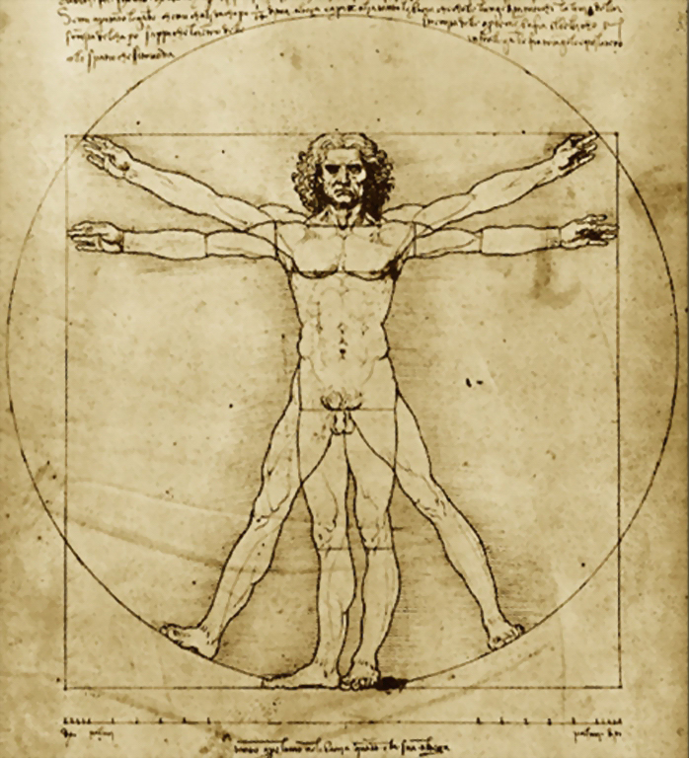
In Poverty,
Biology overcomes Psychology!

Slide 7
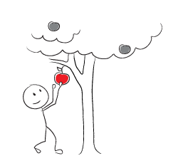
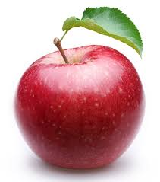
Nutrition as ”low hanging fruit”
to equalize physiological opportunities

Slide 8
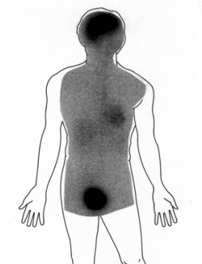
The brain needs glucose!
Consumption
Excretion
Reivich & Alavi (1971)

Slide 9
Influence of glucose on cognitive performance in young college students. Ingestion of 50 g glucose improved immediate (IMM) and delayed (DEL) recall of items from a narrative prose passage and tended to increase performance on an attention test (Minnesota clerical number checking test). * P < 0.01; + P < 0.07; n = 18.
Korol and Gold (1998) Am. J. Clin. Nutr. 67(4):764S–771S

Slide 10
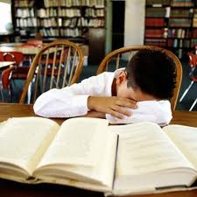
Sleep as ”low hanging fruit”
to equalize physiological opportunities

Slide 11

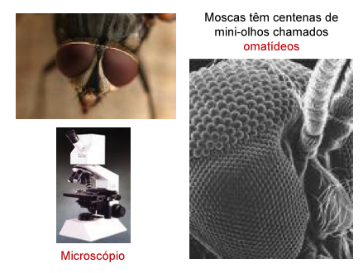
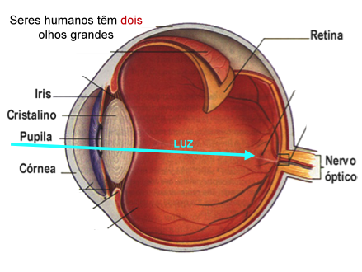
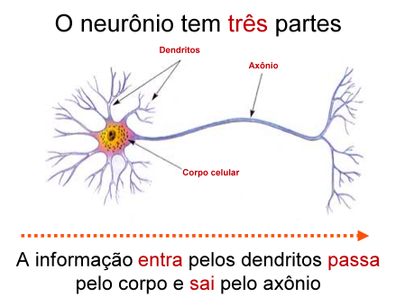
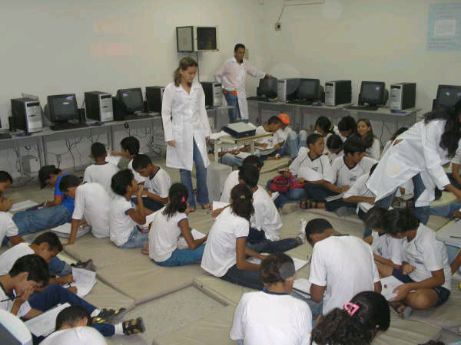
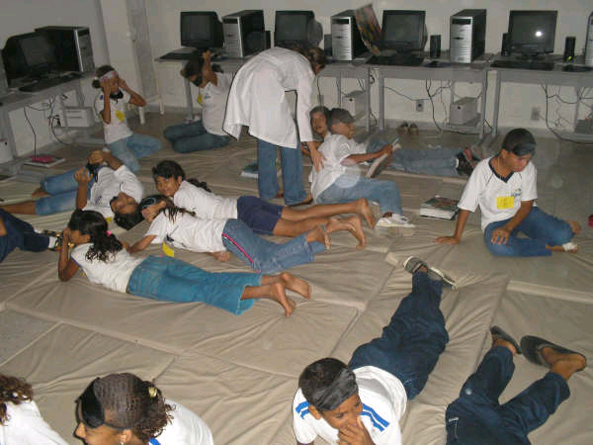
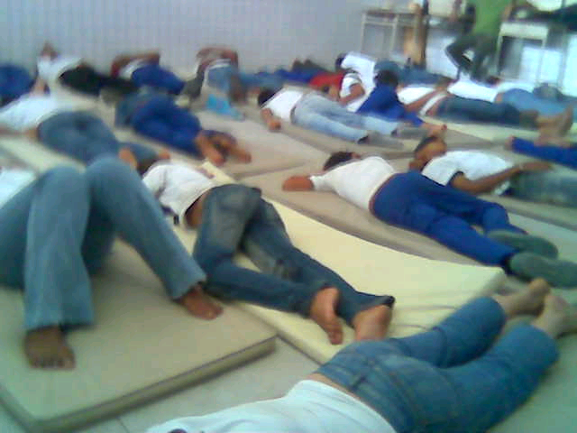
6th grade (11-12 years old);
Pre-test and surprise Post-test (1, 2 and 5 days)
Lecture on "Vision and Memory" for 15 min;
Randomization: sleep versus waking
Nathália Lemos
UFRN
Janaina Weissheimer, PhD
UFRN

Slide 12
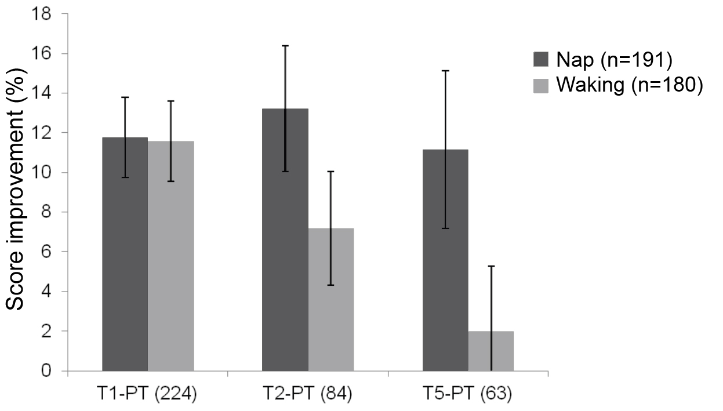
6th grade (11-12 years old);
Pre-test and surprise Post-test (1, 2 and 5 days)
Lecture on "Vision and Memory" for 15 min;
Randomization: sleep versus waking
Nathália Lemos
UFRN
Janaina Weissheimer, PhD
UFRN
*
Lemos, Weissheimer & Ribeiro (2014) Front Syst Neurosci
doi: 10.3389/fnsys.2014.00103

Slide 13


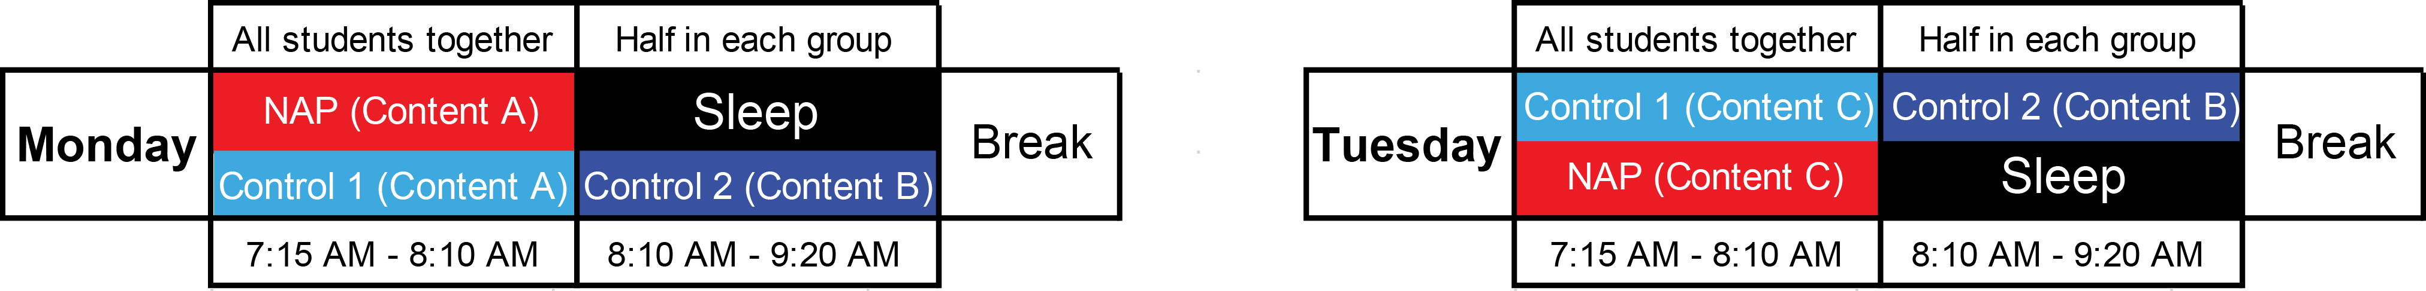
Naturalistic experimental design:
School curriculum and regular teacher
Students in the 5th year (10-11 years); N = 24 for 6 weeks
Science (3 weeks), History (3 weeks)
Within each week, the content was divided into 3 independent parts (A, B, C)
Randomization of the group each week
Thiago Cabral, M.Sc.
ICe, UFRN
Natalia Mota, M.D., Ph.D
ICe, UFRN
Test
10 questions per content
A B C
Friday

Slide 14
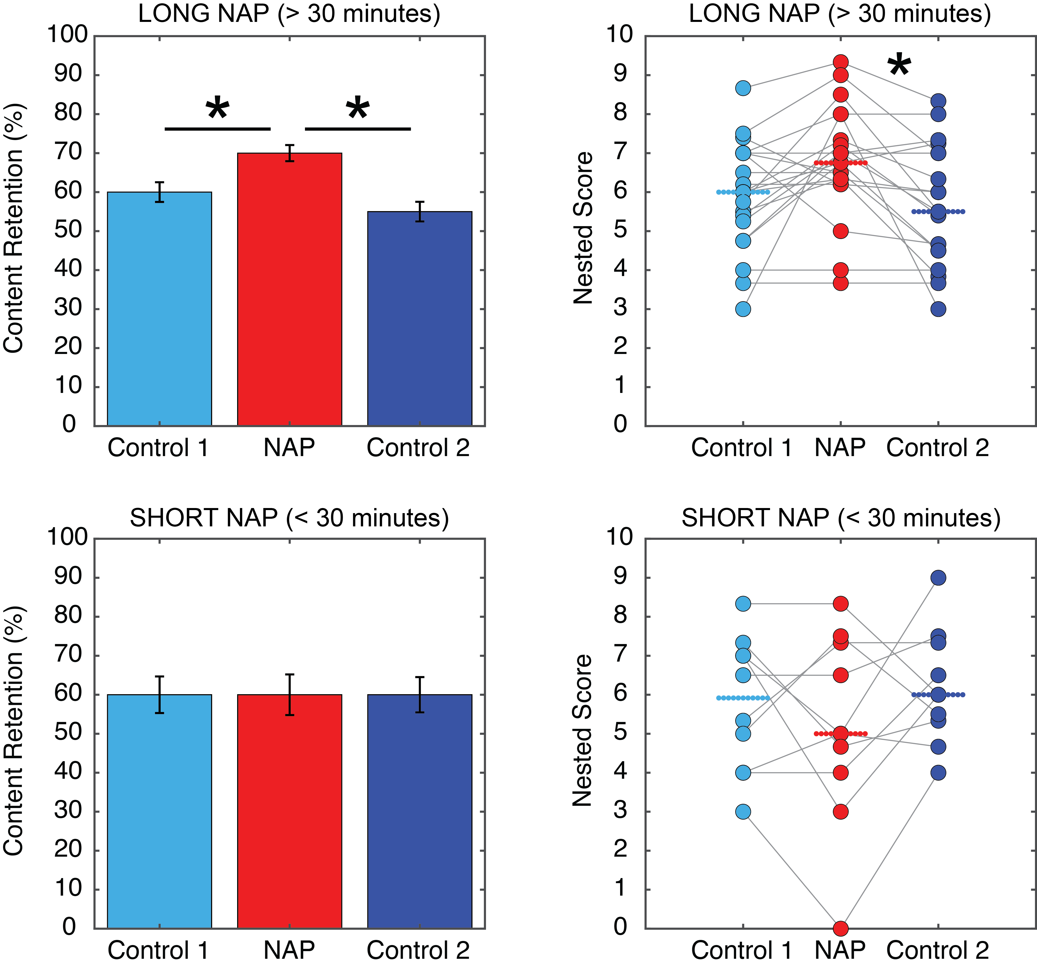
Cabral, Mota, Fraga, Copelli, McDaniel, Ribeiro (2018) Post-class naps boost declarative learning in a naturalistic school setting. npj Science of Learning 3: Article 14.

Slide 15
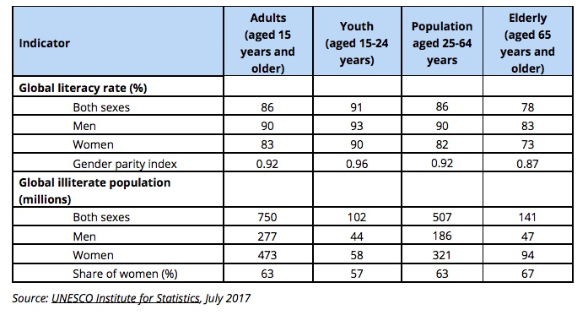
Illiteracy in the World

Slide 16
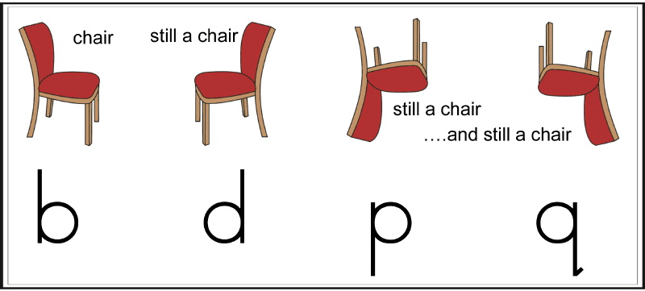
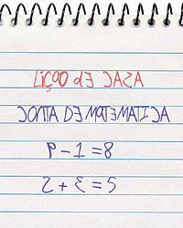
Mirror writing

Slide 17
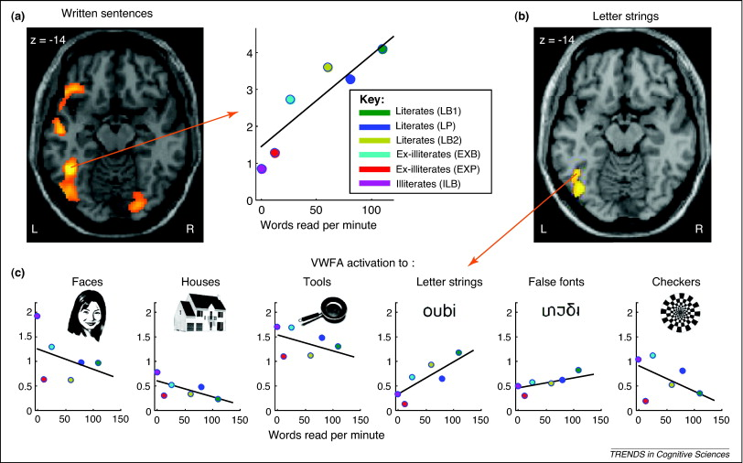
Dehaene, Pegado et al (2010) Science 330: 1359-64

Slide 18
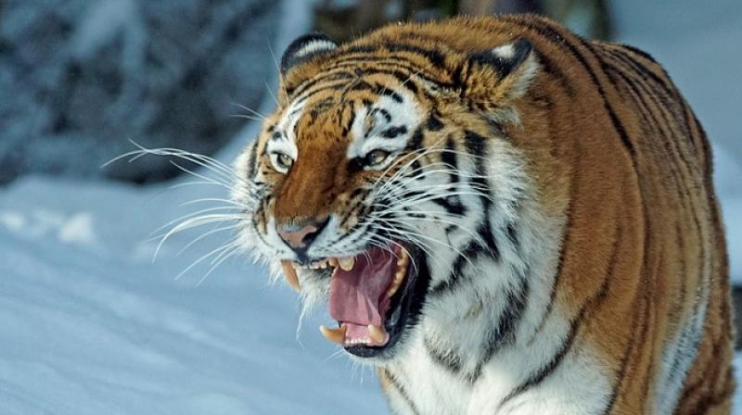
Mirror symmetry is advantageous for recognition
of natural objects, such as faces
"A tiger is equally threatening
when seen from the right or left profile"
Rollenhagen JE, Olson CR (2000) Mirror-image confusion in single neurons of the macaque inferotemporal cortex. Science 287(5457):1506-8.

Slide 19
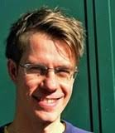

Could we accelerate this learning process
by using adequate training
followed by naps?
Felipe Pegado, MD, PhD
Aix-Marseille University
Ana Raquel Torres
Ph.D.. Student
ICe, UFRN

Slide 20
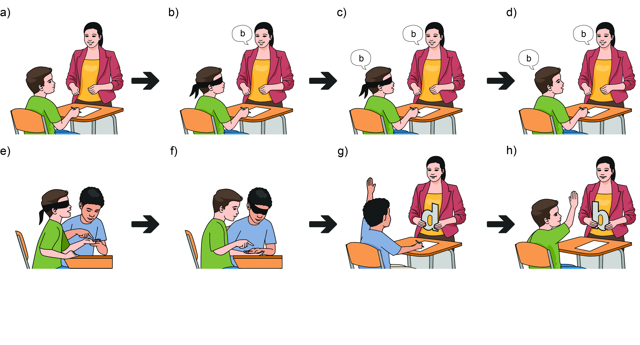
Multi-sensory training

Slide 21
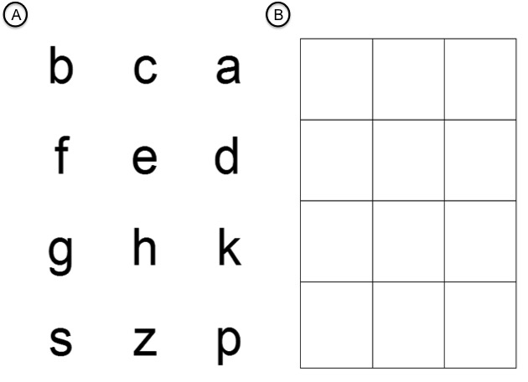
  (N=6)
  (N=9)
  (N=6)
  (N=8)

Slide 22
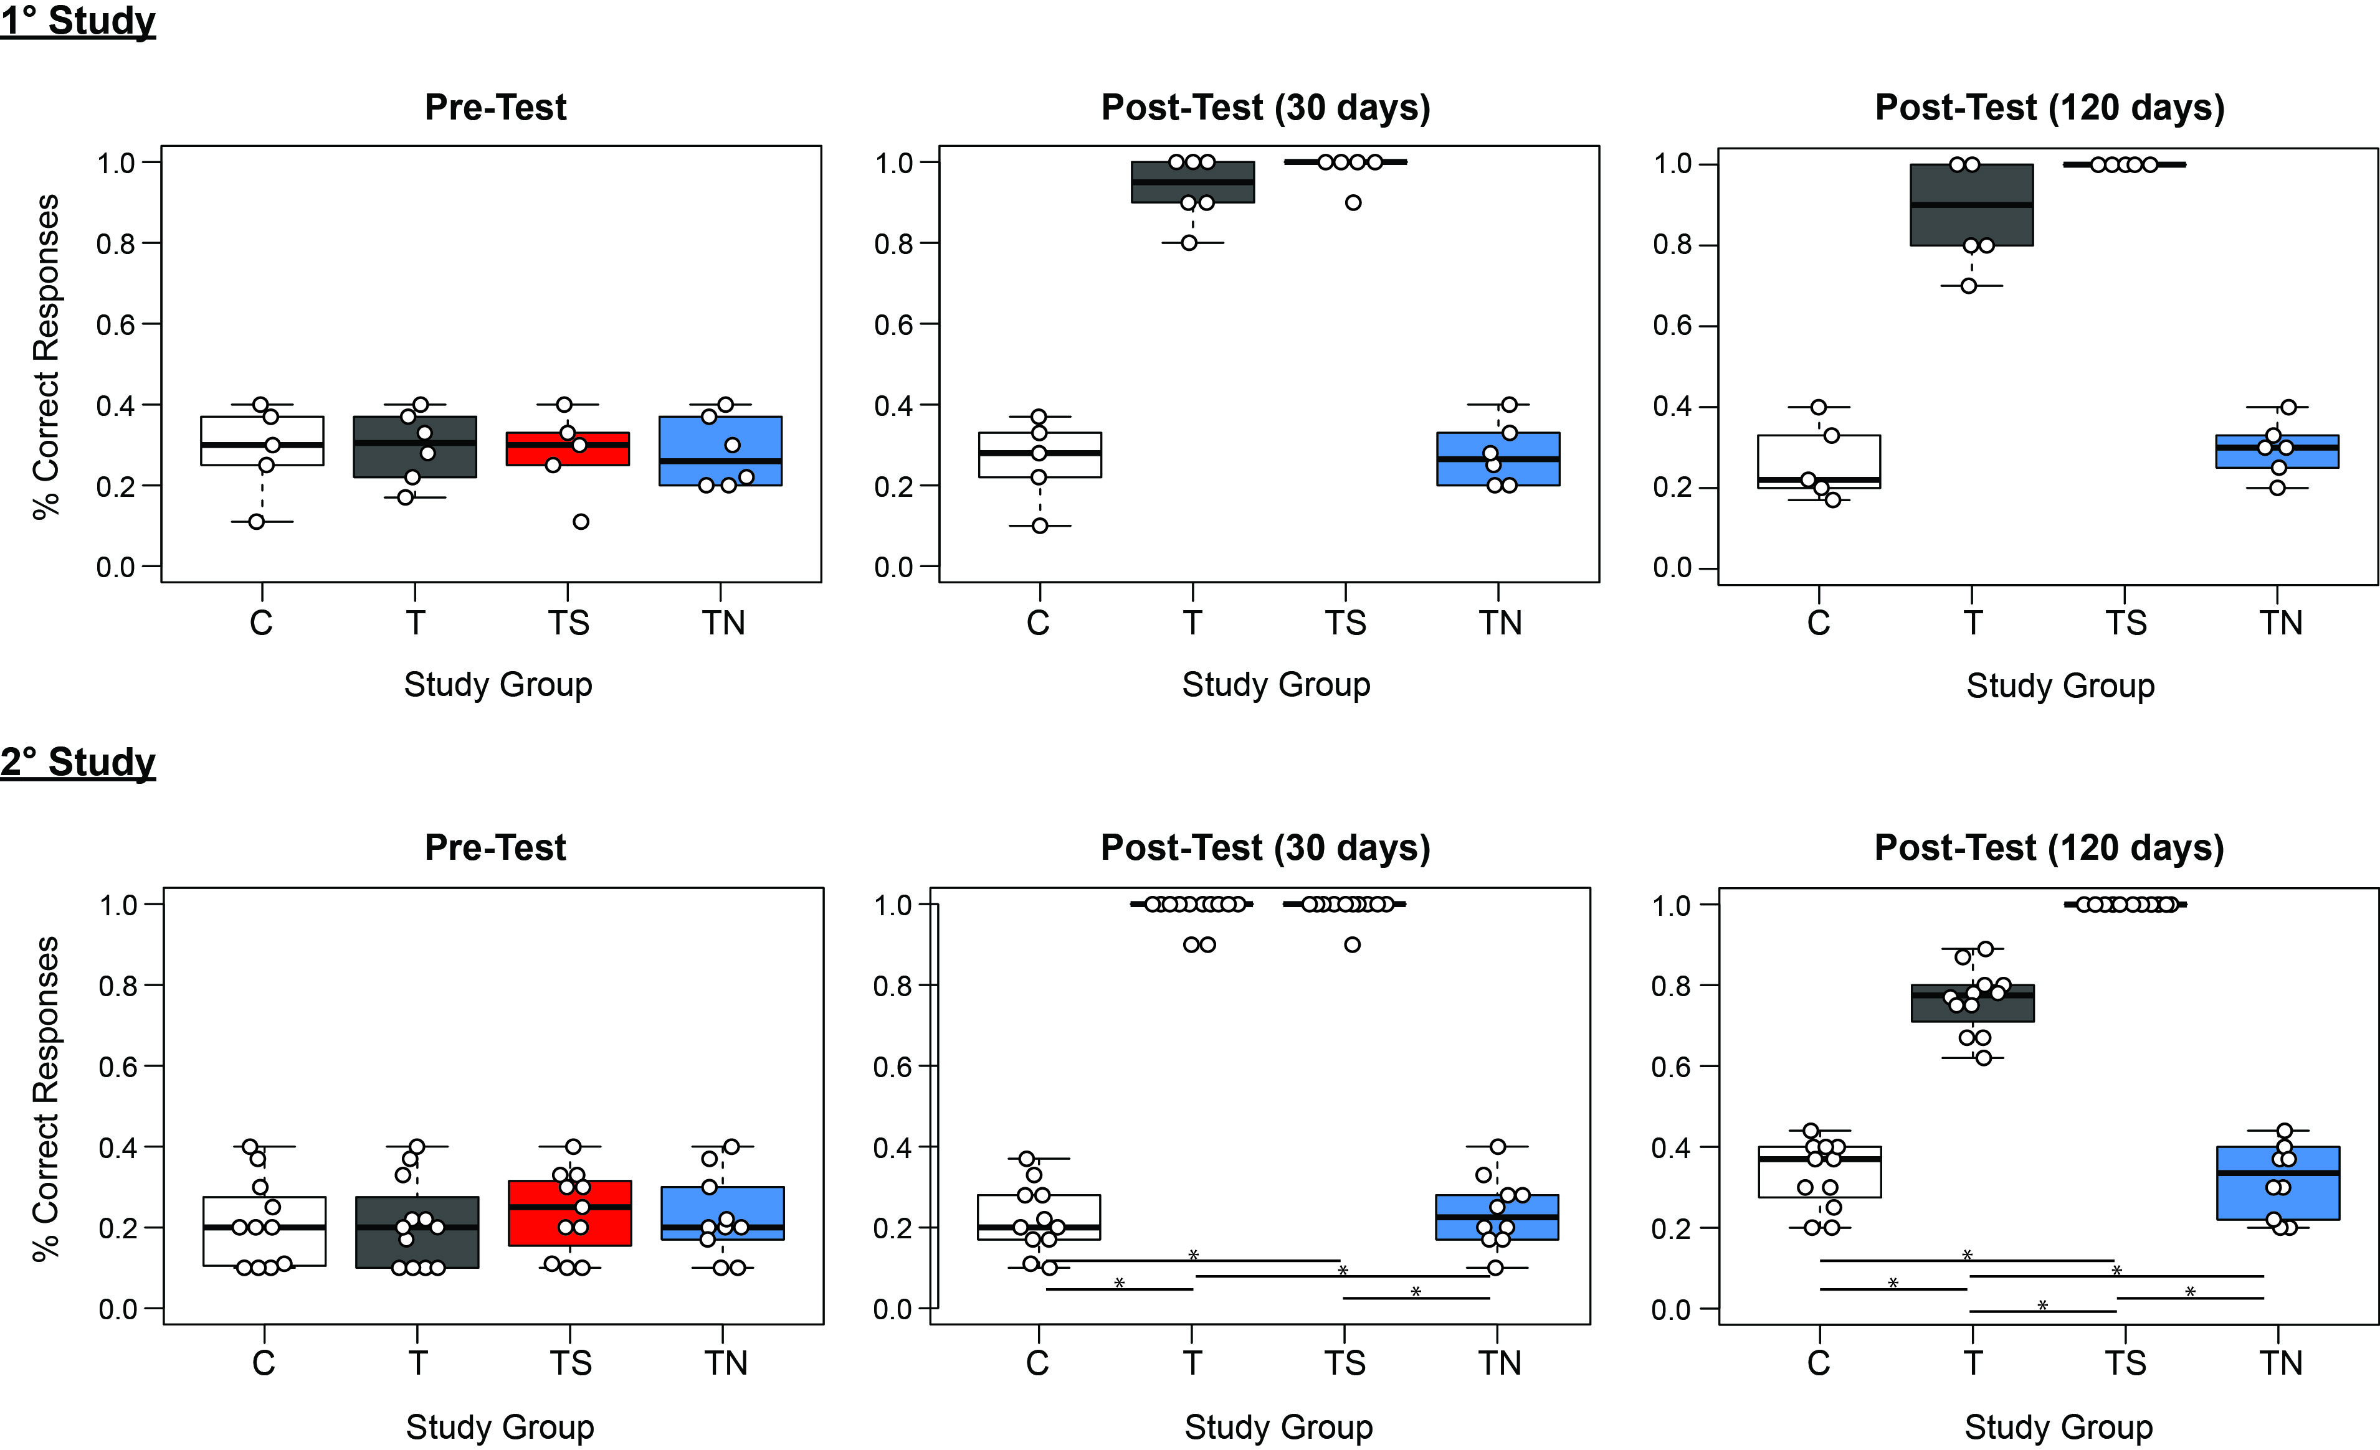
% of correct responses
Torres, Mota, Adami, Weissheimer, Naschold, Pegado, Ribeiro (in preparation)

Slide 23
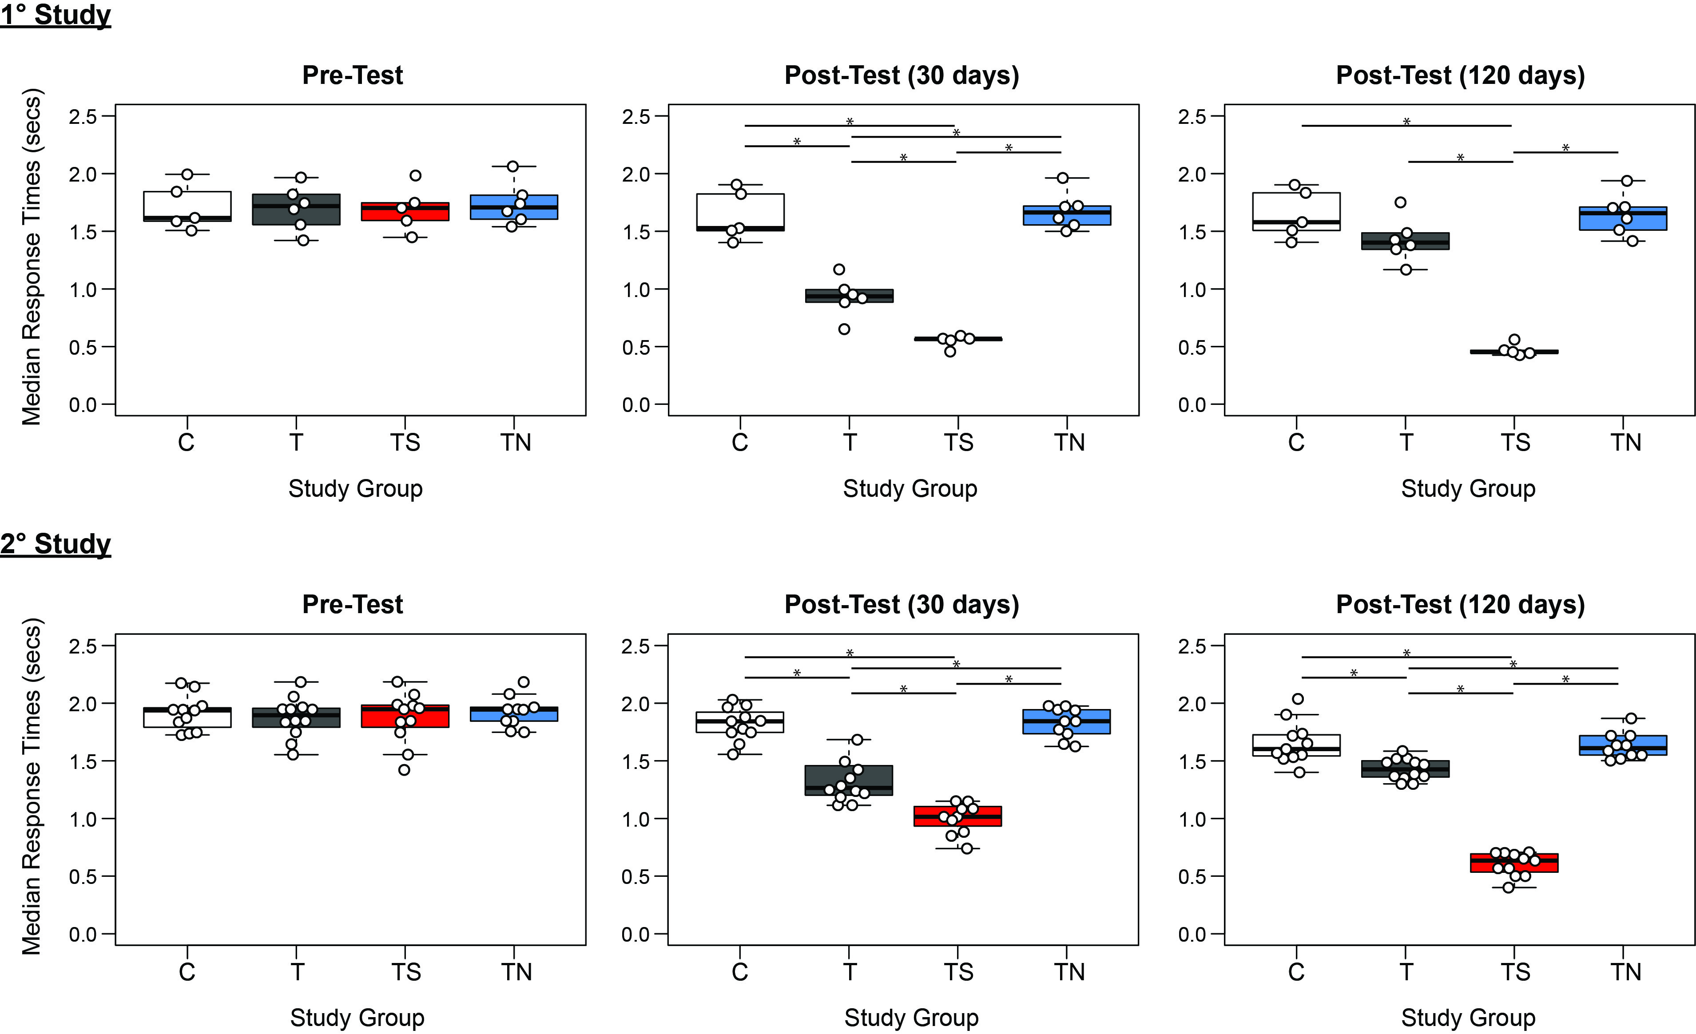
Median response time
Torres, Mota, Adami, Weissheimer, Naschold, Pegado, Ribeiro (in preparation)

Slide 24
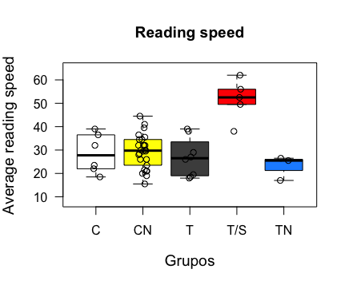
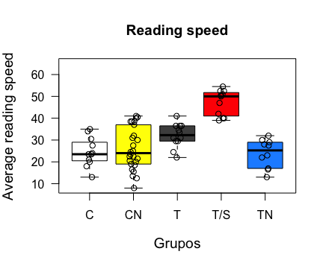
Reading Speed
1st study
2nd study
Torres, Mota, Adami, Weissheimer, Naschold, Pegado, Ribeiro (in preparation)

Slide 25

Conclusions
Multi-sensory training for 3 weeks
eliminates mirror invariance for letters
Post-training naps increase memory persistence

Slide 26
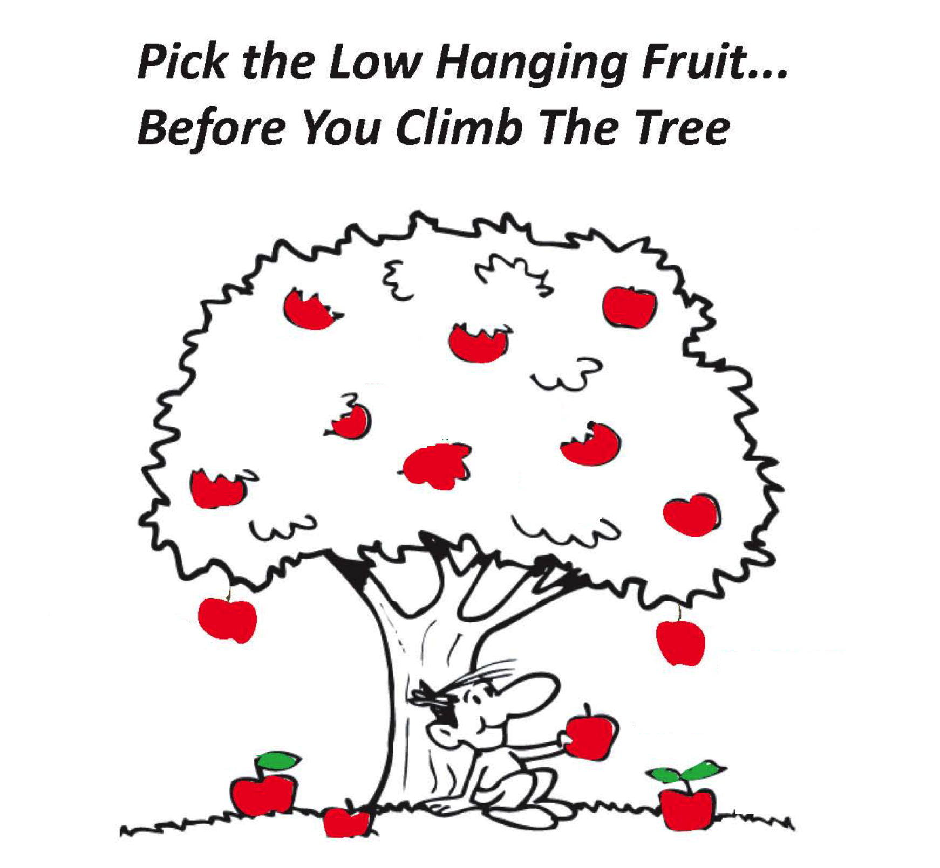
Sleep
Exercise
Nutrition

Slide 27

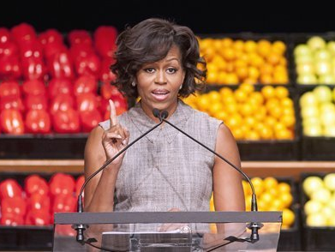
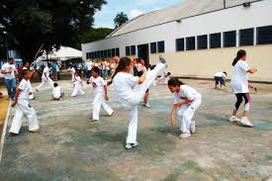
Have a break, rest, slow-wave sleep, rapid-eye movement sleep, pre-training, post-training
Hydration, caloric intake, meal composition, micronutrients, serving sizes, frequency of eating, reward
Procedural memories, motor coordination, executive functions, cardiovascular enhancement, variations, novelty, surprise, fun, teamwork, resilience, fair play.
Sigman, Peña, Goldin and Ribeiro (2014) Neuroscience and education: prime time to build the bridge. Nature Neuroscience 17: 497-502.

Slide 28
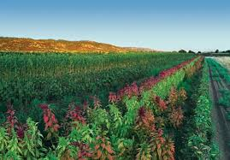
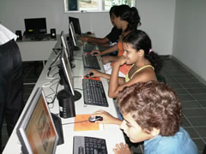
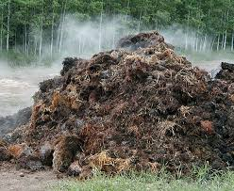
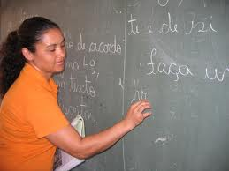

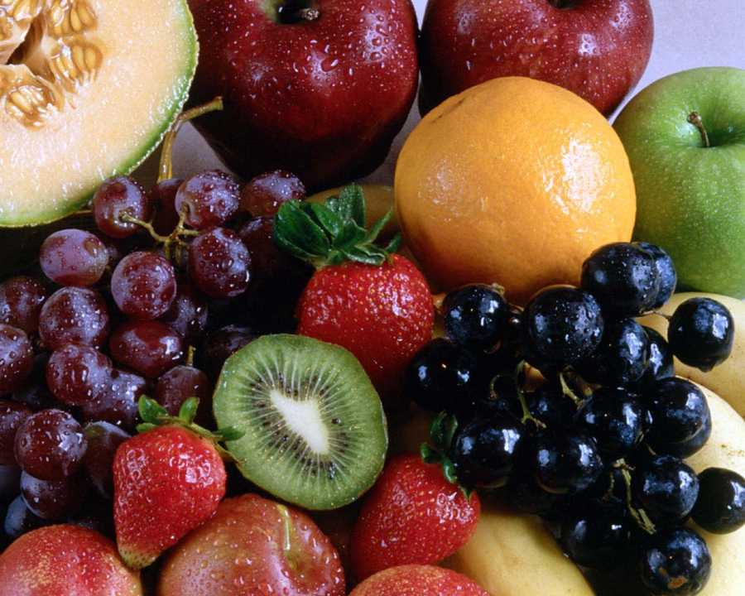
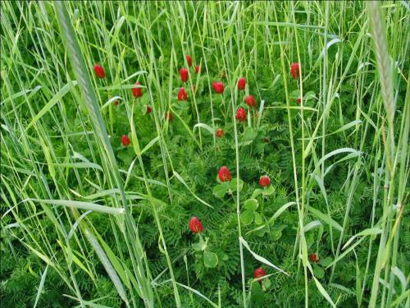
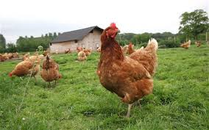
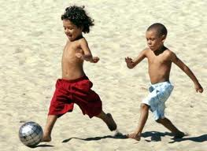
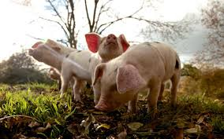
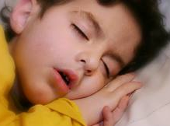
The optimized rotation of
agricultural inputs
increases food production
without contributions of more inputs
Could the optimized rotation of
educational inputs
improve school learning
without extra cost?
Ribeiro and Stickgold (2014) Sleep and school learning. Trends in Neuroscience and Education 3: 18-23.
Ribeiro, Mota, Fernandes, Deslandes, Brockington, Copelli (2017) Prospects UNESCO. doi:10.1007/s11125-017-9393-x.

Slide 29
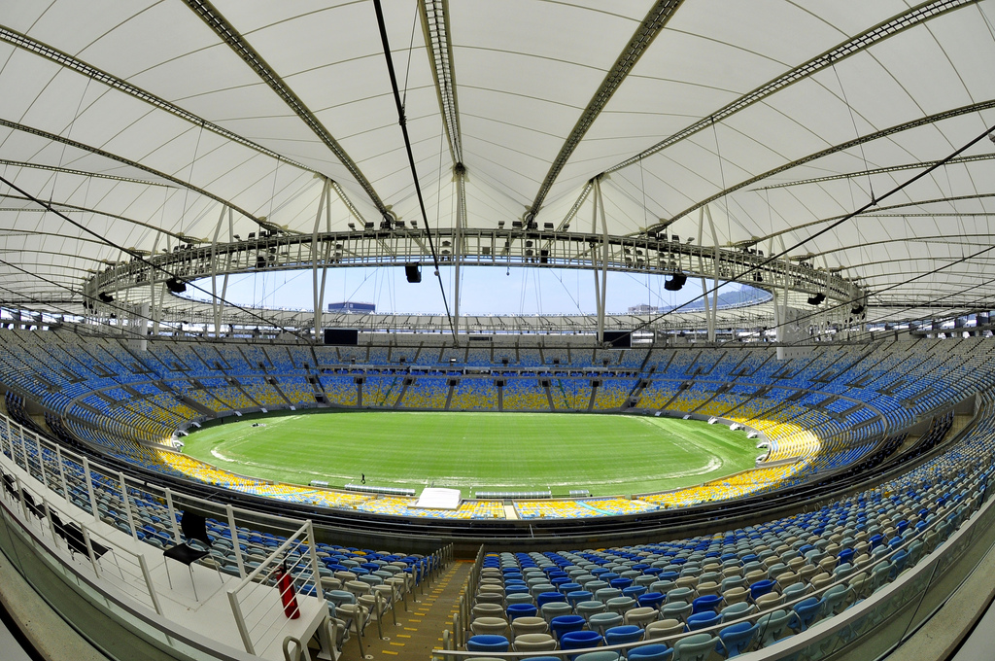
Physiological leveling at schools can help
to make the educational field more balanced
for low-income students

Slide 30


Slide 31


Slide 32









